Slide 1
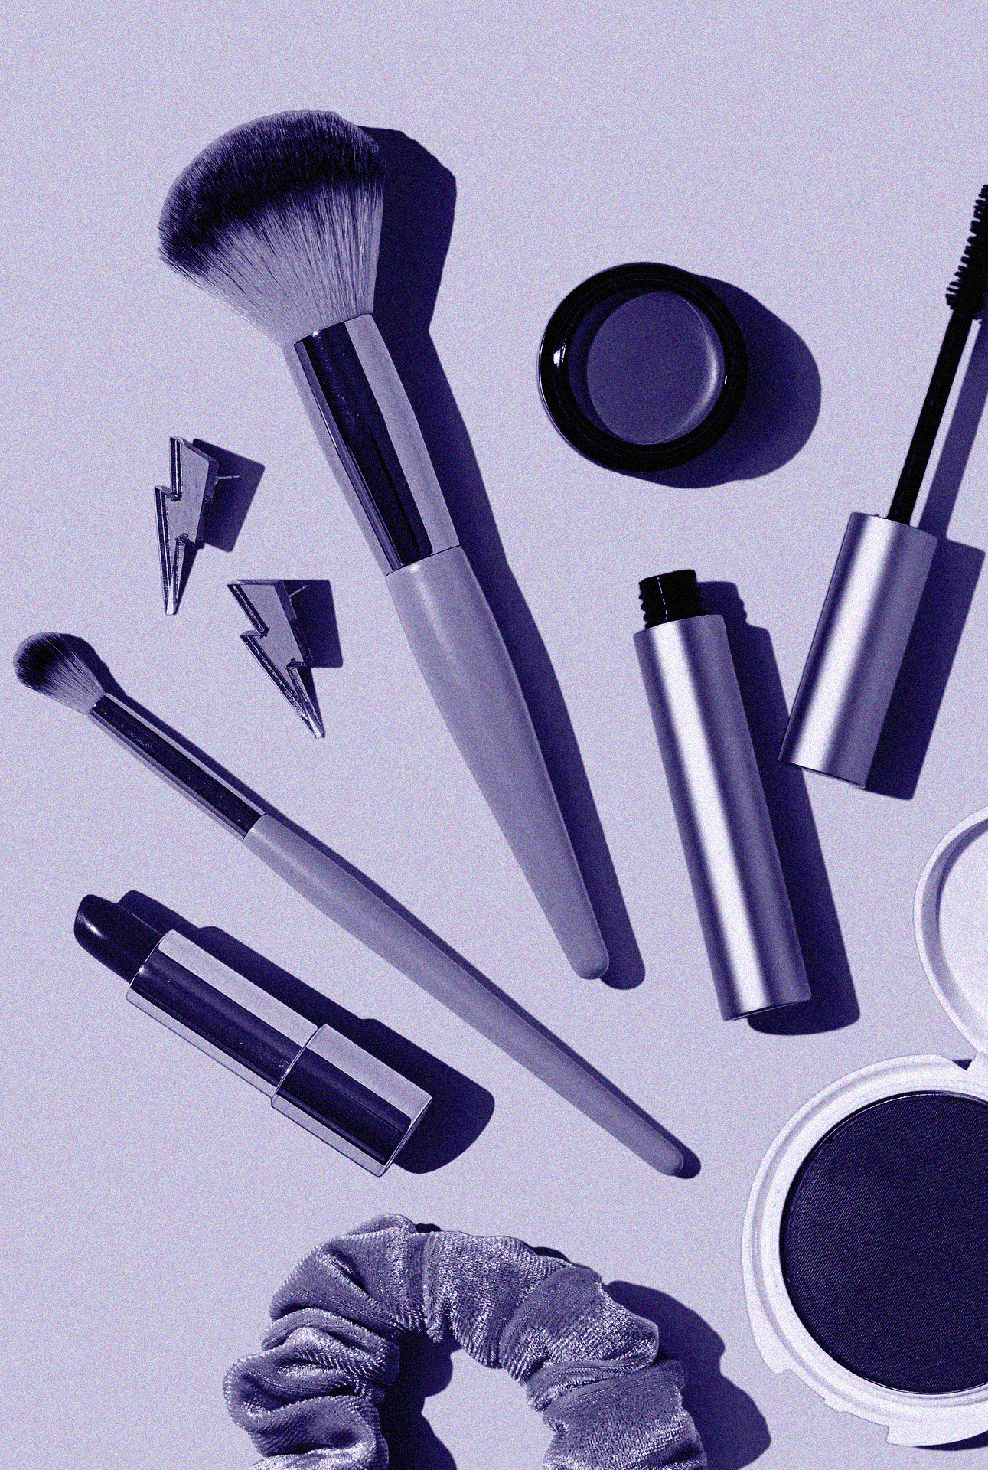
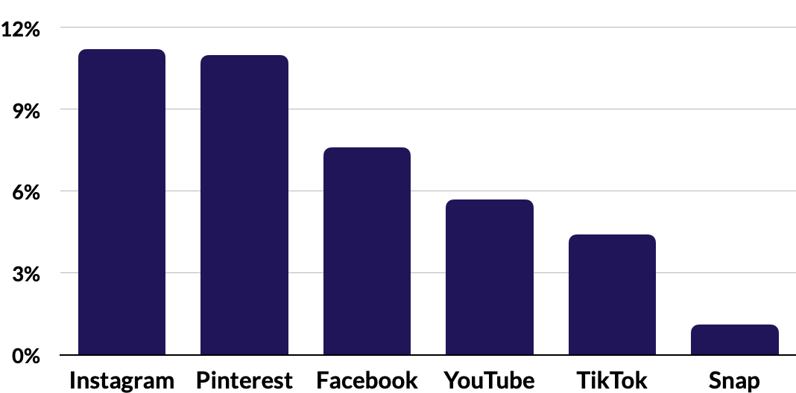
2023 eCommerce Guide
Beauty Benchmarks
and Insights
From the MikMak Shopping Index
x
Category Benchmark:
5.9%
Purchase Intent Rate

Slide 2
Beauty eCommerce Benchmarks and Insights
Consumer preference for Beauty eCommerce has shifted
Category Benchmark:
5.9%
Purchase Intent Rate
According to eMarketer, Beauty eCommerce is predicted to reach $30.73 billion by 2026
Instagram remains the top social platform for Beauty eCommerce in 2023
The average Beauty shopper has a cart size of 6.3 items

Slide 3
Beauty eCommerce Benchmarks and Insights
Beauty Purchase Intent Rate by Social Channel
Instagram x Amazon is your channel /retailer mix for Beauty shoppers
Right now, Instagram yields the highest Purchase Intent Rate (PI Rate)* for Beauty at 11.2 percent (1.9 x than the category benchmark), meaning Beauty shoppers are most likely to continue to purchase from shoppable media running on Instagram.
Following Instagram is Pintererst with an 11 percent PI Rate (1.9 x the category benchmark). Next up is Facebook, with a PI Rate of 7.6 percent (1.3 x the category benchmark). YouTube, TikTok, and Snap round out the top social channels with PI rates of 5.7, 4.4, and 1.1, respectively.
Of the top three social channels for in-market traffic, Facebook sees the most, driving 40.8 percent of Purchase Intent Clicks. Instagram and TikTok follow, driving 23.4 percent and 21.1 percent, respectively. As these three channels make up majority of beauty traffic, it is fair to say that while consumers may be completing their purchase on other social channels, they are certainly discovering products here.
*Purchase Intent Rate:
The percentage of shoppers who clicked through to at least one retailer.

Slide 4
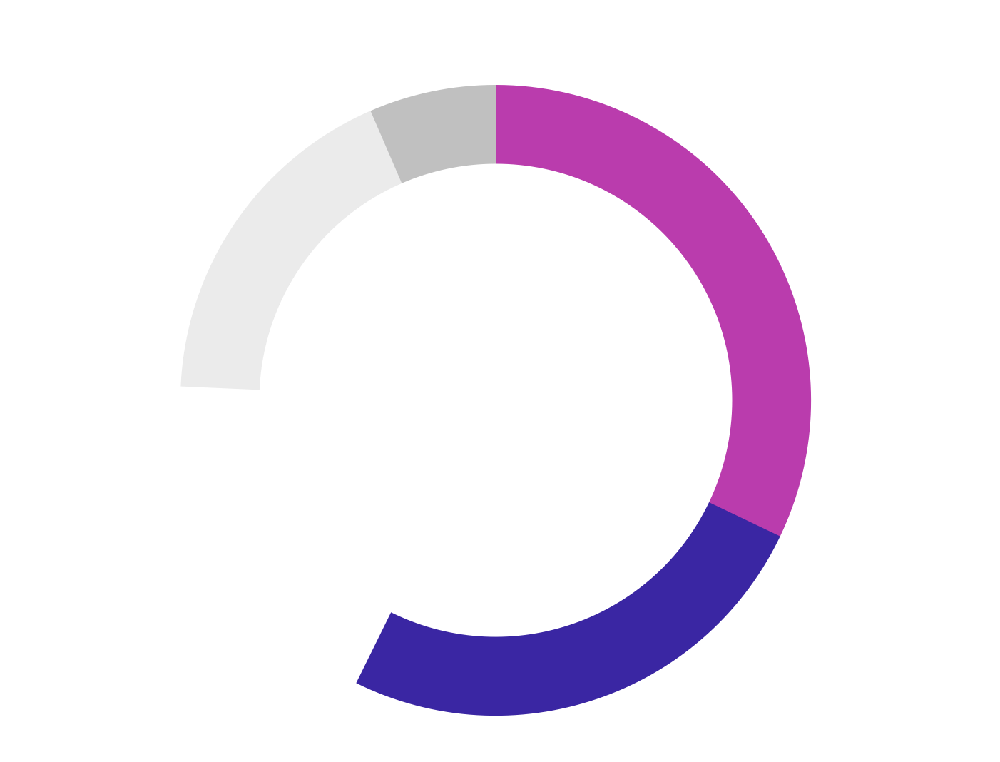
Beauty eCommerce Benchmarks and Insights
Wherever your consumers are engaging, be sure your media and brand website drive them to the retailers they prefer to check out at. Right now, among the Top 5 Beauty retailers, Amazon is the retailer driving the most in-market traffic with 32.1 percent of Purchase Intent Clicks*. Walmart is second with 25.2 percent, respectively. Specialty cosmetic retailer Ulta follows with 18.4 percent of shoppers. Target is fourth with 17.8 percent, and drugstore CVS rounds out the Top 5 Beauty e-retailers with the remaining 6.5 percent.
Advertising on a mix of channels, especially Instagram, and being available at a variety of retailers, especially Amazon, can help your brand win market share with Beauty shoppers.
Share of Purchase Intent by Top 5 Retailers, Beauty
Listen Now
"Consumers are now saying 'I put on makeup because I want to feel good, I put on makeup because I want a pick me up in the middle of the afternoon, and because I want to look a little brighter, a little better, and a little more full of life.' -Kevin Shapiro, Coty
*Purchase Intent Clicks:
The number of times a shopper has clicked through to at least one retailer during a single session.

Slide 5
Beauty eCommerce Benchmarks and Insights
Color Correcting Primer is the top Beauty product right now
Average Basket Size
5.9 items
Top 10 Products by Type (Based on Sales)
1. 2. 3. 4. 5. | Color Correcting Primer Concealer Nail Polish Eyelashes Mascara | 6. 7. 8. 9. 10. | Gel Nail Polish Eyeliner Hair Dye Press-On Nails Liquid Foundation
When looking at basket-level data, the MikMak Shopping Index shows that the average Beauty cart contains 6.3 items.
What’s in those carts? Primers, concealers, and nail care items appear to be the most popularly purchased Beauty items right now.

Slide 6
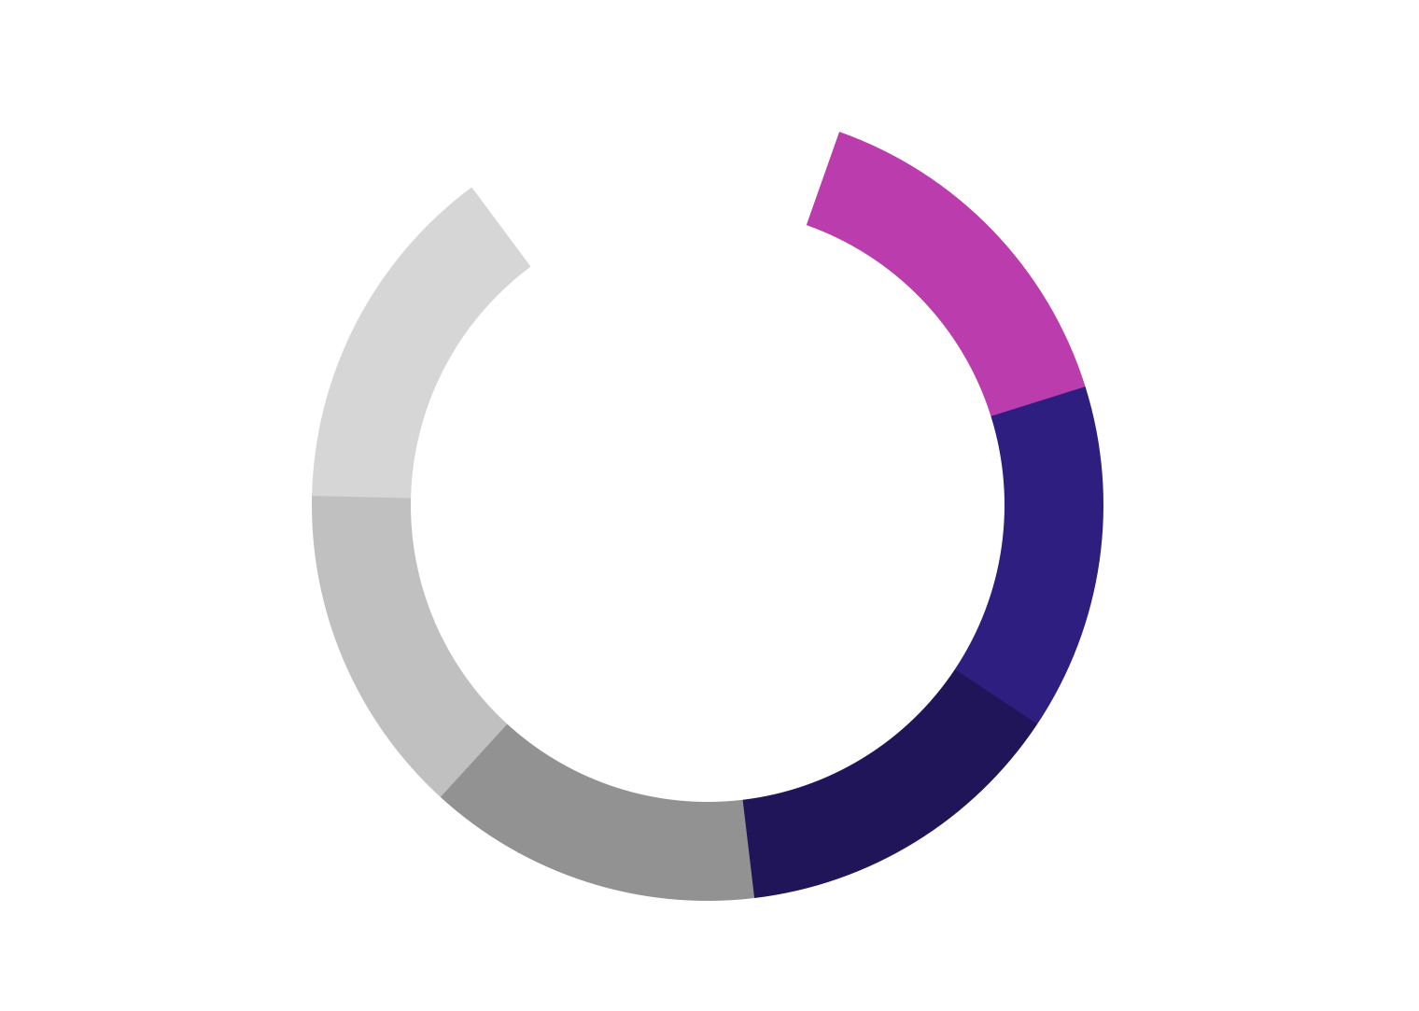
Beauty eCommerce Benchmarks and Insights
Top Days of the Week for Beauty eCommerce (by Purchase Intent Rate)
Beauty Shoppers are most likely to buy Thursday at 5 PM ET
Thursday - 6.1%
Sunday - 6%
Wednesday - 5.9%
Monday - 5.9%
Tuesday - 5.9%
Friday - 5.8%
Saturday - 5.1%
Online Beauty shoppers are most likely to purchase on Thursdays. However, weekends see the most in-market traffic from online Beauty shoppers, with 15.7 percent of Purchase Intent Clicks on Saturday and 14.9 percent on Sunday.
Looking at the time of day, Beauty shoppers are likely to purchase at 5 PM ET, which yields a 6.2 percent Purchase Intent Rate.
Top 5 Hours for Online Beauty Purchase (by Purchase Intent Rate)
Top Days of the Week for Beauty eCommerce (by Purchase Intent Clicks)

Slide 7
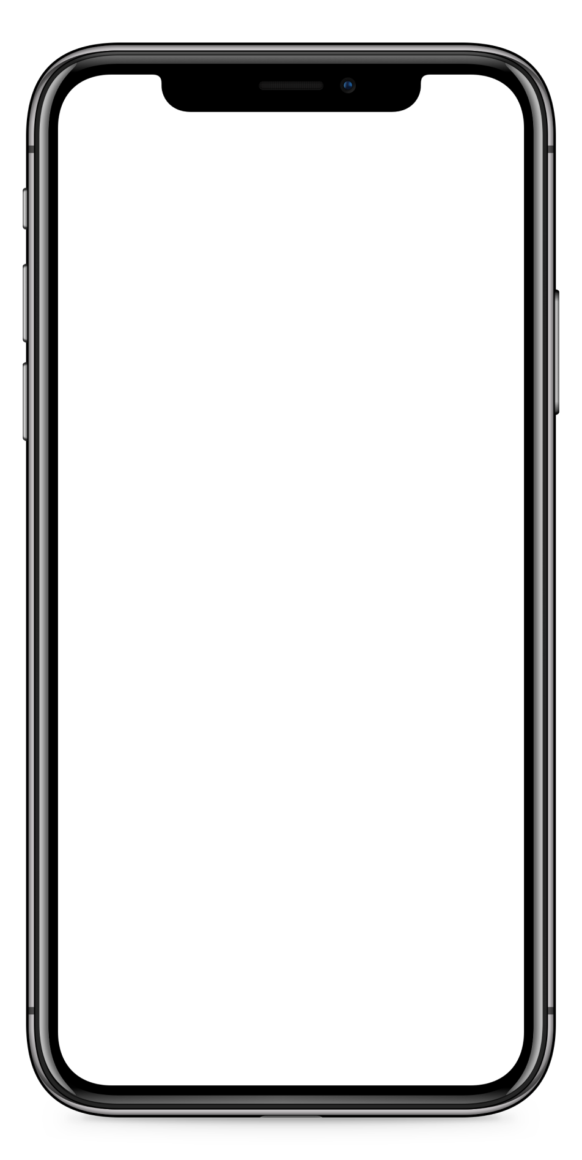
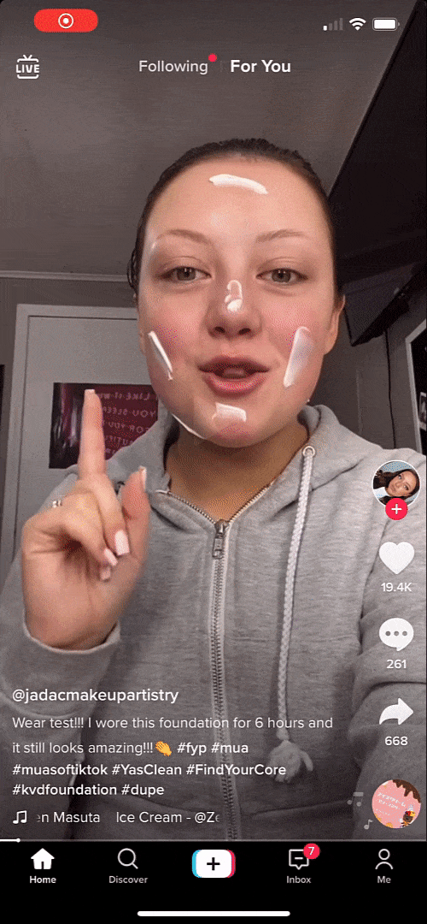
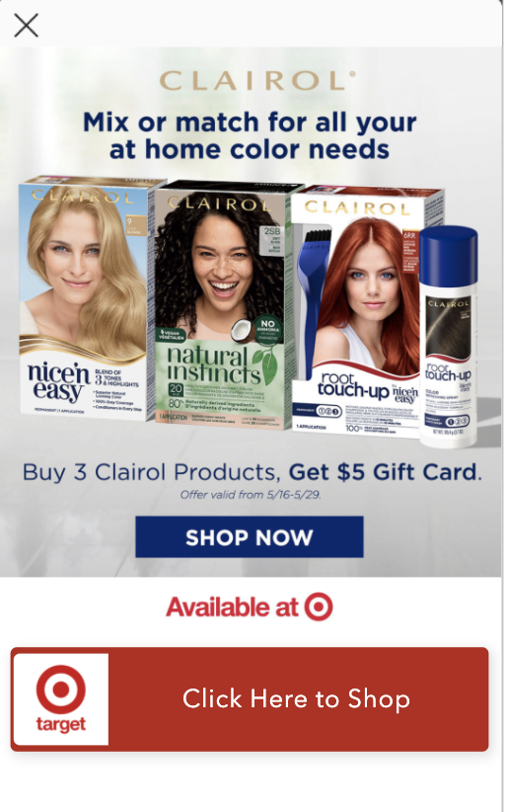
Beauty eCommerce Benchmarks and Insights
Enable eCommerce capabilities like shoppable media
What makes effective eCommerce ads?
What do many of the top-performing Beauty eCommerce ads have in common? Let’s take a closer look and find out:
Bold, eye-catching creative that visually stands out
Product first, showcasing both the product and its value right away
A clear call to action entices customers. Include bold links with simple text such as “Buy Now” or “Check Out”.
Flexible checkout that allows shoppers to switch between in stores and online
Optimize your content with MikMak to allow consumers to find your product locally
Don’t be afraid to try out different formats. Livestreaming, QR codes, and OTT advertising could all drive success for eCommerce Beauty brands
Enable shoppable options on your brand website to promote brand awareness and offer additional checkout and fulfillment options for shoppers.
Read Clairol Case Study
Read COVERGIRL Case Study

Slide 8
Beauty eCommerce Benchmarks and Insights
Your eCommerce Marketing Checklist
So you’ve got the insights, now what? Here’s a list to help you design and optimize your eCommerce marketing initiatives for 2023.
Get the basics down. Are Amazon, Walmart, Ulta, Target, and CVS in your check-out options?
Develop more nuanced insights for consumer relevance. Is your brand’s website utilizing multi retailer checkout? Which channels are part of their shopping journey? Add the channels and retailers that resonate with your consumers to the mix. Can this expand to new formats like livestream and CTV?
Explore growth opportunities. Check your performance against category (and subcategory!) benchmarks to see how you stack up against the competition. A/B test creative and messaging to see if purchase intent increases.
Want to learn more? MikMak can help you get started!
Listen Now
" It all starts with the consumer and understanding what they want from you. I think one of the most important things is not just creating product it is creating products people want. When your community sees that you listen and you act they become very vocal" -Kory Marchisotto, e.l.f

Slide 9
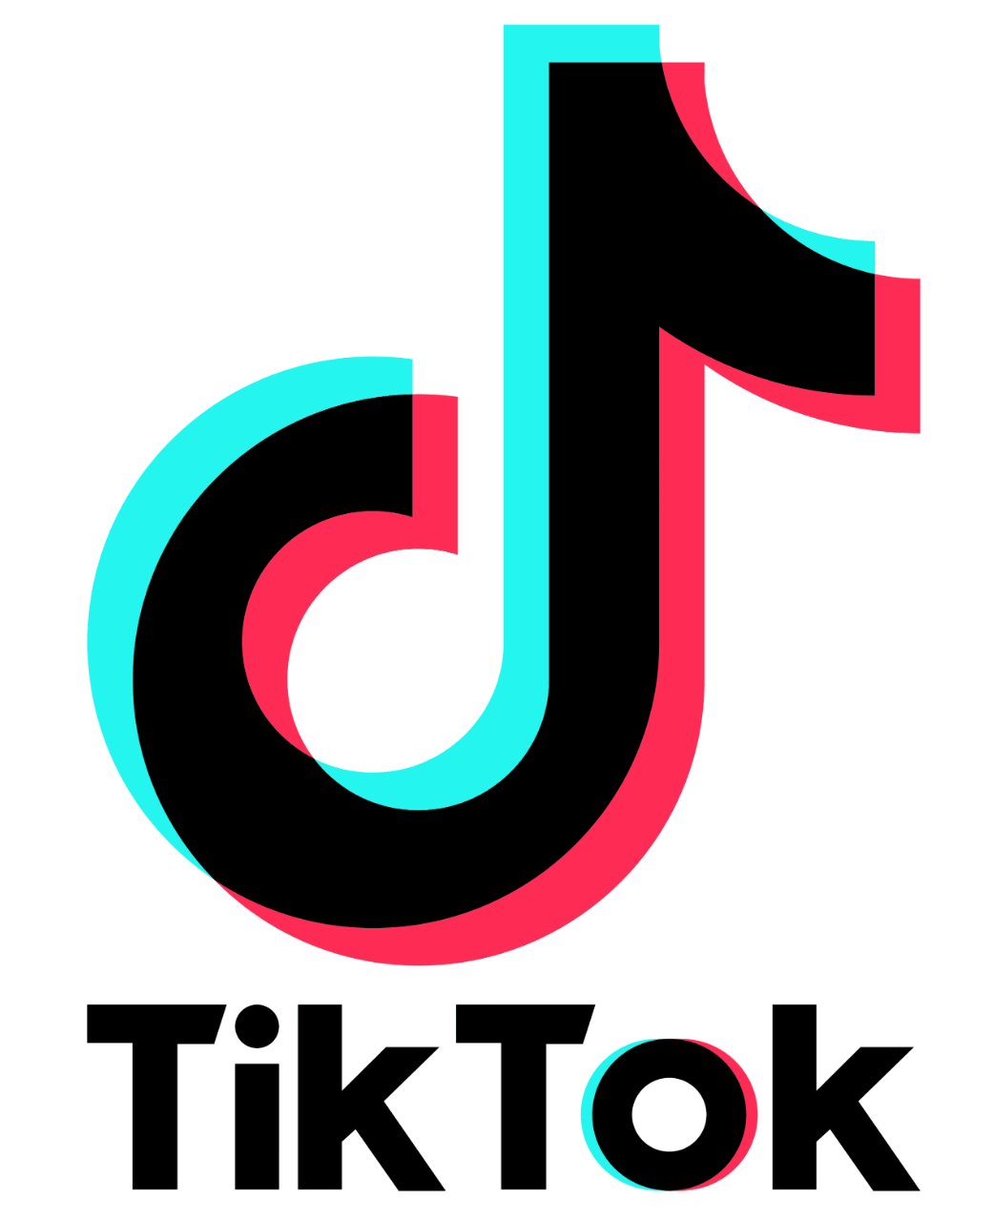
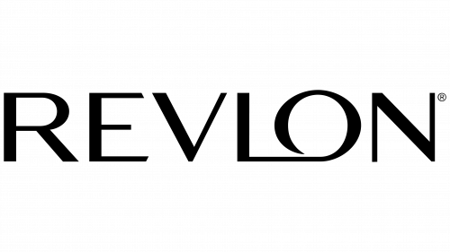
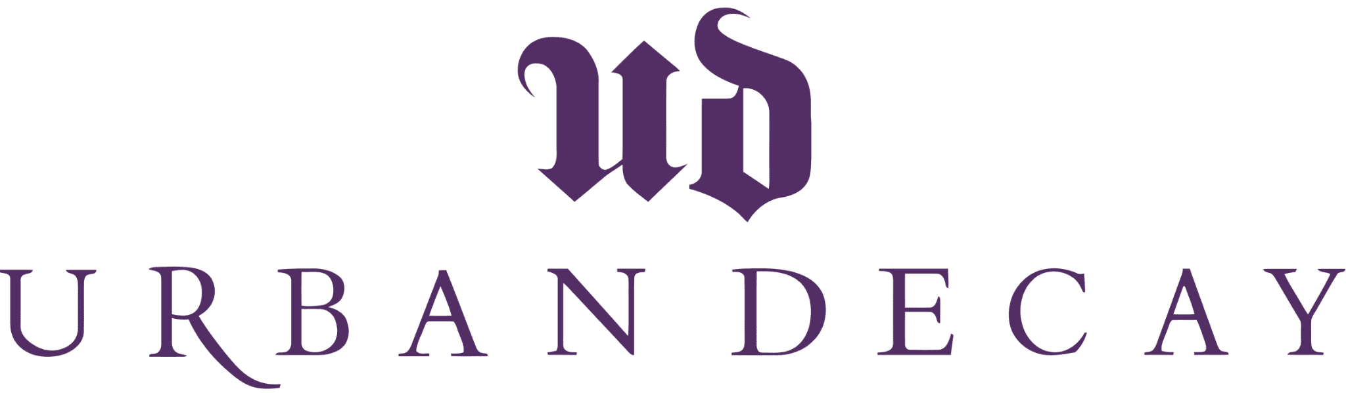
Want to keep learning about beauty insights?
All data and insights from this Category Benchmark and Insights are sourced from the MikMak Shopping Index.
The MikMak Shopping Index was developed to provide a standardized set of metrics, methodology, and benchmarks to help drive brands’ business results and strategy. It is a collection of key eCommerce KPIs collected across hundreds of brands and over 250 channels and more than 2,000 retailer integrations to understand consumer online shopping behavior. The Index also includes data from MikMak Shopper Intelligence, which ties first-party eCommerce data to 1,000+ demographic and psychographic data points and can be segmented by product, retailer, and more. Shopper Intelligence is available through an industry-exclusive partnership with LiveRamp.
Data in this report is from April 30, 2022 - April 30, 2023
Check out these BRAVE COMMERCE episodes:
LISTEN NOW
LISTEN NOW
LISTEN NOW
TikTok's Sandie Hawkins on Revolutionizing eCommerce through Community | Urban Decay's Malena Higuera on the digital transformation of the beauty industry | Revlon CEO Debbie Perelman on capturing a truly omni-experience for consumers in 2021
Let’s chat!
Want to get even more insights?
Contact marketing@mikmak.com!

