Slide 1



Boots UK Benchmarks & Insights Report
From the MikMak Shopping Index

Slide 2
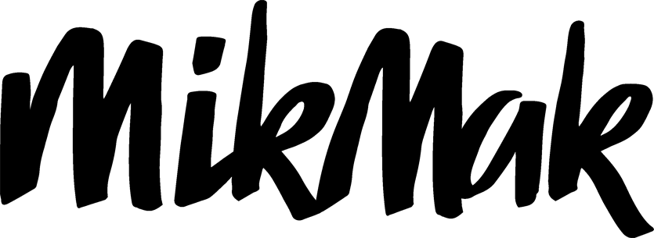
Boots UK Benchmarks & Insights
Consumer preference for Boots eCommerce has shifted
Snapchat has emerged as the second-most popular social commerce platform for Boots shoppers
Fragrances is the top product category driving online shoppers to Boots
Sunday is the best day to reach Boots shoppers
Here are the latest Boots UK eCommerce findings for your 2023 marketing initiatives.

Slide 3
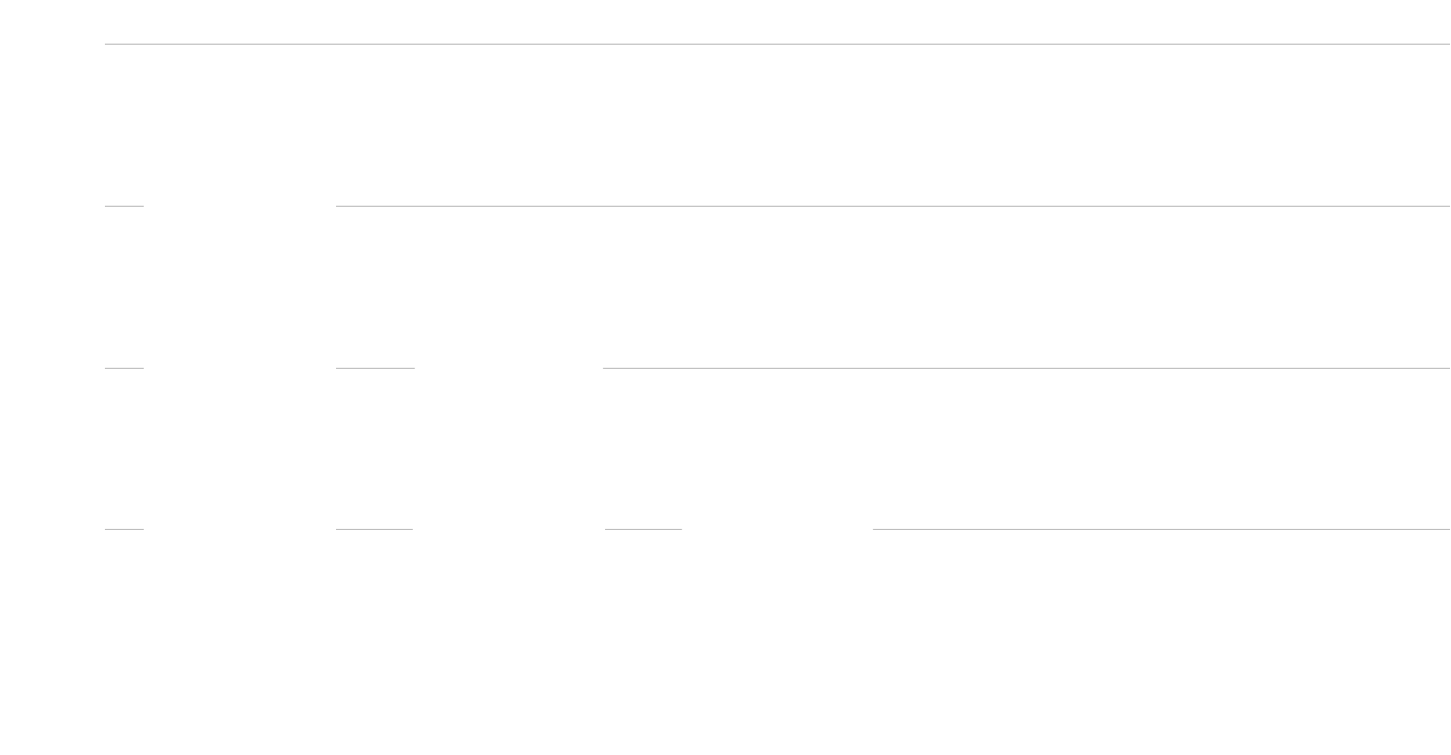

Boots UK Benchmarks & Insights
Top 5 Social Platforms for Boots
by Share of Purchase Intent Clicks
Use a strategic mix of social commerce ads
According to MikMak Shopping Index, Boots is the top choice for both Beauty and Personal Care eCommerce in the UK this year, in terms of Purchase Intent Clicks*, an indicator of overall shopping traffic. In addition to brand websites offering multi-retailer checkout and ‘where to buy’ functionality, social media is key in driving potential buyers to Boots. Let’s take a closer look at these platforms’ positioning this year.
While Facebook is leading (50.3 percent share of Purchase Intent Clicks), Snapchat (30.8 percent) has emerged as a major social commerce platform driving brand media traffic to Boots, followed by TikTok (16.6 percent) in third position, also gaining importance in the mix. Youtube (1.1 percent) and Instagram (1.0 percent) are the next most important social media within the Top 5 platforms driving traffic to Boots.
*Purchase Intent Clicks:
The number of times a shopper has clicked through to at least one retailer during a single session.

Slide 4
Boots UK Benchmarks & Insights
Top 20 Products at Boots
by Purchase Intent Clicks
What product categories matter most?
1. | Fragrance | 11. | Foundation
2. | Loose powder | 12. | Brightening powder
3. | Tinted moisturizer | 13. | Oil-free sunscreen
4. | Eyeshadow stick | 14. | Shower gel
5. | Suncare face cream | 15. | Micellar water
6. | Concealer | 16. | Blush
7. | Body milk | 17. | Anti dark-spot serum
8. | Face primer | 18. | After sun lotion
9. | After sun serum | 19. | Pressed powder
10. | Body cream | 20. | Chemical exfoliator
Boots offers an extensive range of beauty, personal care and health products from leading brands both in-store and online. So, which product categories are seeing the most purchase intent from eCommerce shoppers at Boots?
We looked at the 100 top products based on the number of Purchase Intent Clicks on the MikMak Platform, and found that Fragrances take the lead this year as the top product category driving shopper traffic to Boots. Loose powders, tinted moisturizers, eyeshadow sticks, suncare face creams and concealers position fairly equally within the next top five products that shoppers are looking for at Boots. In addition to fragrances, within the Top 20 products driving eCommerce at Boots, we see a mix of cosmetics, personal care and suncare products for face and body.

Slide 5

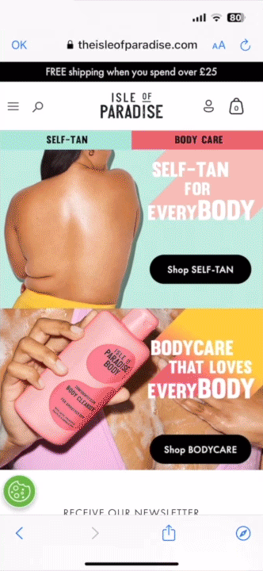

Boots UK Benchmarks & Insights
Enable eCommerce capabilities on your brand websites and all media
What makes effective eCommerce ads?
What do many of the top-performing Beauty and Personal Care eCommerce ads have in common? Let’s take a closer look and find out:
Bold, eye-catching creative that visually stands out
Product first, showcasing both the product and its value right away
A clear call to action entices customers. Include bold links with simple text such as “Buy Now” or “Check Out”
Flexible checkout that allows shoppers to switch between in stores and online
Hot tip: Be quick and nimble with your creative. The world needs to be able to experience your brand and buy it.
"With MikMak, shoppers can easily choose where to buy our products, and we get to see what drives conversion at both our DTC and our Retailer sites."
- Performance Marketing Manager

Slide 6
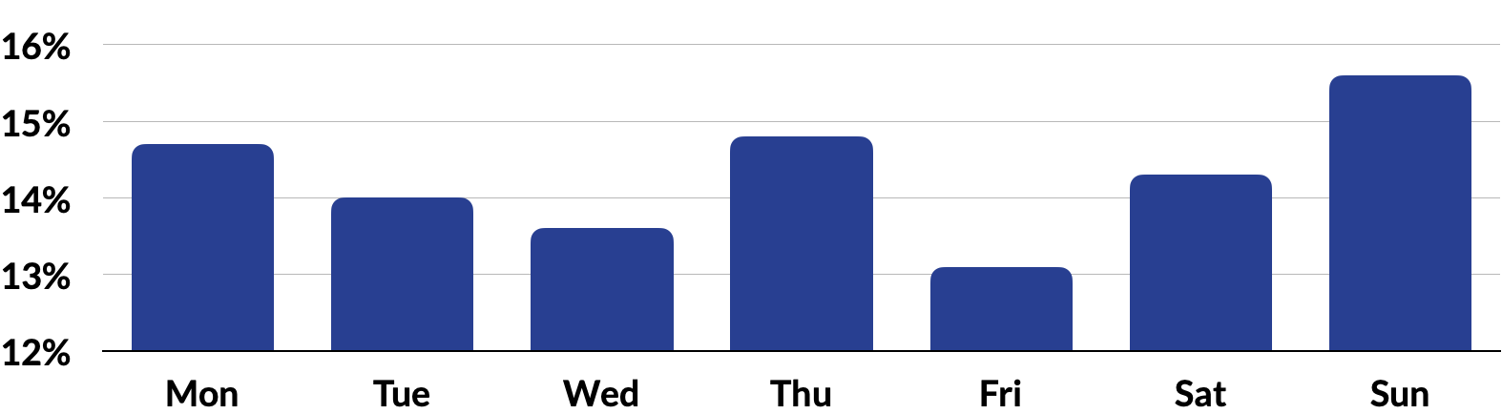
Boots UK Benchmarks & Insights
When looking at seasons, late spring and summer are when Boots shoppers are engaging the most, with June being the busiest eCommerce month.
When are Boots shoppers most active?
According to the MikMak Shopping Index, Sunday sees the most shopping activity from Boots shoppers with 15.6 percent of Purchase Intent Clicks. Thursday (14.8 percent) and Monday (14.7 percent) are the next best days driving in-market traffic to Boots.
Most popular shopping months at Boots by Purchase Intent Clicks
Share of Purchase Intent Clicks
by Day of the Week at Boots
1. | June | 7. | April
2. | July | 8. | February
3. | May | 9. | October
4. | August | 10. | March
5. | December | 11. | January
6. | November | 12. | September
Note: The daily share of Purchase Intent Clicks corresponds to the percentage of the total number of Purchase Intent Clicks of the year generated each day of the week.

Slide 7
Boots UK Benchmarks & Insights
Your eCommerce Marketing Checklist
So you’ve got the insights, now what? Here’s a checklist to start optimizing your Boots marketing initiatives for 2023.
Get the basics down. Are Facebook, Snapchat and TikTok part of your marketing mix? Are you marketing to Boots shoppers with the right products, at the right time, on the right channels? Does your brand utilize its brand website effectively to simplify and accelerate the path to purchase?
Explore joint growth opportunities. Retailers and brands have shared goals: selling more products and earning more revenue. To achieve these goals, it helps to be on the same page and look at the same data. Sharing data leads to more complete insights and more productive relationships. MikMak helps both your brand and your retailers increase speed from insight to action to best respond to evolving shopper preferences and needs.
Stay close to the data, daily. What matters most to your consumers? How does this vary by geography, platform, demographics, and more? Finding out the answers to these questions is the first step in improving your consumer insights and position with retailers, and results in stronger relationships and sales. This can all be done in real time within the MikMak Platform.
Want to learn more? Schedule a demo here.

Slide 8
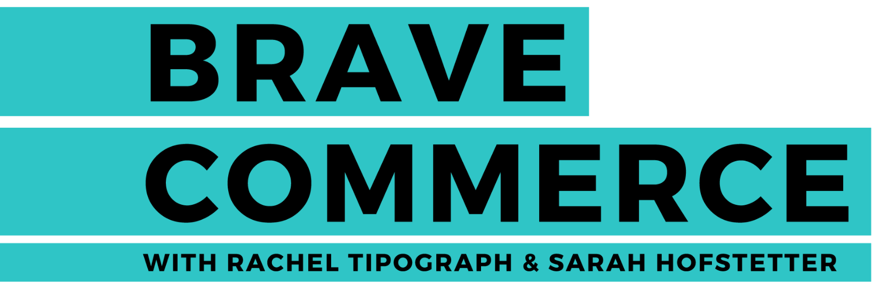

All data and insights from Retailer Benchmark Reports are sourced from the MikMak Shopping Index
The MikMak Shopping Index was developed to provide a standardized set of metrics, methodology, and benchmarks to help drive brands’ business results and strategy. It is a collection of key eCommerce KPIs collected across hundreds of brands and over 250 channels and more than 3,000 retailer integrations to understand consumer online shopping behavior.
All data in this report is from July 1, 2022 to June 31, 2023.
Listen Now
Kristof Neirynck then CMO of Walgreens Boots Alliance on how empathy and purpose can lead to business success
Let’s chat!
Want to get even more insights?
Looking for a different retailer?
Contact marketing@mikmak.com!

