Slide 1




2023 eCommerce Guide
eCommerce Benchmarks & Insights for Multichannel Home Care Brands
How MikMak Helps Home Care Brands Grow, Commerce-First
Average Order Value
$70.95
Purchase Intent Rates for Social Channels

Slide 2
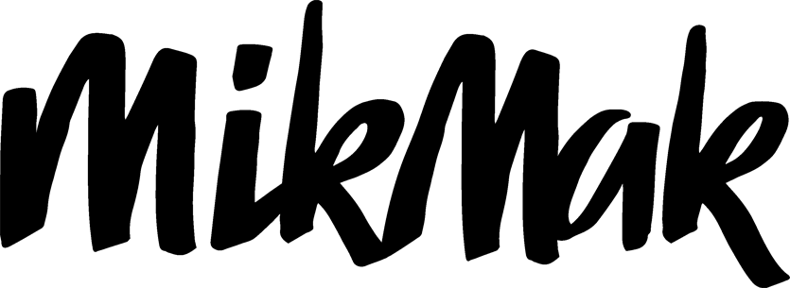
Home Care Brands Benchmarks and Insights
Category Benchmark:
Overview
5.8%
Purchase Intent Rate
According to Statista, revenue in the Home Care market is projected to reach $68.03bn in 2023 worldwide.
Online Home Care Shoppers are most likely to purchase from media displayed on Meta channels and checkout at Walmart
Springtime yields the highest Purchase Intent Rates from online Household Good Shoppers
Home Care is a product category made up of a vast array of product types. In this guide, we took a look at products such as cleaning supply, lawn care, small appliances, home electronics, and housewares (such as cooking supplies, and other functional household tools). Across all channels, Home Care brands have a category benchmark Purchase Intent Rate* of 5.8 percent.
*Purchase Intent Rate:
The percentage of shoppers who clicked through to at least one retailer.

Slide 3
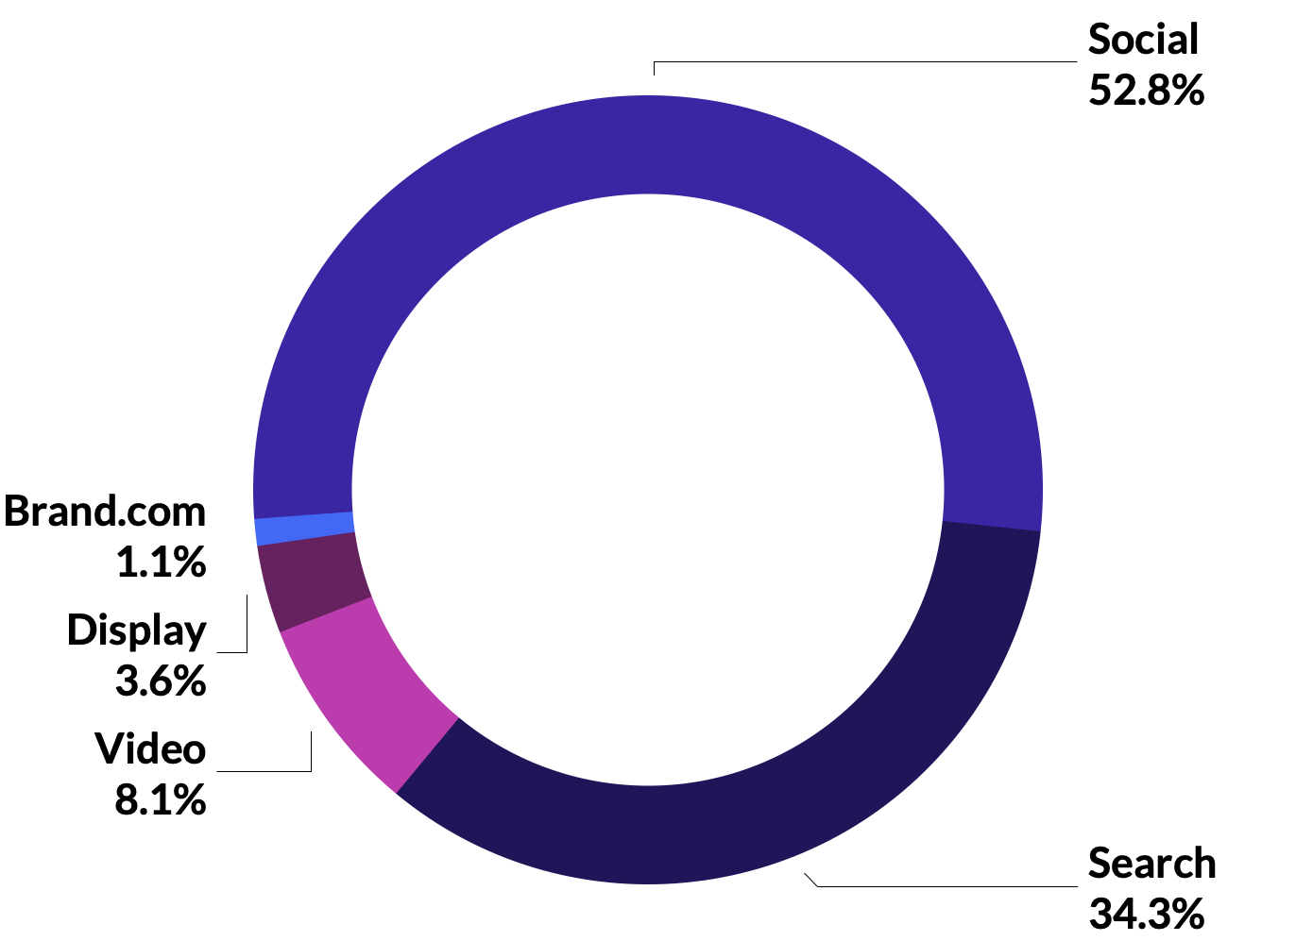
In terms of eCommerce shopping traffic for Home Care brands, social commerce leads the way with 52.8 percent of Purchase Intent Clicks*. Search drives the second most in-market traffic with 34.3 percent. Video ads follow with 8.1 percent, then display at 3.6 percent, and brand websites at 1.1 percent.
Accelerate Sales & Market Share
Make your products discoverable
Meta Channels are top-performing
for Home Care brands
For any brand, it is important that across all media and brand websites, shoppers can find and buy your Home Care products faster, in-store and online.
Across all channels, Home Care brands have a category benchmark Purchase Intent Rate of 5.8 percent.
By Share of Purchase Intent Clicks
*Purchase Intent Clicks:
The number of times a shopper has clicked through to at least one retailer during a single session.

Slide 4
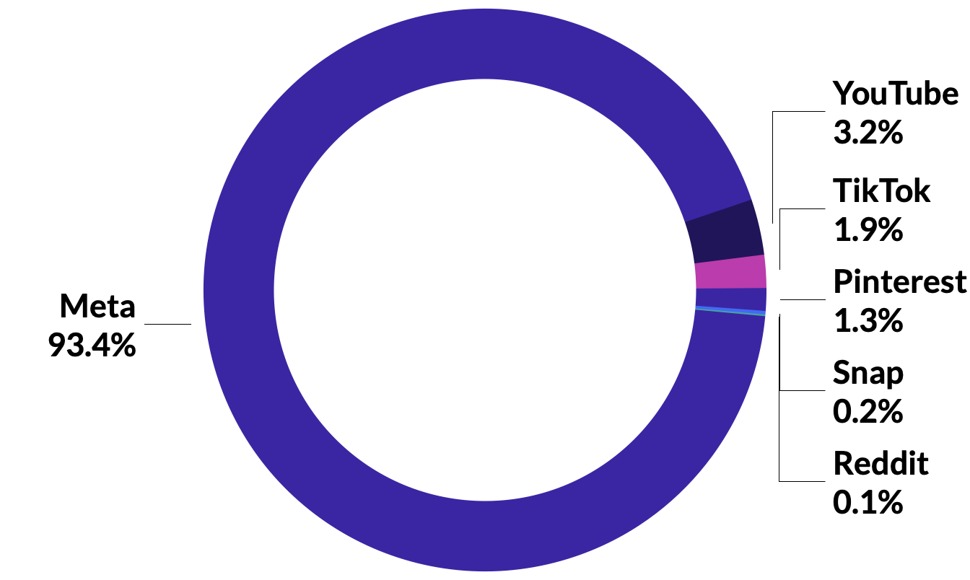

Home Care Brands Benchmarks and Insights
Meanwhile, in terms of in-market traffic, Meta channels continue to lead the way, driving 93.4 percent of Purchase Intent Clicks*. YouTube follows with 3.2 percent. TikTok and Pinterest trail behind with 1.9 and 1.3, respectively. While Snap drives 0.2 percent, and Reddit drives 0.1 percent. It is important to note that this can be due to the fact that brands are spending more of their budget on Meta media than any other social channel, rather than assuming Meta being dominant overall in terms of performance.
When looking at social channels specifically, Meta (Facebook & Instagram) drives the highest Purchase Intent Rates for Home Care brands at 21.1 percent (3.6x the category benchmark). Pinterest follows with 9.3 percent. Trailing behind Pinterest is YouTube with 3.0 percent. TikTok, Reddit, and Snap drive Purchase Intent Rates of 1.5, 1.1, and 0.8 percent, respectively.
Purchase Intent Rates for Social Channels
Meta leads in traffic for Home Care brands
By Share of Purchase Intent Clicks

Slide 5

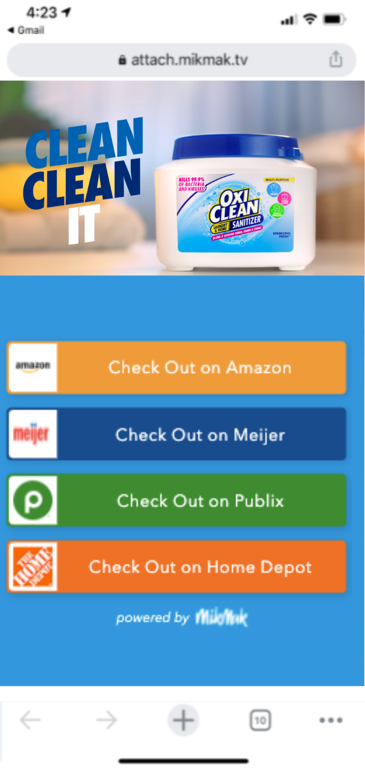
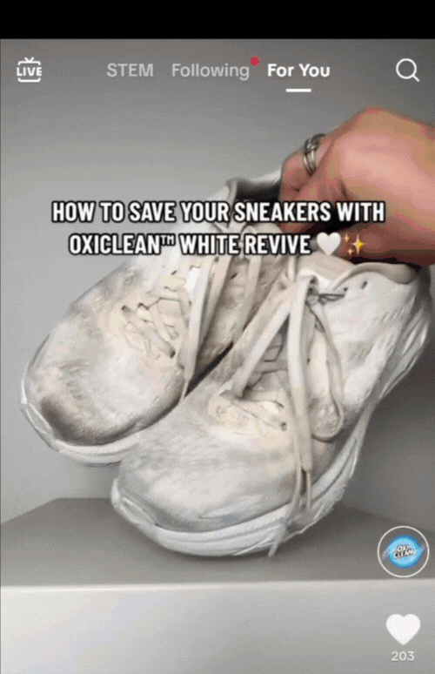
Home Care Brands Benchmarks and Insights
OxiClean drove category-leading purchase intent by leveraging MikMak on a YouTube Video for Action* activation during the key cold and flu season.
How MikMak makes products discoverable
MikMak Commerce provides premium consumer shopping experiences that create a seamless path to checkout at any retailer, from anywhere across your entire media mix, including social media, retail media, programmatic, paid search, CTV, video, email, and brand.com.
23%
Higher Purchase Intent Rate vs. category benchmark on Youtube Video for Action
72%
Lower cost per conversion vs Q1-22 YouTube Select**
+2.2%
Lift in Awareness vs. Q1-22 YouTube benchmark
Read Full Case Study

Slide 6
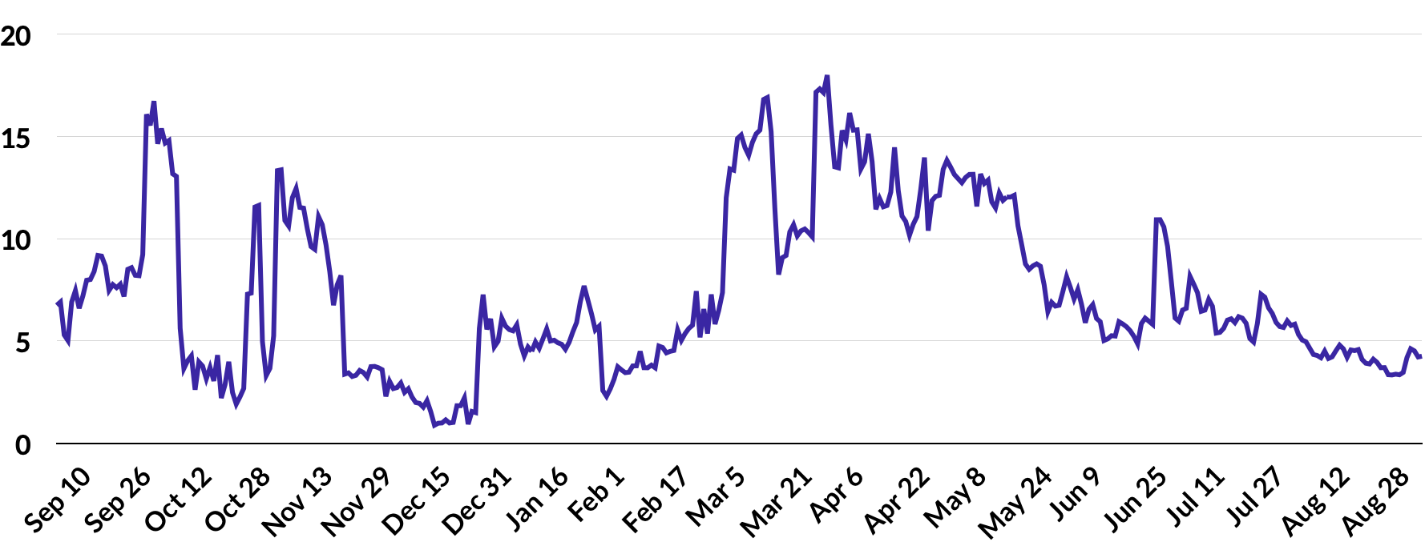
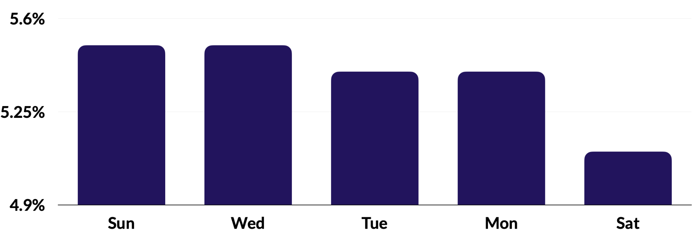
Purchase Intent Rates for Home Care Products
Accelerate Sales & Market Share
Beat the competition
To effectively grow market share, you must know, compare, and optimize your performance against brands in your category by channel, retailer, and more. You must also understand how performance changes over time.
Purchase Intent for Home Care Brands are highest during springtime, on Sundays and Wednesdays
Purchase Intent Rates for Home Care Products by Day of Week
Right now, Home Care shoppers are most likely to purchase online in springtime, with the first week in April driving the highest Purchase Intent Rates in the past year. This could likely be attributed to spring cleaning traditions. These shoppers are also most likely to purchase on Sunday or Wednesday, with a Purchase Intent Rate of 5.5 percent.

Slide 7

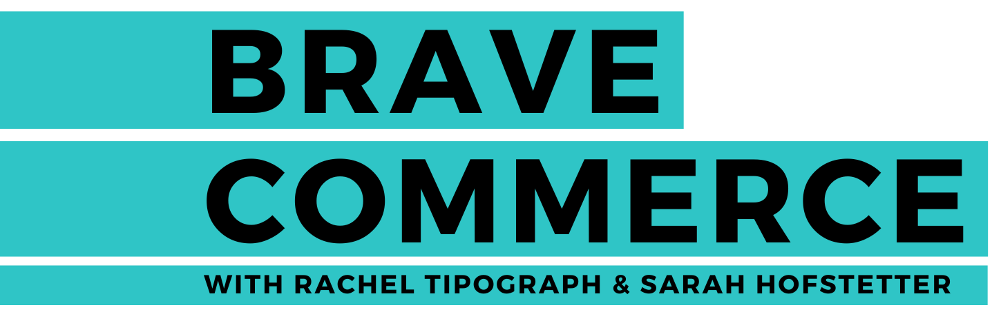

Home Care Brands Benchmarks and Insights
How MikMak creates competitive advantage
LISTEN HERE
With MikMak Benchmark Insights, you can see how your brand stacks up against other brands in your category. More specifically, you can understand your performance and media investment relative to the competition. This allows your brand to identify new conversion opportunities and compare your performance over time to quickly understand changes and progress toward your goals.
“Sometimes people say that being early is the same as being wrong, I actually don’t believe that. I believe that being early is the same as having a head start.”
- Stu Landesberg
Co-Founder & CEO, Thrive Market

Slide 8
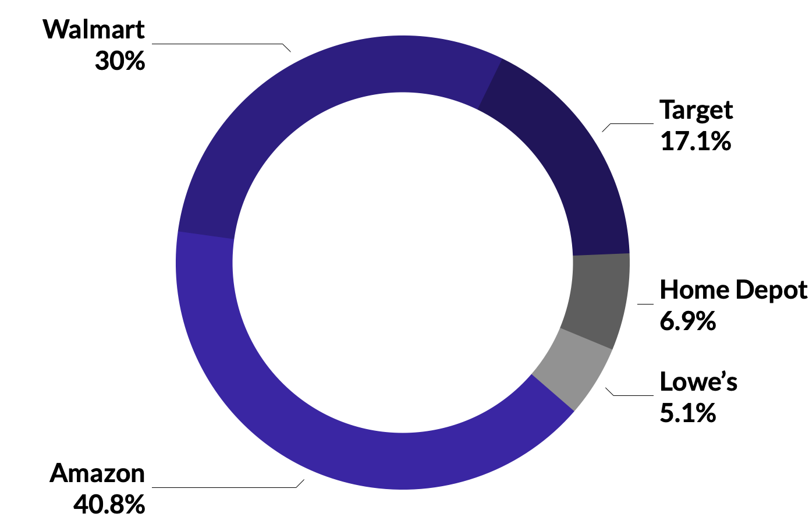
Amazon is the top retailer for Home Care shoppers
Right now, among the Top 5 Home Care retailers, Amazon is the driving the most in-market traffic, with 40.8 percent of Purchase Intent Clicks. Walmart and Target are second and third with 30 percent and 17.1 percent, respectively. Specialty retailers, Home Depot and Lowe’s round out the Top 5 retailers at 6.9 and 5.1 percent. It is important for Home Care brands to be available at a mix of retailers, including specialty retailers, to reach consumers where they prefer to shop.
Accelerate Sales & Market Share
Strengthen Retailer Partnerships
Top 5 Home Care Retailers
Using proprietary, retailer-specific consumer insights in joint planning discussions with retailers can help unlock shelf space and media value.
By Share of Purchase Intent Clicks

Slide 9

Home Care Brands Benchmarks and Insights
Top 10 Products by Type (Based on Sales)
Home Care Shoppers have an Average Basket Size of 6.7 items
According to the MikMak Shopping Index, Home Care shoppers have an Average Basket Size of 6.7 items. The Average Order Value of those baskets is $70.95. Within those baskets, Food Storage Containers are the top products. The MikMak Shopping Index also reveals that these shoppers are often also buying Grocery items, as well as other Home Care products alongside their purchases.
1. 2. 3. 4. 5. 6. 7. 8. 9. 10. | Food Storage Container Lawn Fertilizer Scented Oil Plug-in Cookware Pesticide Glass Bakeware Fabric Refresher Rodent Killer Weed Killer Home Insecticide
Average Basket Size
Average Order Value
6.7 items
$70.95

Slide 10
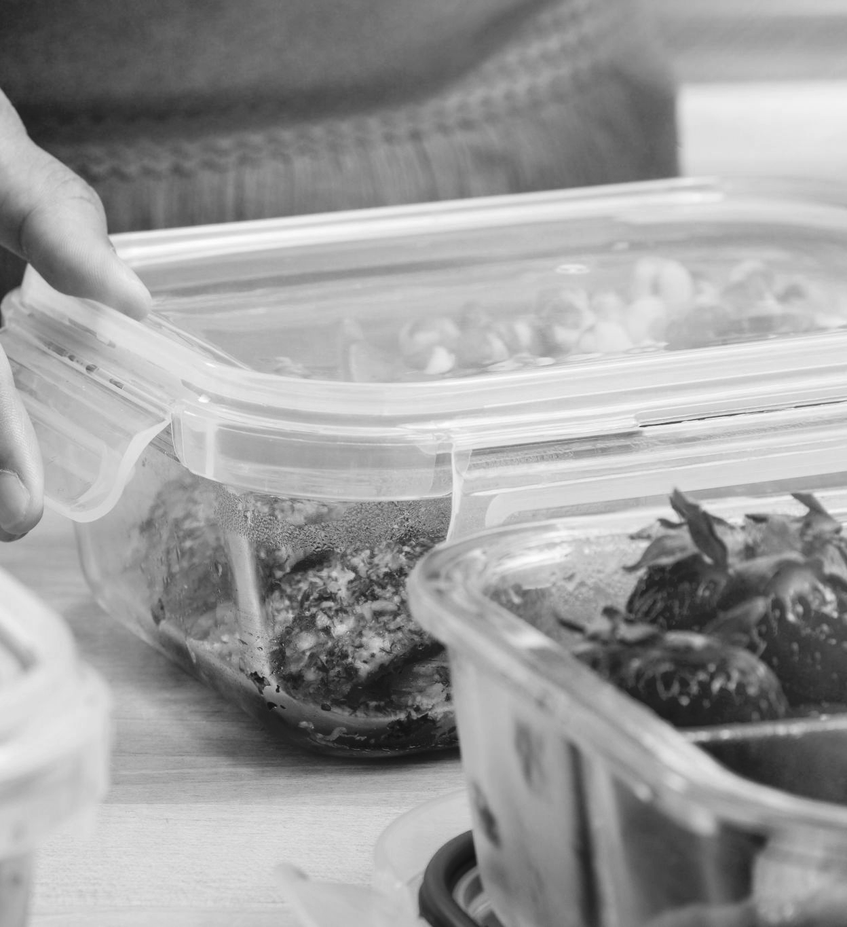
Home Care Brands Benchmarks and Insights
How MikMak helps brands strengthen retailer partnerships
LISTEN HERE
Do you know if your media investment resulted in a purchase? If so, what was in that cart? This is where MikMak Sales Insights’ closed-loop attribution, or the ability to tie granular consumer touchpoints like platform and campaign all the way through to purchase, comes in. Drive business impact and accelerate your eCommerce growth by gaining visibility into your consumers’ shopping journey, all the way through purchases at select retailers.
“We’ve got to get to where the brands and the retailers are on the same side. We’re trying to find consumers, get them the right product for the right price and make profitable businesses on both sides and retail media gives us a way to do that that didn’t exist before.”
- Michal Geller
President of eCommerce & Digital, Newell Brands

Slide 11
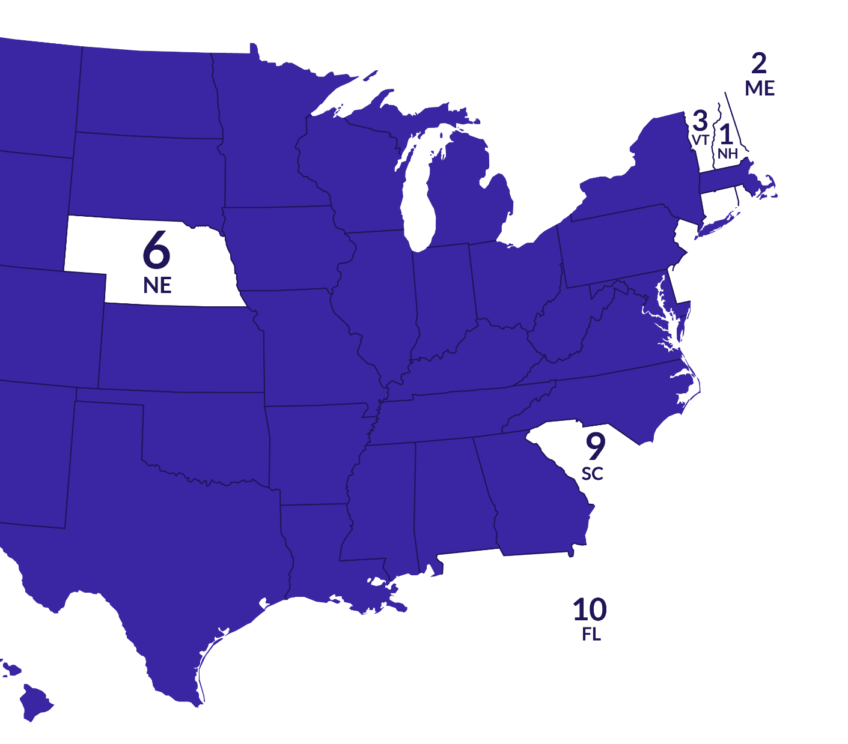

New Hampshire drives the highest Purchase Intent Rates for Home Care brands
NH - 17.1
ME - 15.8
VT- 14.9
NJ - 14.7
DE -14.5
NE - 14.5
RI - 14.2
CT - 14.0
SC - 13.9
FL - 13.8
Drive Profitability & Reduce Costs
Improve marketing effectiveness
Do you know where is best to invest your next marketing dollar? First, it’s important to understand the channels, campaigns, creative, and audiences that actually convert.
Top Hours of Day (by Purchase Intent Rate)
3pm ET
2pm ET
1pm ET
4. 7pm ET
5. 5pm ET

Slide 12

Home Care Brands Benchmarks and Insights
LISTEN HERE
How MikMak improves marketing effectiveness
“I love the idea that there is no playbook for the digital e-com space. And even as you start to get common practices or rules of thumb, it just seems to evolve and mature and change. And that just really energizes me.”
- Sara Aubitz
Director of Consumer Insights and Analytics,
The Clorox Company
MikMak provides the world’s leading Home Care brands with exclusive first-party consumer insights. With MikMak Insights, you can look into your performance from every angle, and dig deeper than other providers

Slide 13
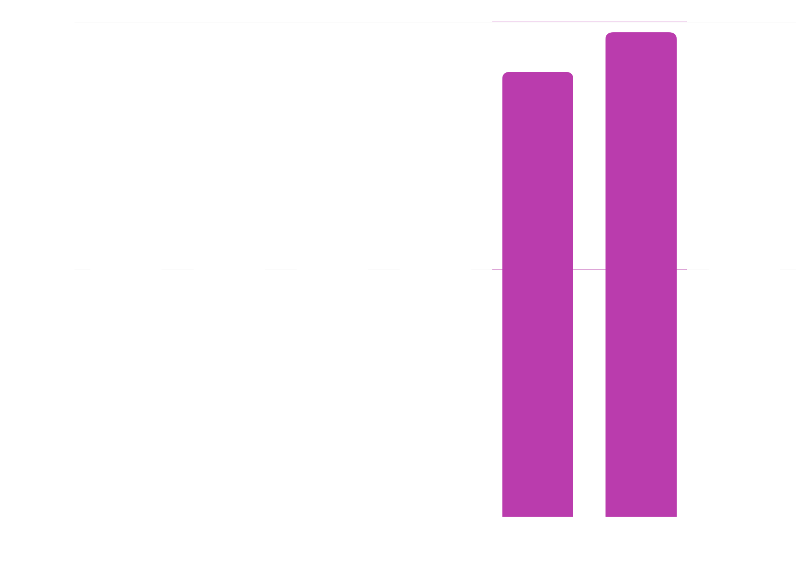

Drive Profitability & Reduce Costs
Baby Boomers are most likely to shop for Home Care Products online
Collect first-party data
To truly improve performance and lower costs, you must also have a consolidated view of your consumer data and audiences.
Purchase Intent Rates are highest in two-person households
Baby Boomers

Slide 14

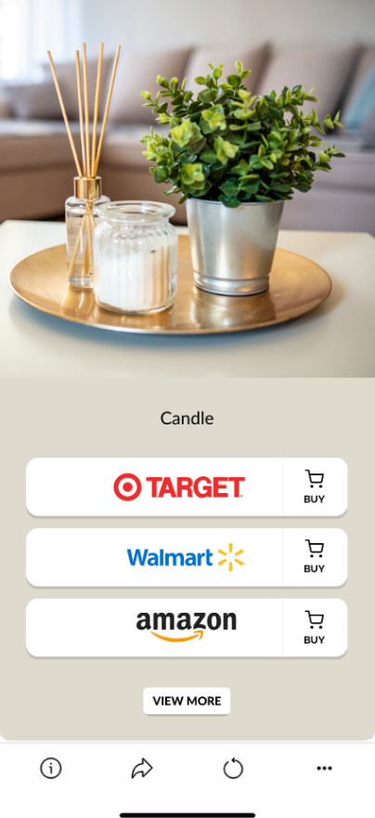
Home Care Brands Benchmarks and Insights
A Household Essentials brand increased purchase intent and reduced media cost by leveraging MikMak Audiences
How MikMak provides first-party data
Use first-party data collected by MikMak Commerce to build and segment qualified shopper audiences within your ads managers/DSP to improve media targeting based on product interest, retailer preferences, and channel behavior. You can also retarget or build lookalike audiences to be leveraged across your entire media plan.
6.4%
Increase in Purchase Intent Rate using MikMak Audiences

Slide 15
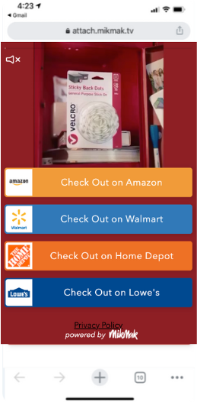
The VELCRO® Brand launched a back-to-school campaign leveraging updated creative and optimized toward Add-to-Cart with conversion campaign objectives to increase purchase intent and sales.
Drive Profitability & Reduce Costs
Save time and money
2.2x
Increase in Purchase Intent Rate compared to the previous month
With consistent, real-time reporting and easy access to consumer, retailer, and platform insights, brands’ internal teams and agencies can save a ton of time and money. Couple these insights with best practices, and your team will be sure to gain market share and drive profitability time and time again.
5.61x
Increase in Total Attributable Sales after launching the BTS campaign with updated campaign objective
3.3x
Higher Purchase Intent Rate on Facebook than category benchmark.
Read Full Case Study

Slide 16
Home Care Brands Benchmarks and Insights
How MikMak saves time and money
LISTEN HERE
MikMak offers one easy-to-use global platform that automatically enables consistent reporting and fast decision-making across the entire organization. With the MikMak Platform, brands can also leverage direct integrations with third-party Product Information Management (PIM) platforms including Salsify and Syndigo; as well as Data Visualization Platforms and Data Lakes like Salesforce and Google Data Studio.
"The fact that so much of your success in eCommerce is about getting those fundamentals rights, those fundamentals around your content, your ratings and reviews, your navigation, your pricing, all of those things that determine whether or not you get that sale everyday"
- Alison Lewis
Chief Growth Officer, Kimberly-Clark

Slide 17
Your eCommerce Marketing Checklist
Get the basics down. Are Instagram, Facebook, and YouTube part of your marketing mix? Are Amazon, Walmart, Target, Home Depot, and Lowe’s in your check-out options?
Develop more nuanced insights for consumer relevance. Is your brand’s website utilizing multi-retailer checkout? Which channels are part of their shopping journey? Add the channels and retailers that resonate with your consumers to the mix. Can you expand to new formats like QR codes and CTV?
Be agile and quick with your data, and use insights to adjust your creative and advertising methods effectively
Explore growth opportunities. Check your performance against category (and subcategory!) benchmarks to see how you stack up against the competition. A/B test creative and messaging to see if purchase intent increases.
We're here to help. MikMak helps multichannel brands gain deeper consumer insights to grow and protect market share. Contact us at marketing@mikmak.com!

Slide 18
All data and insights from this Category Benchmark and Insights are sourced from the MikMak Shopping Index.
Let’s chat!
Want to get even more insights?
Looking for a different category?
Contact marketing@mikmak.com!
The MikMak Shopping Index was developed to provide a standardized set of metrics, methodology, and benchmarks to help drive brands’ business results and strategy. It is a collection of key eCommerce KPIs collected across hundreds of brands and over 250 channels and more than 4,000 retailer integrations to understand consumer online shopping behavior.
All data in this report is from 9/10/22 - 9/10/23.

