Slide 1


Quick Commerce Retailer Benchmarks
& Insights Report
From the MikMak Shopping Index

Slide 2
Quick Commerce Retailer Benchmarks & Insights Report
Quick Commerce (Q-Commerce) retailers have quickly gained momentum in eCommerce
Here are the latest Quick Commerce findings for your 2023 marketing initiatives.
Meta channels dominate social commerce for Quick Commerce retailers
Grocery and Alcohol are largely the most shopped for products on Quick Commerce Retailers
Saturday evening is the best time to reach Quick Commerce shoppers

Slide 3

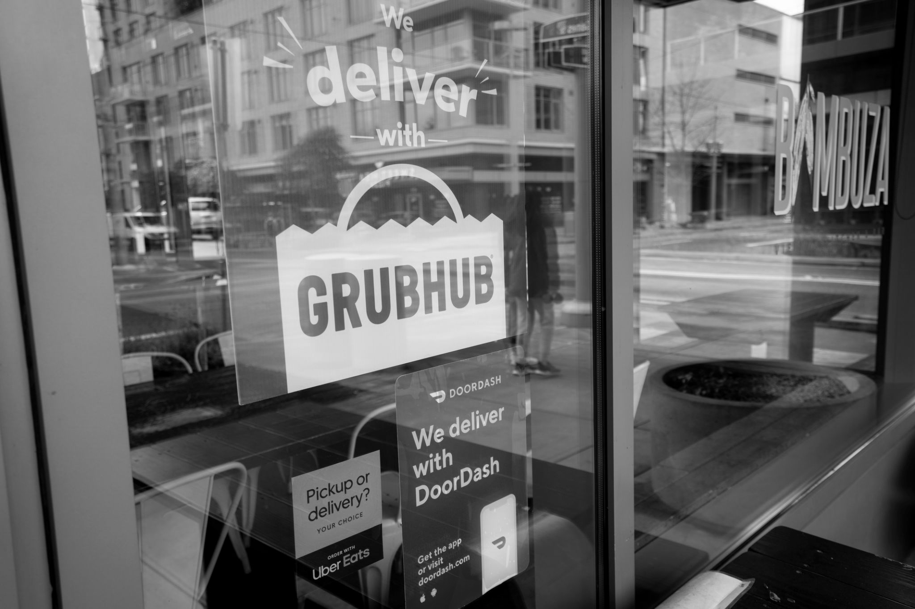
Quick Commerce Retailer Benchmarks & Insights Report
Quick Commerce shoppers are largely discovering products on Meta
Top 5 Social Platforms to Quick Commerce Retailers by Share of Purchase
Quick Commerce retailers are those that have their own delivery drivers and can get products in the hands of consumers, fast. MikMak took a look at some of the biggest players in the Q-Commerce space, including Instacart, Uber Eats, DoorDash, Grubhub, goPuff, Total Wine, Drizly, ReserveBar, FreshDirect, and Getir, to glean the latest trends on consumer preferences and buying behaviors.
When looking at the top 5 Social Platforms that are driving traffic to Quick Commerce retailers, Meta channels, Facebook and Instagram, largely take the lead with Facebook yielding 61.2 percent of Purchase Intent Clicks. Following is Instagram with 33.6 percent.
YouTube comes in third behind Meta channels at 2.8 percent. Snap and Pinterest round out the top 5 channels, driving 1.7 percent and 0.7 percent, respectively.
*Purchase Intent Clicks:
The number of times a shopper has clicked through to at least one retailer during a single session.

Slide 4



Quick Commerce Retailer Benchmarks & Insights Report
What brand categories matter most?
Quick Commerce retailers provide delivery options for a multitude of products. However, consumers turn to these services the most to fulfill their Grocery and Alcohol needs. In fact, some Quick Commerce retailers, such as Drizly and ReserveBar, only sell Alcohol.
Excluding the Alcohol-only Quick Commerce retailers, the MikMak Shopping Index found that Grocery is the top category, with products in this category driving 72.2 percent of Purchase Intent Clicks. Second, is the Alcohol category at 22.5 percent, demonstrating that consumers turn to Q-Commerce for Alcohol purchases even with non-Alcohol exclusive providers.
Outside of Grocery and Alcohol, Health Care Items come in third with 2.3 percent. Household products follow with 1.3 percent.
Pets, Personal Care, and Beauty products all drive less than 1 percent of Quick Commerce Purchase Intent Clicks with 0.8 percent, 0.7 percent, and 0.2 percent, respectively.
Share of Quick Commerce Purchase
Intent Clicks by Category

Slide 5
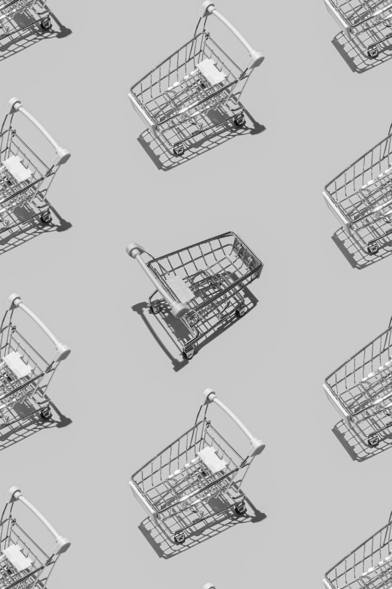




Quick Commerce Retailer Benchmarks & Insights Report
Quick Commerce shoppers have smaller basket sizes
On average, Q-Commerce shoppers have 1.9 items in their shopping carts. This is a relatively small basket size when we compare this to more established eCommerce sites such as Target (4.6) or Walmart (8). It is likely that shoppers are only using Q-Commerce retailers for small, immediate needs and one-off items.
According to the MikMak Shopping Index, when looking at Grocery Q-Commerce Retailer FreshDirect, Milk and Sparkling Water dominate the top products. Meanwhile, Alcohol Q-Commerce Retailer Drizly shows flavored whiskeys, gin, red wine, and vodka. We can expect these types of products to also be popular with similar Q-Commerce retailers, such as ReserveBar for Alcohol and Instacart for Grocery.
Channel + Category
Mix (Traffic)
X Grocery
Top Products from FreshDirect
Top Products from Drizly
1. 2. 3. 4. 5. | Oat Milk Whole Milk Sparkling Water, Tea & Lemonade Flavor Fat-Free Milk Sparkling Water, Fruit Flavors
1. 2. 3. 4. 5. | Peanut Butter Flavored Whiskey Gin Red Wine Cinnamon Flavored Whiskey Vodka

Slide 6

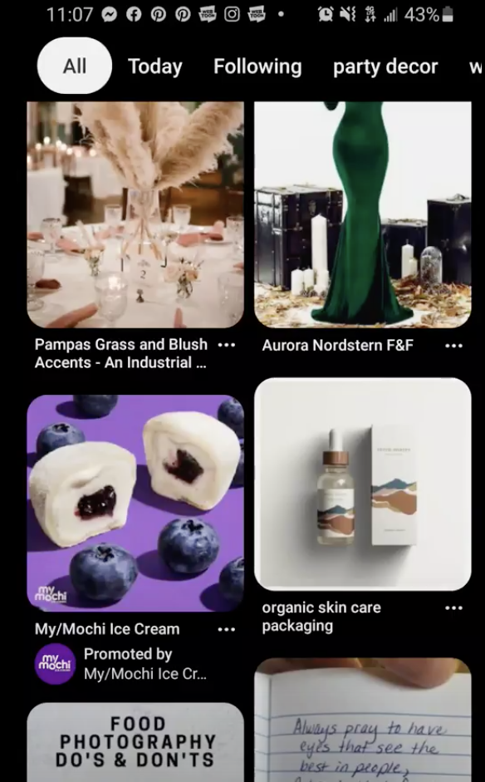
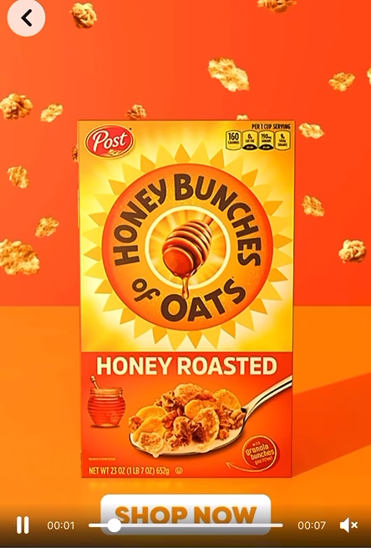
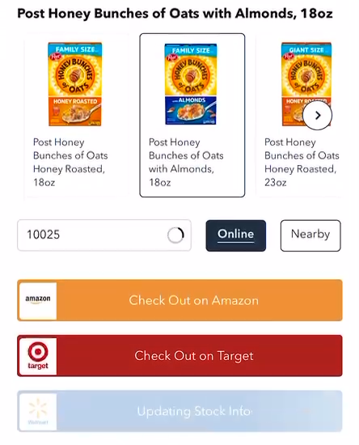
Quick Commerce Retailer Benchmarks & Insights Report
Grocery spotlight
Given that Grocery is the top product category for Quick Commerce shoppers, here are a few tips and data points for brands in the category.
Bold, eye-catching creative that visually stands out
Product first, showcasing both the product and its value right away
Have a clear call to action. Include bold links with simple text such as “Buy Now” or “Check Out”.
Flexible checkout that allows shoppers to switch between in store and online, different geolocations, and fulfillment options
Don’t be afraid to try out different formats. Successful Grocery brands have effectively used QR codes, OTT advertising, and livestream commerce to reach consumers.
Enable shoppable options on your brand website to promote brand awareness and offer additional checkout and fulfillment options for shoppers.
Hot tip: Be quick and nimble with your creative.
The world needs to be able to experience your brand and buy it.

Slide 7
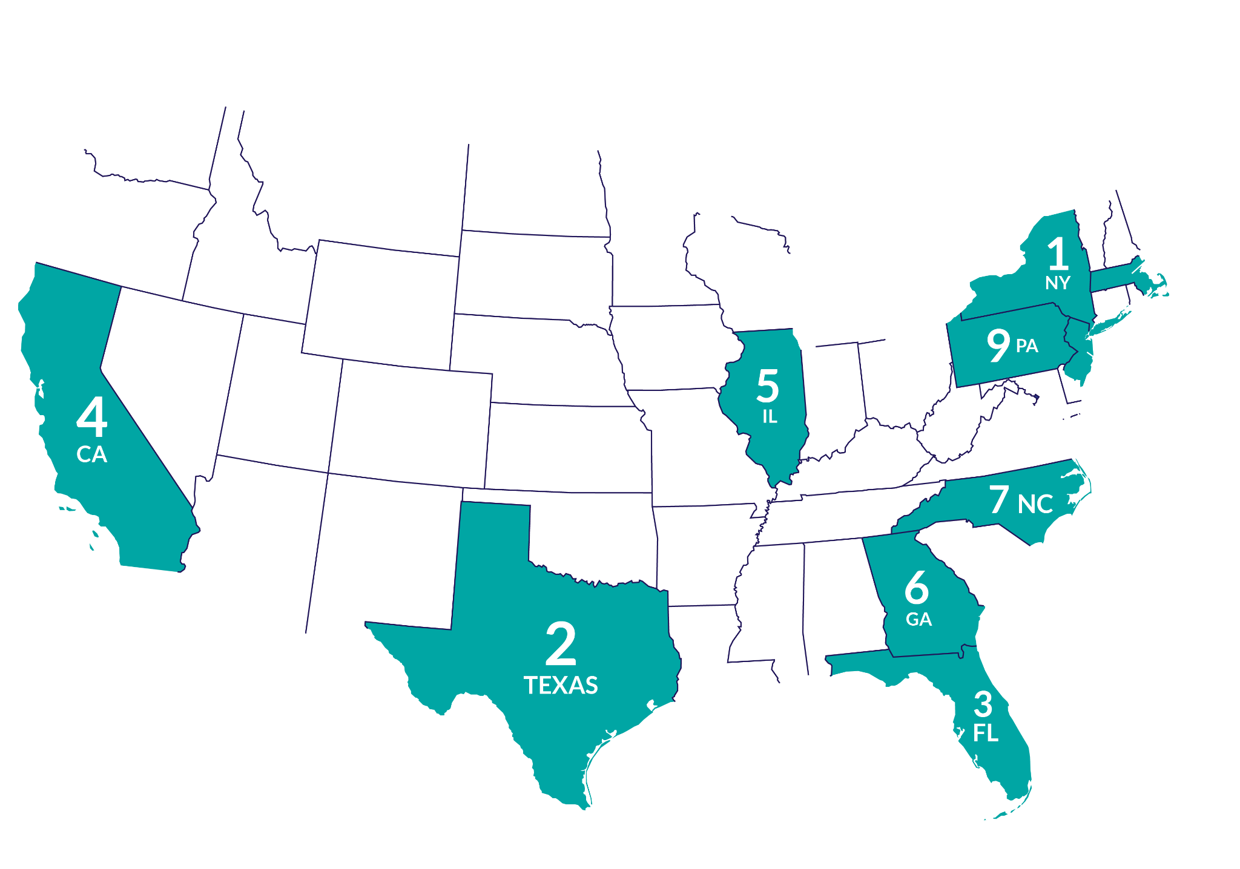


Quick Commerce Retailer Benchmarks & Insights Report
When do they shop the most? According to the MikMak Shopping Index, Saturday sees the most shopping activity from Quick Commerce consumers. In general, evening hours seem to be best. This could be from shoppers getting their late-night snacks, or being home from work and available to accept deliveries.
Where are Quick Commerce shoppers, and when are they shopping?
In the US, the city with the most Quick Commerce shoppers is New York. Following New York are Chicago, LA, Houston, and Dallas. When looking at the data by state, New York also takes the lead for Quick Commerce shoppers, followed by Texas, Florida, California, Illinois, Georgia, North Carolina, New Jersey, Pennsylvania, and Massachusetts.
Most Popular Shopping Days of Week
Sat
Thurs
Tues
4. Sun
5. Wed
NY
TX
FL
CA
IL
GA
NC
NJ
PA
MA
Most Popular Shopping Time of Day: (EST)
9pm
8pm
7pm
4. 6pm
5. 10pm

Slide 8
Quick Commerce Retailer Benchmarks & Insights Report
Your eCommerce Marketing Checklist
So you’ve got the insights, now what? Here’s a list to help optimize your Quick Commerce marketing initiatives for 2023.
Get the basics down. Are your ads on Meta informing shoppers of Quick Commerce options? Are you marketing to Quick Commerce shoppers in the right regions, at the right time, and day of the week? Does your brand allow shoppers to check out from Q-Commerce retailers directly from its website?
Explore joint growth opportunities. Retailers and brands have shared goals: selling more products and earning more revenue. To achieve these goals, it helps to be on the same page and look at the same data. Sharing data leads to more complete insights and more productive relationships.
Stay close to the data, daily. What matters most to your consumers? How does this vary by geography, platform, demographics, and more? Finding out the answers to these questions is the first step in improving your consumer insights and positioning with retailers, and results in stronger relationships and sales. This can all be done in real time within the MikMak Platform.
Want to learn more? Schedule a Demo here.

Slide 9
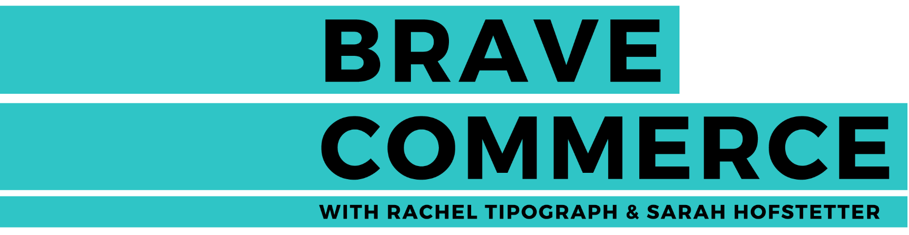



Want to keep learning about retailer insights?
All data and insights from Retailer Benchmark Reports are sourced from the MikMak Shopping Index
The MikMak Shopping Index was developed to provide a standardized set of metrics, methodology, and benchmarks to help drive brands’ business results and strategy. It is a collection of key eCommerce KPIs collected across hundreds of brands and over 250 channels, and over 3000 retailer integrations to understand consumer online shopping behavior.
All data in this report is from 6/6/2022 to 6/6/2023.
Check out these BRAVE COMMERCE episodes:
LISTEN NOW
LISTEN NOW
LISTEN NOW
Chris Rogers of Instacart on Developing Strong Retailer Relationships, and Utilizing AI for Commerce | Gopuff's Daniel Slotwiner on following the data to find success | Uber Eats' Eduardo Donnelly on the digital transformation of Latin America as a result of the pandemic
Let’s chat!
Want to get even more insights? Looking for a different retailer?
Contact marketing@mikmak.com

