Slide 1
2023 eCommerce Guide
eCommerce Benchmarks & Insights for Multichannel Toy Brands
How MikMak Helps Toy Brands Grow, Commerce-First

Slide 2
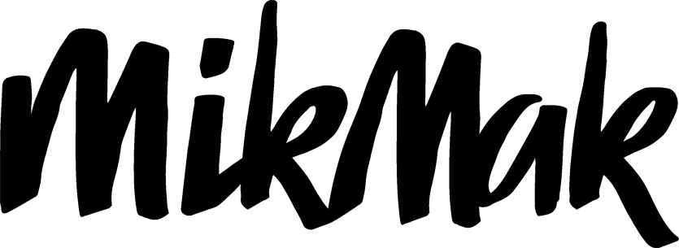
Toy Brands Benchmarks and Insights
*Purchase Intent Rate:
Overview
The percentage of shoppers who clicked through to at least one retailer.
According to Statista, eCommerce revenue for the Toys and Hobby industry is projected to reach $256.33 million in 2023, and grow to $385.17 million by 2027
MikMak Commerce-enabled Brand Websites drive the highest Purchase Intent Rates* for Toy brands compared to other channels
Walmart is the most popular online retailer for Toy Brands based on Share of Purchase Intent Clicks

Slide 3
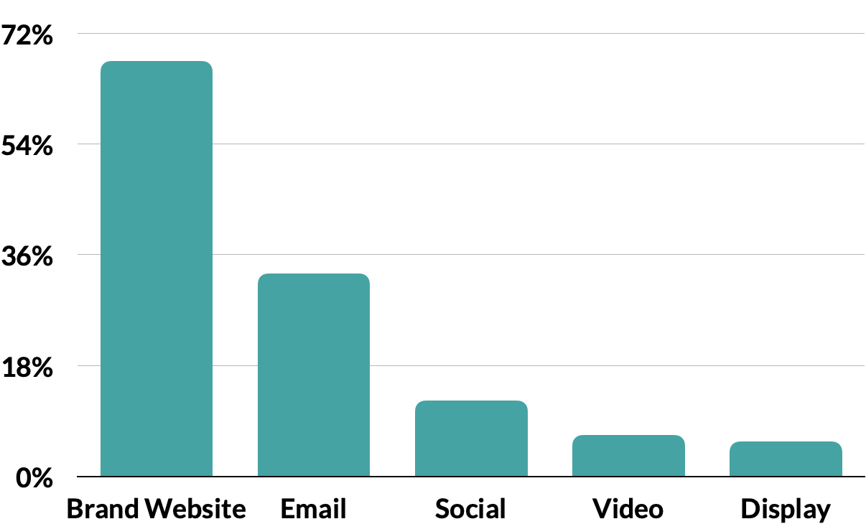
Toy Brands Benchmarks and Insights
Right now, for Toy brands, their MikMak Commerce-enabled brand websites drive the highest Purchase Intent Rates* with 67.5 percent Email drives the second highest with 33 percent. Social ads follow with 12.3 percent, then Video at 6.7 percent, and Brand Websites at 5.7 percent.
Accelerate Sales & Market Share
Make your products discoverable
Purchase Intent Rates by Channel Type
For any brand, it is important that across all media and brand websites, shoppers can find and buy your Toy Brand products faster, in-store and online.
Across all channels, Toy brands have an average category benchmark Purchase Intent Rate of 17 percent.
Brand Website |  | 67.51%
Email |  | 32.97%
Social |  | 12.29%
Video |  | 6.71%
Display |  | 5.65%

Slide 4
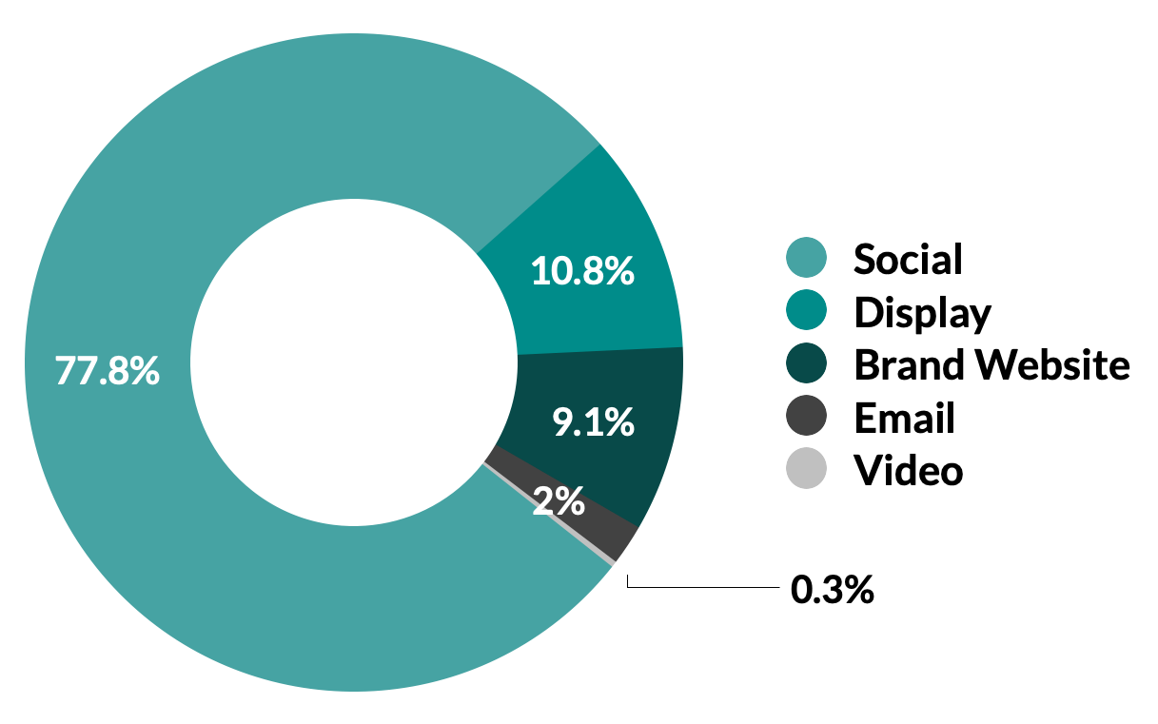
Toy Brands Benchmarks and Insights
*Purchase Intent Clicks
Share of Purchase Intent Clicks by Channel Type
The number of times a shopper has clicked through to at least one retailer during a single session.
Purchase Intent Rate by Social Platform
Meanwhile, in terms of eCommerce shopping traffic for Toy brands, social commerce leads the way with 77.8 percent of Purchase Intent Clicks*. This is largely due to marketers investing most of their advertising dollars into social commerce. Display drives the second most in-market traffic with 10.8 percent. Brand websites come in third at 9.1 percent. Email marketing follows with 2.0 percent of Purchase Intent Clicks, and video rounds out the channels with 0.3 percent.
When looking at social channels specifically, Facebook drives the highest Purchase Intent Rates for Toy brands at 51.1 percent (3x the category benchmark). YouTube follows at 48.4 percent (2.6x the category benchmark). Third is Instagram at 23.1 percent (1.4x the category benchmark). Pinterest and TikTok drive Purchase Intent Rates of 14.8 and 9.1 percent, respectively.

Slide 5
Toy Brands Benchmarks and Insights
How MikMak makes products discoverable
LISTEN HERE
“We have evolved the footprint to such a degree where we are in tourist locations, hospitality locations. We've significantly diversified away from traditional malls in those areas where there are lots of traffic. We're replicating what was truly the original strategy of being in places where people go for fun and entertainment and memory making and family gathering.”
- Sharon John
President & CEO, Build-A-Bear Workshop
MikMak Commerce provides premium consumer shopping experiences that create a seamless path to checkout at any retailer, from anywhere across your entire media mix, including Social Media, Retail Media, Programmatic, Paid Search, CTV, Video, Email, and Brand Websites.

Slide 6
Toy Brands Benchmarks and Insights
Make Your Products Discoverable
Leading toy brand drove purchase intent by leveraging MikMak in a #1 Trending YouTube video posted by a brand partner with 110 Million Subscribers.
67.7%
Purchase Intent Rate
2.3x
Higher Purchase Intent Rate than Toy category benchmark for organic traffic
4x
More Purchase Intent Clicks at Amazon than Walmart

Slide 7
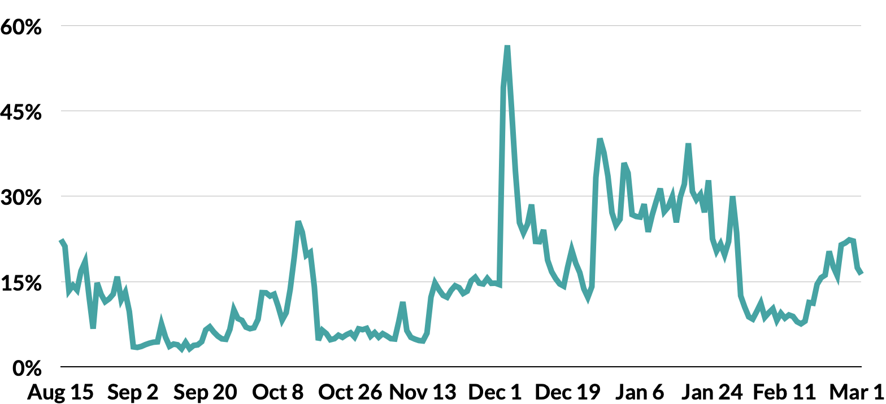
Toy Brands Benchmarks and Insights
Purchase Intent for Toy brands peaks in late spring and summer
For Toy brands, when looking at the past year. As expected, the MikMak Shopping Index saw a peak on December 4th, leading up to the holiday season. However, the highest Purchase Intent Rates in the past year happened on May 9th, reaching 57.5 percent (3.4x the category benchmark). The MikMak Shopping Index shows consistent Purchase Intent Rates throughout May, and then another smaller peak in July.
Accelerate Sales & Market Share
Beat the competition
To effectively grow market share, you must know, compare, and optimize your performance against brands in your category by channel, retailer, and more. You must also understand how performance changes over time.

Slide 8
Toy Brands Benchmarks and Insights
How MikMak creates competitive advantage
LISTEN HERE
With MikMak Benchmark Insights, you can see how your brand stacks up against other brands in your category. More specifically, you can understand your performance and media investment relative to the competition to identify new conversion opportunities and compare your performance over time to quickly understand changes and progress toward your goals.
“I think it all starts with an understanding of the audiences that you have, the passion points that adhere to them and ultimately where do you play within the channel and to best connect with them.”
- Luke Sebire
Head of Global eCommerce Centre of Excellence, LEGO

Slide 9
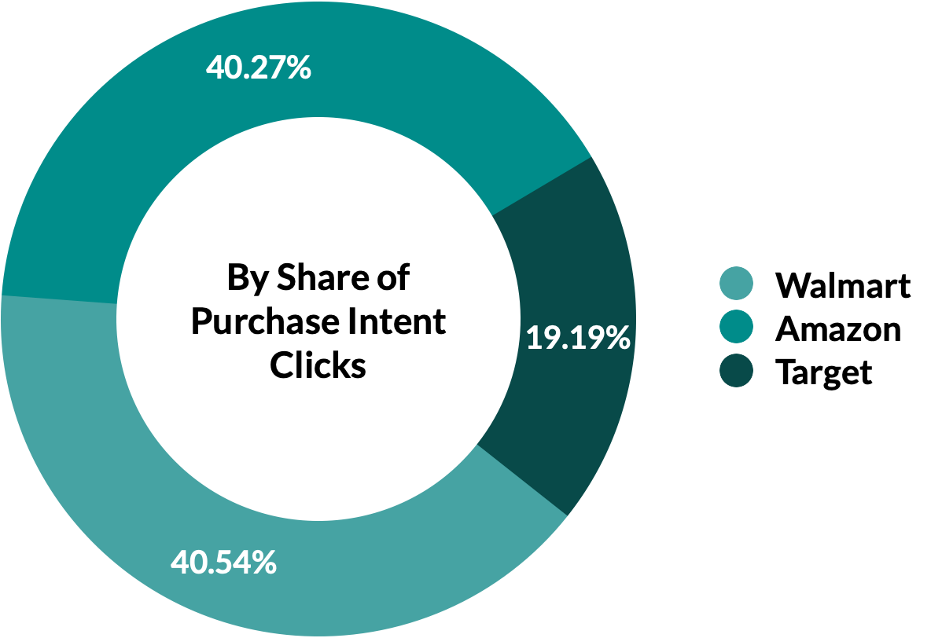
Toy Brands Benchmarks and Insights
Walmart is the top retailer for Toy Brands
Right now, among the Top three Toy retailers, Walmart is driving the most in-market traffic, with 40.5 percent of Purchase Intent Clicks. Amazon is very close behind with 40.3 percent. Target is third with 19.2 percent.
Accelerate Sales & Market Share
Top Three Retailers by Share of Purchase Intent Clicks
Strengthen Retailer Partnerships
Using proprietary, retailer-specific consumer insights in joint planning discussions with retailers can help unlock shelf space and media value.

Slide 10
Toy Brands Benchmarks and Insights
Top 10 Toy Items (by Purchase Intent Rate)
Toy Shoppers are spending an average of $81.41 per order
1 | Fashion Dolls
2 | Toy Gun
3 | Toy Rocket Ship
4 | Food Playset
5 | Magic Potion Play Set
6 | Toy Dog
7 | Read-along Story Play Set
8 | Doll
9 | Stuffed Animal
10 | Rocking Horse
Average Order Value
$81.41

Slide 11
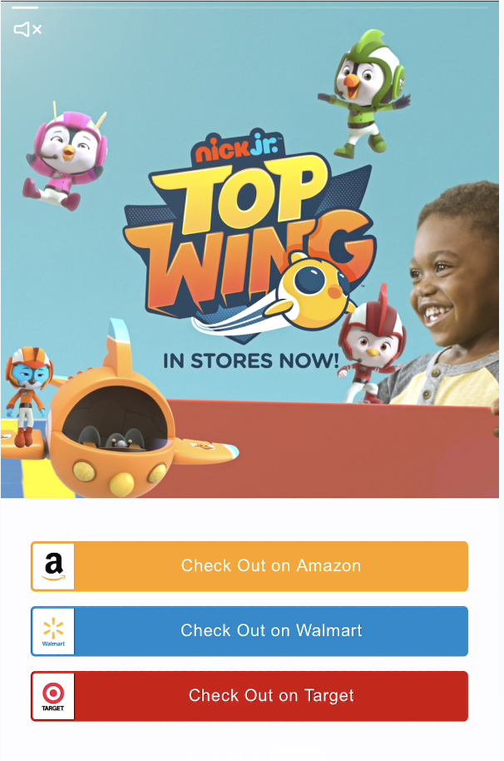
Toy Brands Benchmarks and Insights
Toy Brand Success Story
How MikMak helps brands strengthen retailer partnerships
Leading toy brand identified the best performing channel and retailer mix for a new product line in just weeks, in-turn maximizing marketing effectiveness.
86%
Do you know if your media investment resulted in a purchase? If so, what was in that cart? This is where MikMak Sales Insights’ closed-loop attribution, or the ability to tie granular consumer touchpoints like platform and campaign all the way through to purchase, comes in.
Drive business impact and accelerate your eCommerce growth by gaining visibility into your consumers’ shopping journey, all the way through purchases at select retailers.
Of Purchase Intent generated from YouTube
41%
Of overall Purchase Intent took place at Walmart
Engager Audiences
Used in future campaigns to drive conversion

Slide 12
Toy Brands Benchmarks and Insights
Chicago drives the Highest Purchase Intent Rates By US City for Toy brands
Drive Profitability & Reduce Costs
Improve marketing effectiveness
Do you know where is best to invest your next marketing dollar? First, it’s important to understand the channels, campaigns, creative, and audiences that actually convert.
Top Days of the Week (by Purchase Intent Rate)
Top Hours of Day (by Purchase Intent Rate)
1 | Monday
2 | Sunday
3 | Thursday
4 | Tuesday
5 | Wednesday
1 | 10 AM ET
2 | 11 AM ET
3 | 1 PM ET
4 | 2 PM ET
5 | 3 PM ET

Slide 13
Toy Brands Benchmarks and Insights
LISTEN HERE
How MikMak improves marketing effectiveness
"Gaming, in a digital space, became the new playground. Kids couldn't play together on the physical playground so games became their place to gather and hang out."
"We think of our websites and our direct to consumer channels as part of an overall consumer experience so we have that direct line of communication with shoppers and then we can use that data and experience to better optimize their whole journey with us."
- Laura Henderson
EVP of Marketing, Spin Master
MikMak provides the world’s leading Toy brands with exclusive first-party consumer insights. With MikMak Insights, you can look into your performance from every angle, and dig deeper than other providers

Slide 14
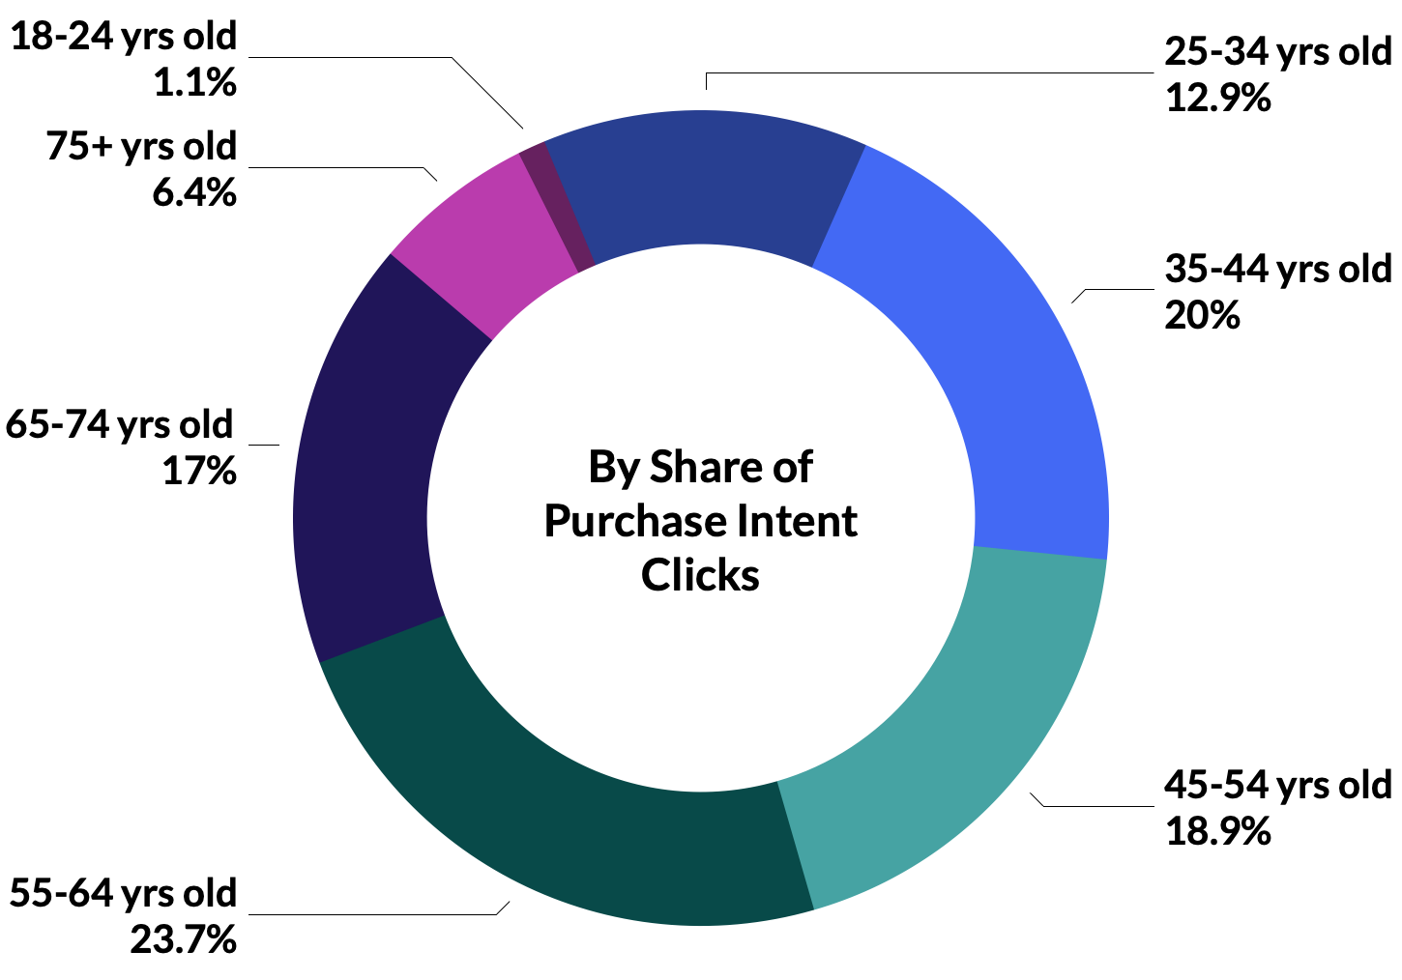
Toy Brands Benchmarks and Insights
Baby Boomers drive the most in-market traffic to Toy brands
Drive Profitability & Reduce Costs
Collect first-party data
Age Ranges by Share of Purchase Intent Clicks
To truly improve performance and lower costs, you must also own and have a consolidated view of your consumer data and audiences.
Households with 1 child are most likely to shop for Toys online.
Purchase Intent Rate by Household Size

Slide 15
Toy Brands Benchmarks and Insights
How MikMak provides first-party data
Use first-party data collected by MikMak Commerce to build and segment qualified shopper audiences within your ads managers/DSP to improve media targeting based on product interest, retailer preferences, and channel behavior. You can also retarget or build lookalike audiences to be leveraged across your entire media plan.

Slide 16
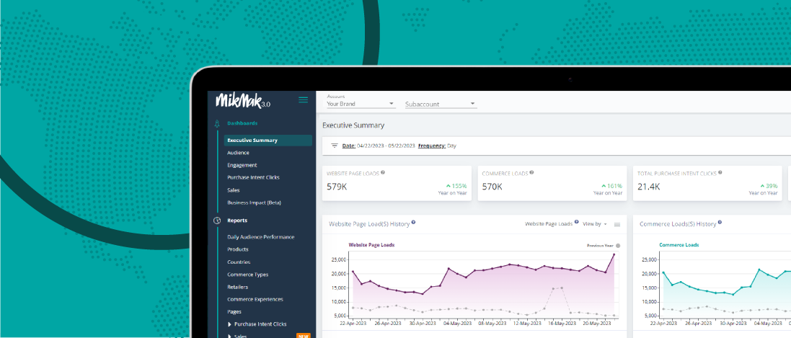
Toy Brands Benchmarks and Insights
Drive Profitability & Reduce Costs
Save time and money
With consistent, real-time reporting and easy access to consumer, retailer, and platform insights, brands’ internal teams and agencies can save a ton of time and money. Couple these insights with best practices, and your team will be sure to gain market share and drive profitability time and time again.
How MikMak saves time and money
MikMak offers one easy-to-use global platform that automatically enables consistent reporting and fast decision-making across the entire organization. With the MikMak Platform, brands can also leverage direct integrations with third-party Product Information Management (PIM) platforms including Salsify and Syndigo; as well as Data Visualization Platforms and Data Lakes like Salesforce and Google Data Studio.

Slide 17
Your eCommerce Marketing Checklist
Get the basics down. Are Facebook, YouTube, and Instagram part of your marketing mix? Are you taking a multichannel approach with multi-retailer checkout? Are Amazon, Walmart, Amazon, and Target in your check-out options?
Develop more nuanced insights for consumer relevance. Is your brand’s website utilizing multi-retailer checkout? Which channels are part of their shopping journey? Add the channels and retailers that resonate with your consumers to the mix. Is retail media included in your media mix? Can you expand to new formats like QR codes and CTV?
Be agile and quick with your data, and use insights to adjust your creative and advertising methods effectively
Explore growth opportunities. Check your performance against category (and subcategory!) benchmarks to see how you stack up against the competition. A/B test creative and messaging to see if purchase intent increases.
We're here to help. MikMak helps multichannel brands gain deeper consumer insights to grow and protect market share. Contact us at marketing@mikmak.com!

Slide 18
All data and insights from this Category Benchmark and Insights are sourced from the MikMak Shopping Index.
Let’s chat!
Want to get even more insights?
Looking for a different category?
Contact marketing@mikmak.com!
The MikMak Shopping Index was developed to provide a standardized set of metrics, methodology, and benchmarks to help drive brands’ business results and strategy. It is a collection of key eCommerce KPIs collected across hundreds of brands and over 250 channels and more than 4,000 retailer integrations to understand consumer online shopping behavior.
All data in this report is from 1/1/22 - 8/15/23.

