Slide 1
2023 eCommerce Guide
YouTube Benchmarks and Insights for Multichannel eCommerce Brands
Subscribe
How MikMak Helps Brands Grow on YouTube, Commerce-First

Slide 2
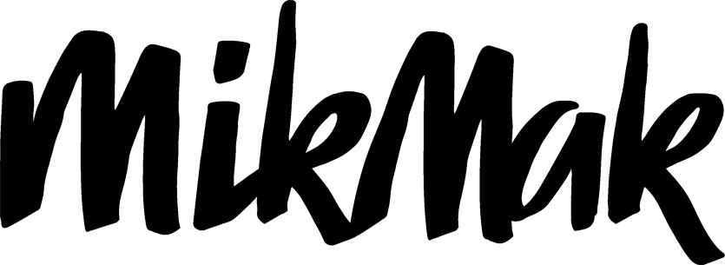
YouTube Benchmarks & Insights Report
*Purchase Intent Rate:
Overview
The percentage of shoppers who clicked through to at least one retailer.
68% of YouTube users watch YouTube to help make a purchase decision
YouTube is a social media and commerce giant that draws in more than 122 million viewers every day. It also opens up major selling opportunities for eCommerce brands, with 68 percent of users saying they watch YouTube to make purchasing decisions.
Wondering how to capitalize on YouTube trends and funnel as many YouTube users to your eCommerce brand as possible? This guide draws on MikMak benchmark data and insights to lay out the latest YouTube shopping trends, along with tips to help eCommerce brands cash in.
Toys are by far the most popular YouTube product category, with a 55.3 percent Purchase Intent Rate* by category
YouTube shoppers are most likely to buy on the weekends, with the Purchase Intent Rate jumping above 9 percent on Saturdays and Sundays

Slide 3
YouTube Benchmarks & Insights Report
What ads perform best on YouTube?
Audiences head to YouTube for “edutainment.” They want to learn and be entertained at the same time. For eCommerce brands, it’s a chance to grab consumers’ attention and show off activities or solutions that feature your products.
Accelerate Sales & Market Share
Make your products discoverable
Enhance viral videos with shoppable experiences
eCommerce brands can amplify their reach by tracking trending videos and jumping on opportunities. For instance, one leading toy brand used MikMak to piggyback on a brand partner’s number one trending YouTube video. The toy brand then saw its:
Purchase Intent Rate hit 67.7 percent
Purchase Intent Rate soar 2.4x higher than the toy category benchmark for organic traffic
Not every brand will bring in and keep the same level of a shopper’s attention on YouTube. To capture views and turn them into sales, brands need to lean into trends and adjust ads to fit the platform.
YouTube has a category benchmark of 7.2 percent Purchase Intent Rate. Purchase Intent Rate describes how many visitors add one or more items to their shopping cart on your site.

Slide 4
YouTube Benchmarks & Insights Report
How MikMak makes your brand discoverable
MikMak Commerce provides premium consumer shopping experiences that create a seamless path to checkout at any retailer, from anywhere across your entire media mix, including Social Media, Retail Media, Programmatic, Paid Search, CTV, Video, Email, and Brand Websites.
On YouTube and other social platforms, MikMak creates a seamless shopping experience while simultaneously collecting impactful insights so you can see how and where shoppers are purchasing your products.

Slide 5
YouTube Benchmarks & Insights Report
Weekends are hot shopping days on YouTube
Traffic surges to YouTube on the weekend, with Saturday and Sunday each at least two full Purchase Intent Rate percentage points above the next best-performing day. Sunday’s PI Rate is 9.2 percent, while Saturday’s is 9 percent. Monday is the busiest weekday, clocking in at a 7 percent PI Rate. Tuesday is next, at 6.2 percent, and Wednesday closes the top five with 5.7 percent.
Accelerate Sales & Market Share
Beat the competition
To stand out on YouTube, eCommerce marketers need to understand how their brand is performing against competitors, track changes in performance, and adjust rapidly. It’s also important to craft entertaining and highly visual content that shows off a product’s value as quickly as possible.
Top Days of the Week by Purchase Intent Rate
Time YouTube ads right for top results
Timing ads right is essential if you want to hit consumers when they’re online, open to messages, and ready to buy.

Slide 6
YouTube Benchmarks & Insights Report
A leading toy brand
When launching a new product line, a top toy brand crafted eye catching ads that targeted YouTube shoppers. The campaign sparked an 86 percent Purchase Intent Rate from YouTube, all in a matter of weeks.
A top healthcare name
When a leading healthcare brand launched shoppable experiences across its media channels, YouTube sales took off. The brand saw Purchase Intent Rates soar 600 percent higher on YouTube than on other channels, and purchase intent increased 106 percent after expanding to the platform.
Learn from high performing eCommerce brands
Here are some examples of high performing brands on YouTube:

Slide 7
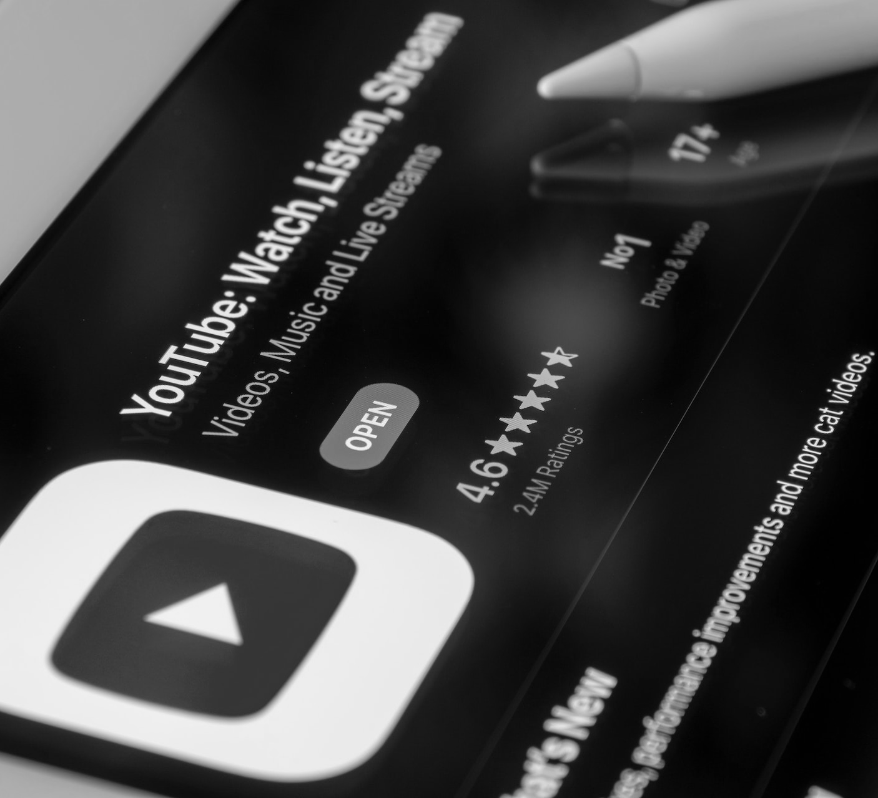
YouTube Benchmarks & Insights Report
How MikMak creates competitive advantage
LISTEN HERE
MikMak Benchmark Insights reveal how your brand compares to other brands in your category. They shine a light on your brand’s performance and how your media investment stacks up against competitors. With these insights in hand, it’s easy to spot new conversion opportunities, adjust to changing trends, and hit your brand’s goals.
“We are shifting to a world where there is more of a partnership between retailers and brands than ever before.”
- Michal Geller
President of eCommerce & Digital, Newell Brands

Slide 8
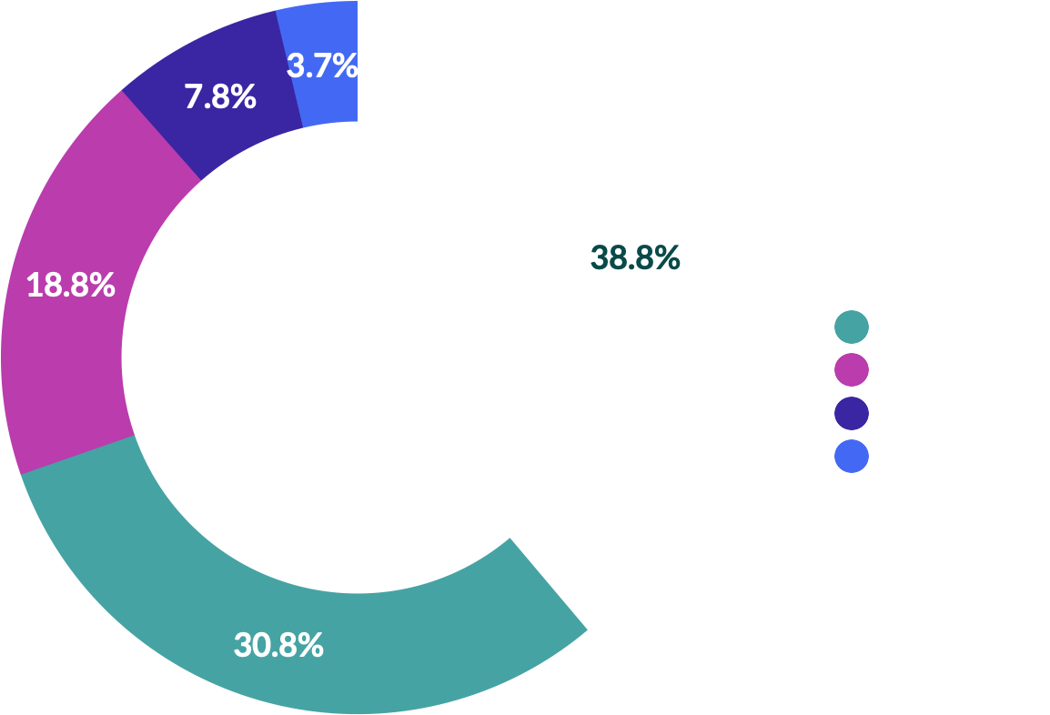
YouTube Benchmarks & Insights Report
Amazon and Walmart lead retailers on YouTube
When looking at Purchase Intent Clicks* among the top five retailers on YouTube, Amazon leads the way with 38.8 percent. Walmart stands in second place with 30.8 percent. In the third slot, with 18.8 percent, Target is the only other retailer hitting double digits.
Instacart and Kroger finish off the top five with 7.8 percent and 3.7 percent, respectively.
Accelerate Sales & Market Share
Strengthen Retailer Partnerships
Top Five Retailers by Share of Purchase Intent Clicks
Strategic retailer partnerships can boost a brand’s sales. When picking out the right retail partner for your brand, it’s important to follow trends and team up with retailers that your audience connects with.
*Purchase Intent Clicks:
The number of times a shopper has clicked through to at least one retailer during a single session.

Slide 9
YouTube Benchmarks & Insights Report
Purchase Intent Rate by Category
Toys are red-hot on YouTube
Toys are dominating all other products on YouTube with a 55.3 percent Purchase Intent Rate. The second most popular category is Beauty, with 5.5 percent. Personal Care slides into the third spot with 5.4 percent, and Groceries are next at 5.1 percent.
Home Care sits in the fifth slot with 4.7 percent Purchase Intent Rate. Alcohol, Health & Wellness, and Pets round out the top eight categories, with 3.9 percent, 3.5 percent, and 3.3 percent, respectively.

Slide 10
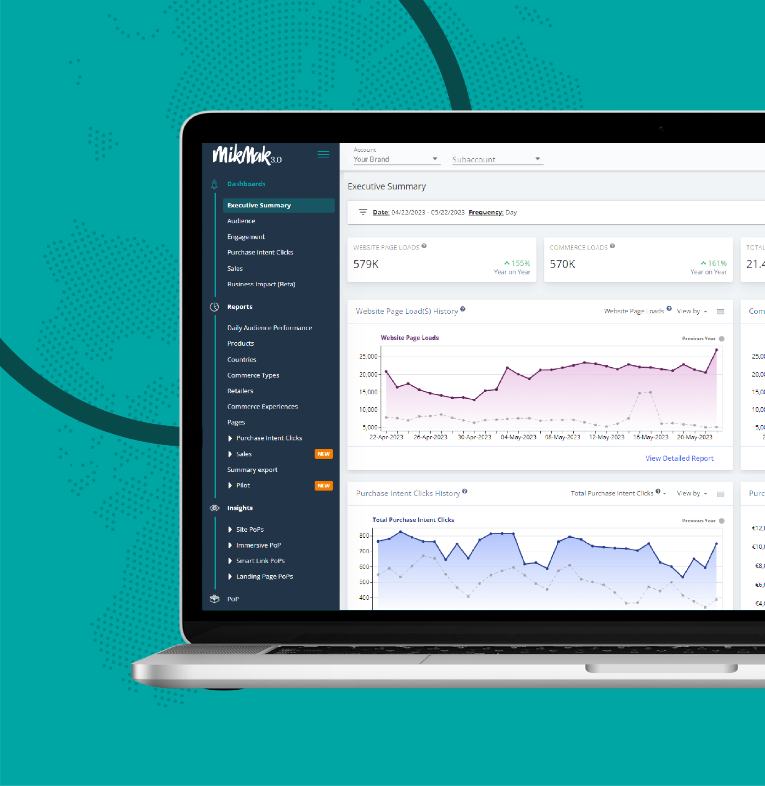
YouTube Benchmarks & Insights Report
How MikMak helps brands strengthen retailer partnerships
Want to see how your media investments are paying off in purchases? Curious about what’s in your shoppers’ carts when they check out? MikMak’s closed loop attribution gives you those important details and more. They zoom in on granular information, so you can see the touchpoints, platforms, campaigns, and behaviors that are driving purchases.
MikMak sales insights showcase your consumer’s full shopping journey so you can speed up your eCommerce brand’s growth.

Slide 11
YouTube Benchmarks & Insights Report
Selling peaks in the early evening
In the early evening, Purchase Intent Rate on YouTube hits its high at 4 p.m. ET (8 percent Purchase Intent Rate). The next highest occurs around 5 p.m. ET, grabbing a 7.8 percent rate. Next is 11 a.m. ET, with a 7 percent Purchase Intent Rate. The next hottest times are 12 p.m. ET and 6 p.m. ET, with respective rates of 6.9 percent and 6.8 percent.
Drive Profitability & Reduce Costs
Improve marketing effectiveness
Top Hours of the Day by Purchase Intent Rate
Maximizing marketing ROI
It’s not enough to just feature your brand on YouTube. To maximize ROI, eCommerce brands need to understand which audiences will buy and when to hit them with key messages.

Slide 12
YouTube Benchmarks & Insights Report
How to build eye catching ads on YouTube
YouTube is a highly visual platform where shoppers seek learning and entertainment. That means eCommerce ads need to grab their attention and keep them locked onto the product. Here are a few best practices for YouTube marketing:
Drive Profitability & Reduce Costs
Save time and money
Use sharp Images, quick cuts, and bright visuals
Looking for the key to saving time and money when marketing for brands on YouTube? Start by tracking real time reporting and monitoring consumer, retailer, and YouTube insights. Then use best practices to create ads and hit YouTubers with the right message, at the right time, to grab more market share.
Show off a product’s benefits right away
Introduce new activities, recipes, and uses for products
Drive engagement with long-form content, such as tutorials or product reviews

Slide 13
YouTube Benchmarks & Insights Report
How MikMak saves time and money
MikMak features an intuitive global platform that generates automatic reporting and enables leaders across the organization to make smarter decisions more quickly MikMak’s platform also integrates easily with product information management (PIM) platforms, such as Salsify and Syndigo, along with popular data visualization platforms and data lakes such as Salesforce or Google Data Studio.

Slide 14
Your eCommerce Marketing Checklist
Get the basics down. Is your brand utilizing YouTube to its fullest potential? Are Amazon, Walmart, Target, Instacart and Kroger all available in your checkout options?
Develop more nuanced insights for consumer relevance. Is your brand’s website utilizing multi-retailer checkout? Which channels are part of their shopping journey? Add the channels and retailers that resonate with your consumers to the mix. Can you expand to new formats? Are you engaging with and utlizing viral videos and influencer marketing as part of your strategy?
Be agile and quick with your data, and use insights to adjust your creative and advertising methods effectively
Explore growth opportunities. Check your performance against category (and subcategory!) benchmarks to see how you stack up against the competition. A/B test creative and messaging to see if purchase intent increases.
We're here to help. MikMak helps multichannel brands gain deeper consumer insights to grow and protect market share. Contact us at marketing@mikmak.com!

Slide 15
All Data and Insights from Social Channel Benchmark Reports Are Sourced from the MikMak Shopping Index
Let’s chat!
Want to get even more insights?
Looking for a different social channel?
Contact marketing@mikmak.com!
The MikMak Shopping Index was developed to provide a standardized set of metrics, methodology, and benchmarks to help drive brands’ business results and strategy. It is a collection of key eCommerce KPIs collected across hundreds of brands and over 250 channels and more than 4,000 retailer integrations to understand consumer online shopping behavior.
All data in this report is from 9/28/22 - 9/28/23.

