Slide 1
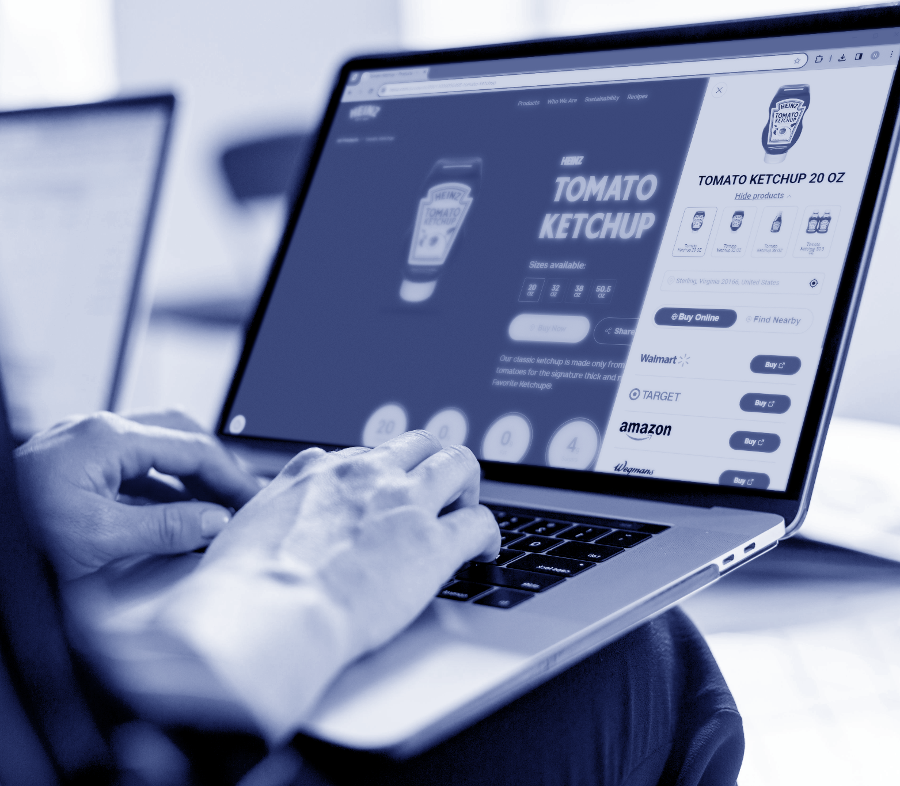

How to Accelerate Sales
with Where-to-Buy Solutions
on Brand Websites
Best Practices for Multichannel Brands

Slide 2

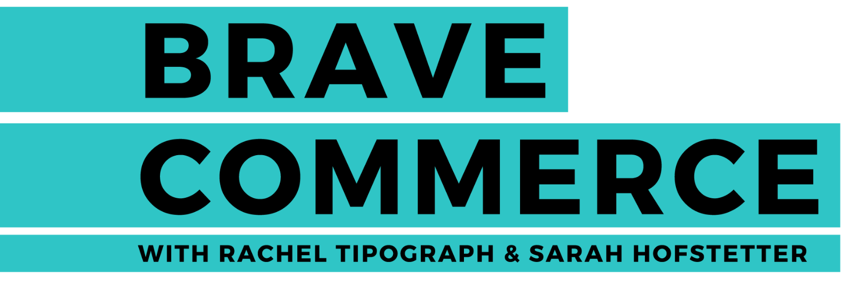


Introduction
Brand websites rank among the Top 5 places for pre-purchase research, with 56 percent of shoppers visiting them to gather information about products they consider buying. While most brands have a website, many only showcase their products, setting up a conversion dead-end.
The Direct-To-Consumer (DTC) eCommerce approach isn’t suitable for all brands, as many rely heavily on retailer partners. It’s also becoming increasingly evident today that the DTC-only model has passed its peak. Multichannel brands require alternative methods to capture consumer behaviors and preferences.
Where-to-Buy solutions like MikMak Commerce for Brand Websites can enhance shopping experiences by directing shoppers straight to checkout at retailers, both online and in-store. This solution also enables you to monitor your brand website audience’s preferences, providing invaluable insights to optimize marketing for both loyal and new customers.
In this guide, we have compiled best practices, creative examples, and insights from industry-leading brand partners of MikMak, demonstrating how implementing a Where-to-Buy solution on your brand website can improve marketing effectiveness, and accelerate sales.
LISTEN NOW
“DTC is much harder today than it was a few years ago, with all the different changes in technology and privacy policies. Our strong belief today, at least for the type of brand we are running, is that you must have a strong retail partner, and you cannot really do it on your own.”
- Julien Bouzitat, General Manager

Slide 3

4 | What is a Where-to-Buy solution?
5 | Why use Where-to-Buy on your Brand Websites?
10 | How to choose your Where-to-Buy solution provider
12 | Creative Best Practices
21 | Evaluating Where-to-Buy performance
24 | Why choose MikMak Commerce for Brand Websites?
29 | Conclusion
30 | Recommended Reading
Table of Contents

Slide 4

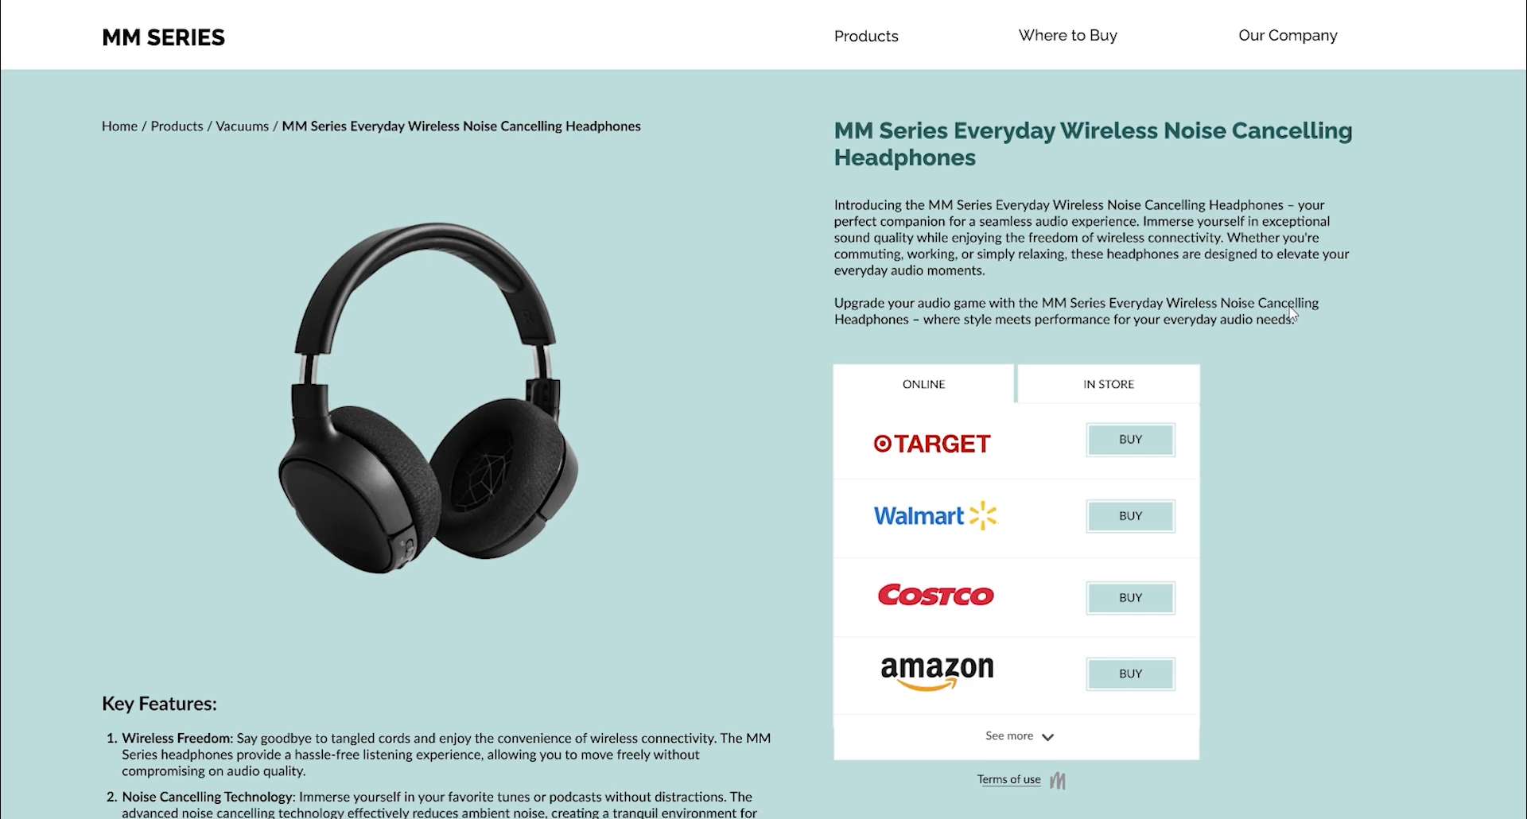

What is a Where-to-Buy solution?
1. User taps on ‘Where-to-Buy’ call-to-action
A ‘Where-to-Buy’ solution is a technology that brands can integrate into their websites to facilitate purchases from the brand’s retailer partners. This technology enables on-site eCommerce, even for brands without a Direct-To-Consumer (DTC) shopping site. At MikMak, we refer to this solution as MikMak Commerce for Brand Websites - a multi retailer eCommerce enablement Where-to-Buy solution. It dynamically displays retailers for both online and in-store shopping based on user location and product inventory availability, thereby helping brands accelerate sales.
A Where-to-Buy solution can take the form of a ‘buy now’ button or it can be embedded directly into a webpage, allowing shoppers to seamlessly choose their preferred retailer and proceed to checkout. We will illustrate various ways to implement a Where-to-Buy solution in the following chapters. Here’s a brief example of how it works from a consumer’s perspective:
2. Online and In-Store (optional) retailer views are displayed based on user location
3. User selects retailer and initiates checkout

Slide 5

1. Generate incremental sales with seamless shopping experiences
The fewer obstacles that stand between your consumers and checkout, the more often they’ll buy. 66 percent of online shoppers say convenience is the biggest reason they pick a retailer.
With a Where-to-Buy solution, your brand clears the path to purchases and saves shoppers an extra Google search.
This also reduces the risks of shoppers encountering competitor ads. Where-to-Buy solutions offer a direct path to checkout, free from external messages or distractions.
Why use Where-to-Buy on your brand websites?
Where-to-Buy solutions allow multichannel brands to make their products discoverable, and help shoppers find and buy their products faster, online and in-store. Here are 5 ways Where-to-Buy solutions give brands an edge:
“A big cultural change over the last few years is that customers now demand and are willing to pay for convenience above all else.”
- Darren MacDonald, Chief Customer Officer
LISTEN NOW

Slide 6
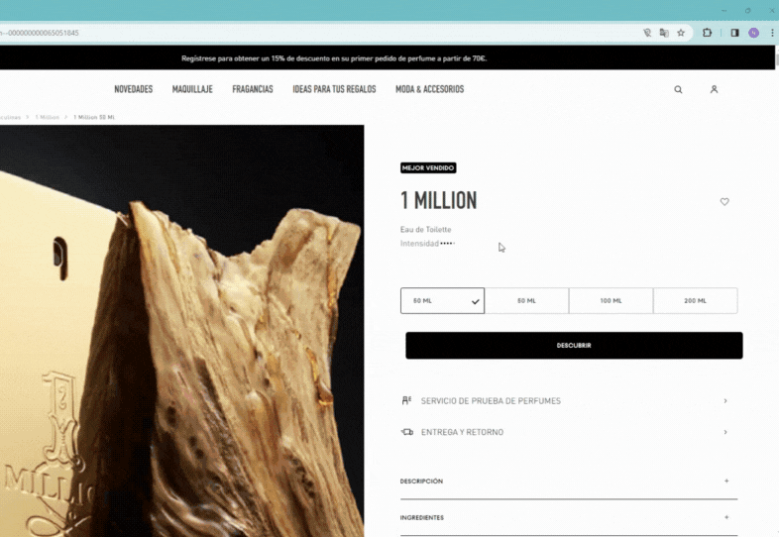
2. Give your shoppers more options
Consumers appreciate having options. By offering multiple checkout choices, brands empower consumers with the freedom to purchase where they prefer. Even if your brand directly sells to consumers, it's beneficial to provide visitors with the opportunity to buy from their preferred retailer or platform.
Why use Where-to-Buy on your brand websites?
How Paco Rabanne accelerates sales on both its DTC store and retailers
Paco Rabanne Spain allows shoppers to choose the most convenient purchasing option based on their preferences. The brand offers website visitors the choice to buy from its own DTC store, online retailers, or locate the nearest physical stores. All options and product variants are easily accessible within a single user interface, ensuring a seamless shopping experience.

Slide 7
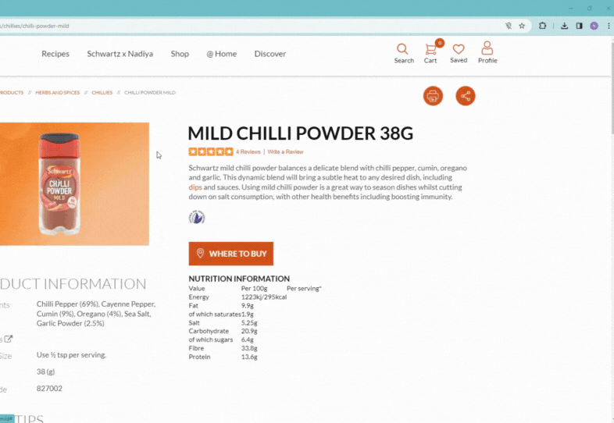
3. Keep selling when stock runs out
Selling Direct-To-Consumer (DTC) always carries the risk of running out of stock. Without a backup option, shoppers might turn to competitors. According to Statista, brands lose an estimated $71.4 billion annually due to shoppers seeking out-of-stock products elsewhere. Where-to-Buy solutions provide brands with a backup plan. When stock runs dry, shoppers can still purchase your products through other retailers.
Why use Where-to-Buy on your brand websites?
How Schwartz uses Where-to-Buy to avoid out-of-stock experiences
On the Schwartz UK website, consumers can purchase products directly from the brand's DTC store. However, when a product is out of stock, a Where-to-Buy option is automatically presented, redirecting website visitors to retailers with available products online and in-store, based on the shopper's geographic location.

Slide 8
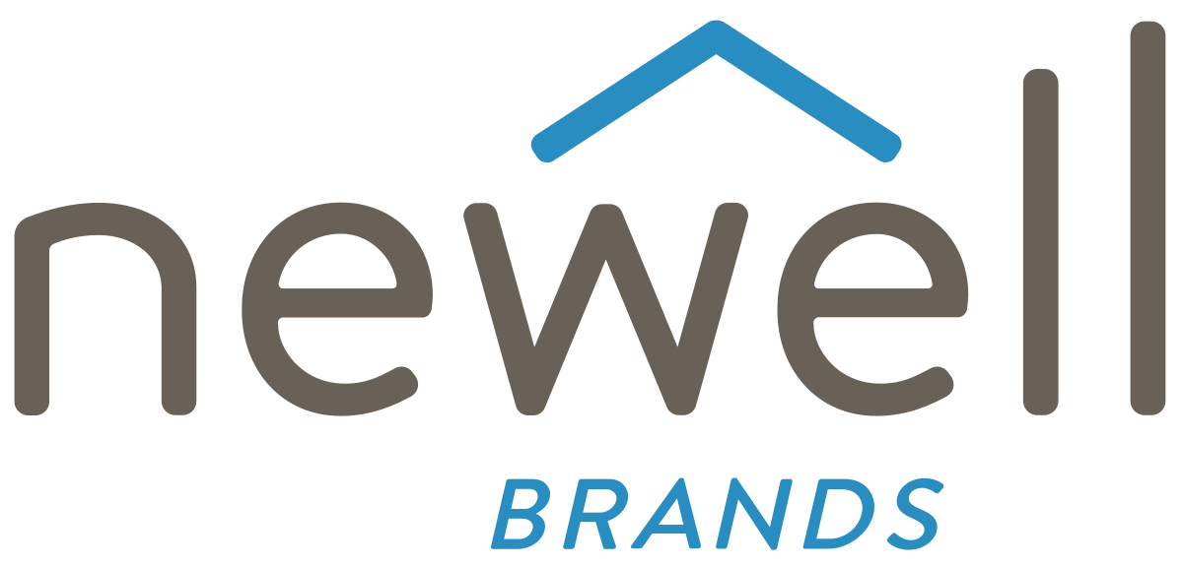
4. Strengthen retailer partnerships
Negotiating with retailers can be challenging, but Where-to-Buy solutions can tilt the scales in your favor. By providing evidence of actively driving sales for them through collected data, you strengthen your brand's value proposition to retailers.
Why use Where-to-Buy on your brand websites?
“We’ve got to get to where the brands and the retailers are on the same side. We’re trying to find consumers, get them the right product for the right price, and make profitable businesses on both sides.”
- Michal Geller, President of eCommerce & Digital
LISTEN NOW

Slide 9


5. Gain actionable insights about your audience with first-party data
When shoppers click through to retailers from your site through a Where-to-Buy solution, you also gather valuable behavioral data. By determining the products and retailers your buyers prefer, you can identify marketable groups and target them with messages tailored to highlight their preferences.
Why use Where-to-Buy on your brand websites?
“MikMak enables us to create seamless shopping paths for our audiences on our brand websites and social media, while measuring purchase intent and sales at our retailers. With key insights into shopper preferences, we can optimize our digital marketing strategy."
“Since the impressively efficient implementation of MikMak on our brand website, we've achieved remarkable results with optimized sales strategies thanks to tracking and analyzing the shopper traffic we generate to our multi-retailer partners.”

Slide 10
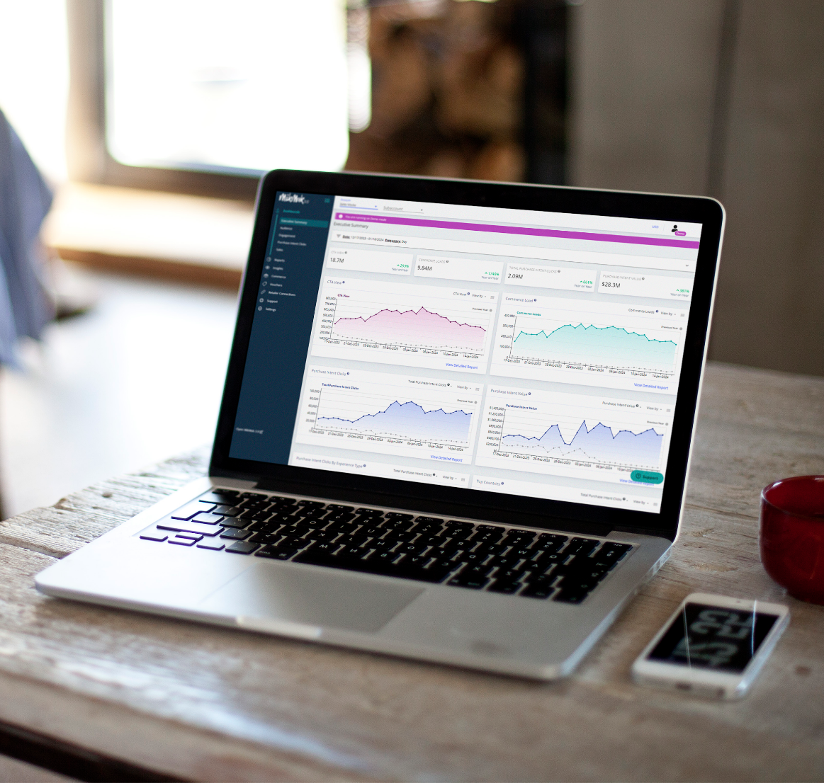
How to choose your Where-to-Buy solution provider
Once you understand the benefits of Where-to-Buy solutions for your website, how do you choose the right technology? Depending on your company's decision-making processes, in addition to peer recommendations, case studies, and market research, you may want to conduct a thorough RFP (Request for Proposal) to study different solutions. To assist you in this endeavor, here are a few key considerations from our recent guide on preparing an RFP to evaluate and select the optimal Shoppable Media and Where-to-Buy solution for your business.

Slide 11

Specify Evaluation Criteria - Your Priorities
Insight into how your company will be grading vendors provides transparency into the process and lets vendors know what the company's priorities are. Knowing how you will be scoring the RFP also allows vendors to cater their RFP to your specific goals.
Examples of areas that can be involved in the evaluation process include:
Best fit out of the box - which vendor checks the most boxes on your feature requirements
Managed services - what is the vendor’s managed services model? How do they provide support to your company?
Cultural fit - How does the vendor align with your company’s goals and values?
Pricing - Is the price within the budget?
Asking the right questions upfront can save your business time and resources in your eCommerce strategies and help you achieve your goals more efficiently. As the digital landscape evolves rapidly, it's also essential to consider the potential for evolution with your Where-to-Buy service provider. This adaptability will enable you to stay agile and adjust to shifting trends.
List Problems You’re Looking to Solve - Your Objectives
A shared understanding of the business problems you’re looking to solve and your goals between you and the vendor you select will go a long way toward establishing a successful relationship.
We recommend stating a business problem followed by a list of supporting questions that will help identify the vendor best suited to help you achieve your goals.
Define Feature Requirements - Your Needs
List feature requirements in a quadrant of must have - should have - could have - and should not have. This provides vendors with an easy understanding of your requirements and helps identify which vendor most meets your needs.

Slide 12
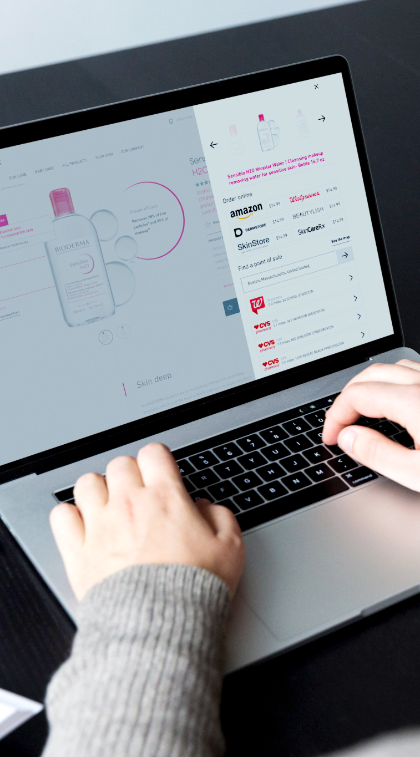
Creative best practices: MikMak Commerce for Brand Websites
When it comes to determining the most effective creative layout and Where-to-Buy solution template, there are no one-size-fits-all solutions. The choices should align with your brand’s unique goals. Once you've established your key success criteria, it's crucial to act swiftly, engage in testing and learning, and remain adaptable.
With MikMak Commerce, you can achieve all of this seamlessly. We offer a streamlined integration process, complete with templatized UX options, to easily incorporate our Where-to-Buy solutions into your brand website. This allows you to quickly start accelerating sales by providing frictionless, convenient shopping experiences for your consumers.
You have the flexibility to choose how to display your Where-to-Buy solution: as a pop-in window upon clicking a CTA button, on specific landing pages, integrated directly onto your PDPs (product detail pages), or a combination thereof. MikMak provides a variety of pre-built templates that are simple to implement and customize to match your brand's aesthetic. Here are a few best practice tips, along with examples from MikMak's clients, to help you get started.

Slide 13

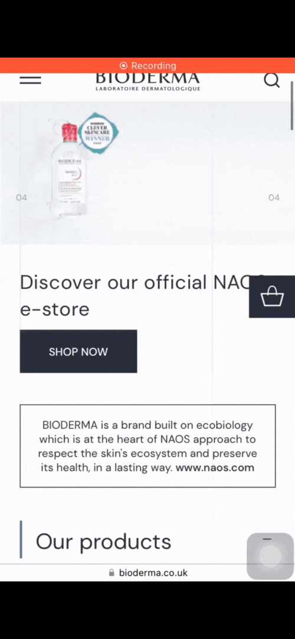
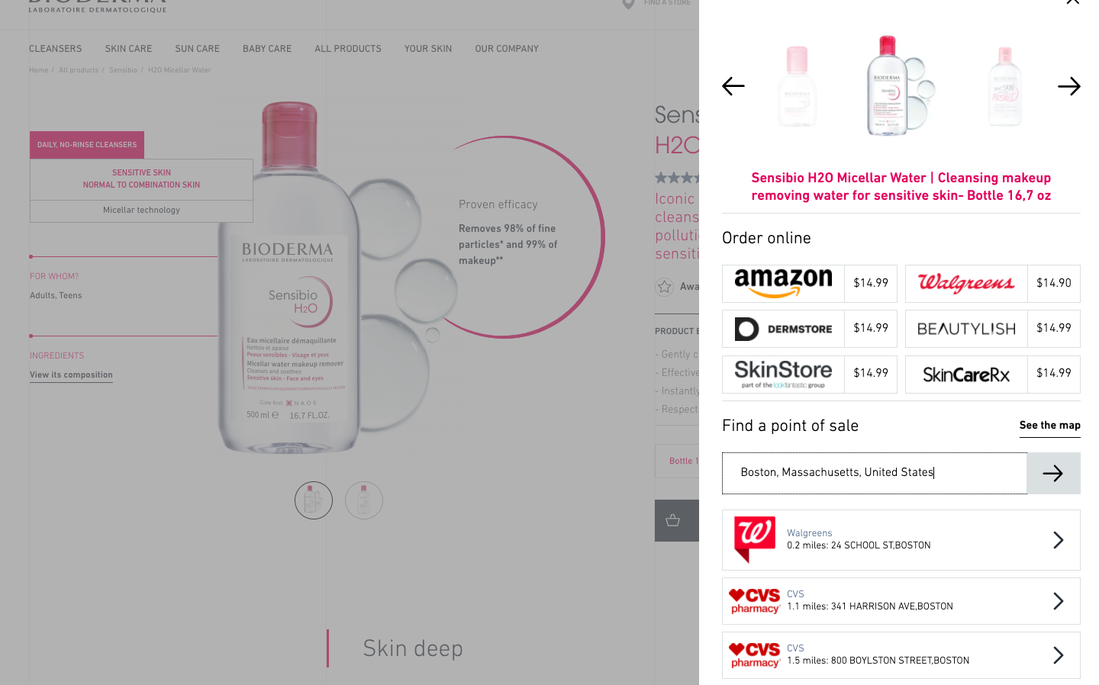
1. Simplify Checkout
Use a clear CTA like ‘Buy now’, and make it visible on all your product pages and other pages with high traffic.
Purchase options available with an always-on CTA
On the website of the dermo-cosmetics brand Bioderma, a 'sticky' shopping basket button remains visible as users browse, ensuring that purchase options are always accessible on product pages. When clicked, the Where-to-Buy solution opens like a 'drawer', displaying the visited page in the background when accessed from a desktop. Bioderma US has opted to include prices from various retailers within the solution to assist shoppers in their decision-making process. In other countries, different strategies have been implemented based on what proves most effective in their respective local markets.
Bioderma incorporated MikMak Commerce on its websites and social media to provide a frictionless path to purchase across 32 countries.
+126%
Increase in Purchase Intent Clicks
from 2022 to 2023
+109%
Increase in Purchase Intent Rate
from 2022 to 2023
19.6%
Of Purchase Intent Clicks show
offline purchase intent interest
READ CASE STUDY

Slide 14
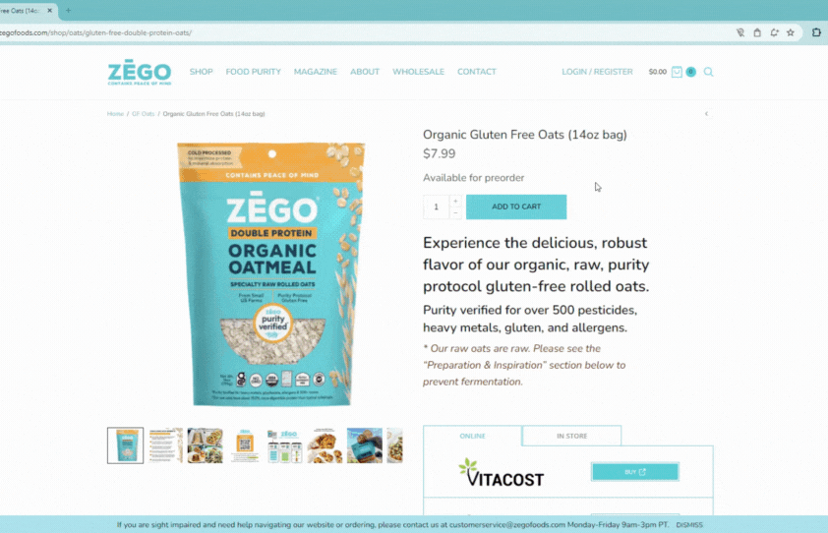

2. Increase Convenience
Let your shoppers complete their purchase at any of their preferred retailers - in addition to your DTC store (if you have one).
Driving sales wherever the consumers prefer to shop
ZEGO food brand caters to diverse consumer shopping preferences by seamlessly integrating the Where-to-Buy solution onto their Product Detail Pages (PDP). This allows consumers who prefer not to purchase directly from their e-shop to conveniently explore and select from available online retailers or locate nearby physical stores offering their products.
LISTEN NOW
"I realized along the way that nothing's changed over the past 23 decades, in the sense that you're following a shopper. You're meeting a shopper where they want to engage, where they want to find your products."
- Eric Tarnowski, Vice President,
Connected Commerce

Slide 15
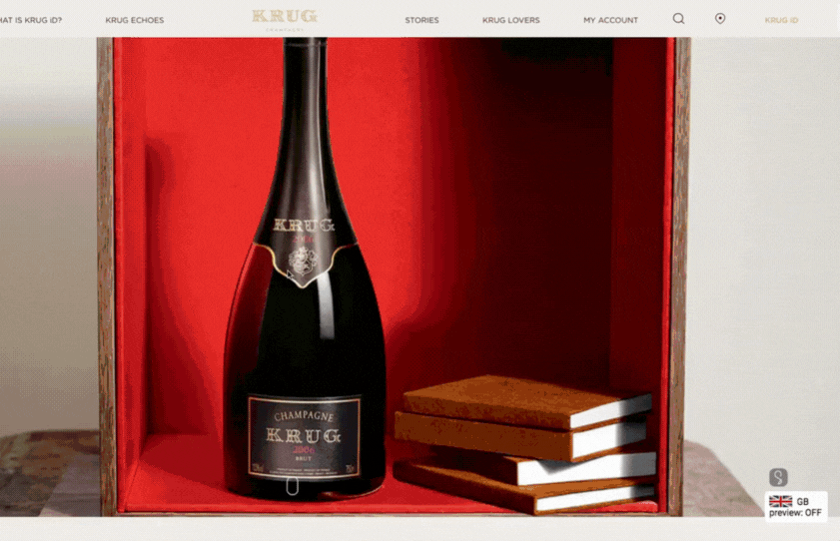
3. Reduce Clicks
Display both online and in-store checkout options within one user interface/design. You can make the checkout options quickly accessible from any page via a sticky ‘Buy now’ CTA button that is always on. You can also embed your Where-to-Buy solution directly into your product pages, to display it instantly, thereby further shortening the path to purchase.
Some brands enhance these methods by providing a dedicated Where-to-Buy page on their website, showcasing their product catalog with advanced filters. This allows visitors to easily select product types and variants, and view available checkout options for their chosen items. The page can also be used as a destination to redirect consumers from marketing campaigns to a shop-alike environment on your website.
Letting shoppers find and buy your products faster
The Krug champagne brand ensures that visitors to their website can access shopping options, in one click, and get redirected to online retailers or guided to nearby stores based on geographic location. The Where-to-Buy solution seamlessly integrates the brand's visual identity, providing customers with a smooth and immersive shopping experience.

Slide 16
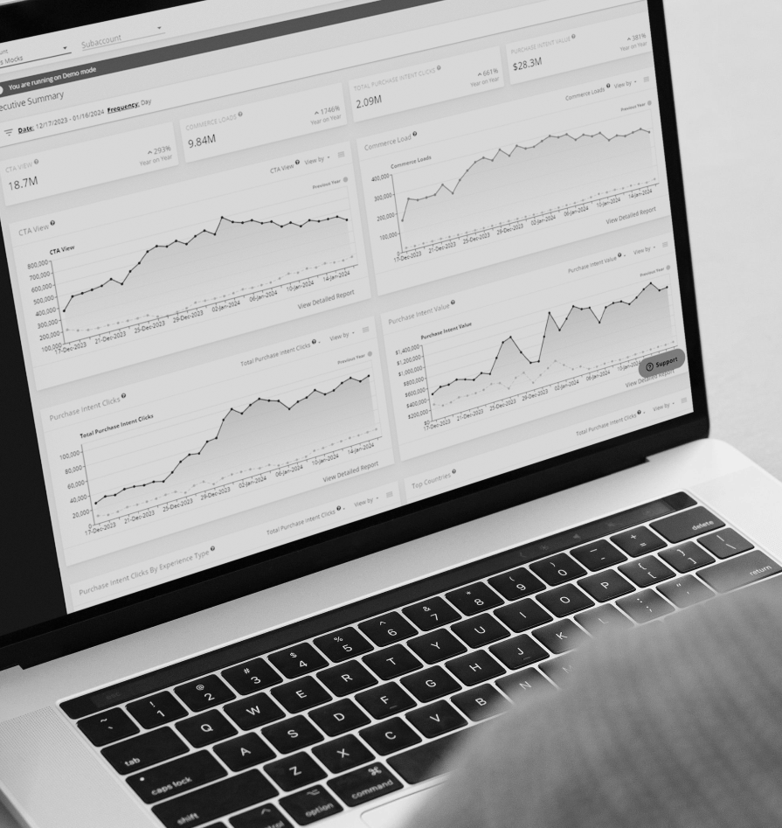

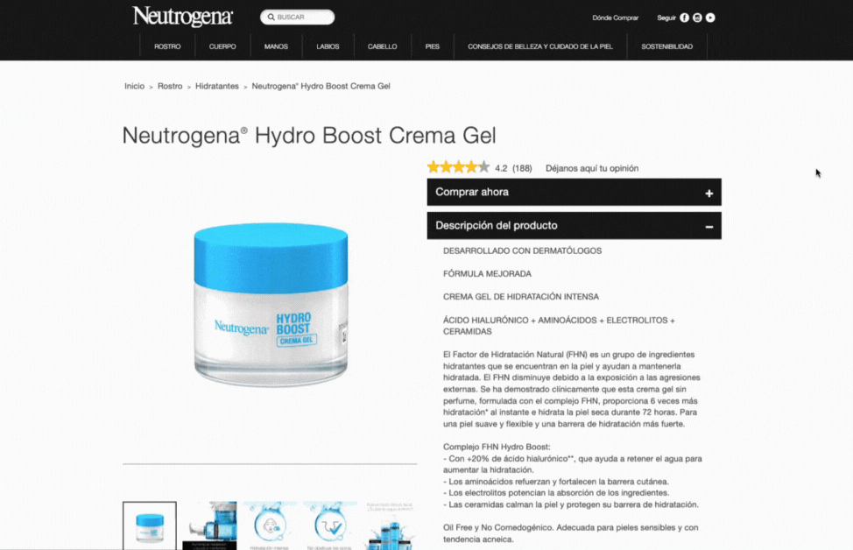
Accelerating checkout from product detail pages
On the product pages of Neutrogena skincare brand in Spain, consumers immediately visualize different shopping options. Visitors have the choice to check out with online retailers or use a separate tab to locate the nearest offline stores.
Hot tip:
To boost conversions on your website, consider combining three methods to access Where-to-Buy purchase options. With MikMak Commerce you can: Implement an always-on CTA, embed a Where-to-Buy solution on your product detail pages, and create a dedicated Where-to-Buy shopping page with product category filters. Each method offers unique advantages, and by integrating them, you can maximize the benefits.

Slide 17

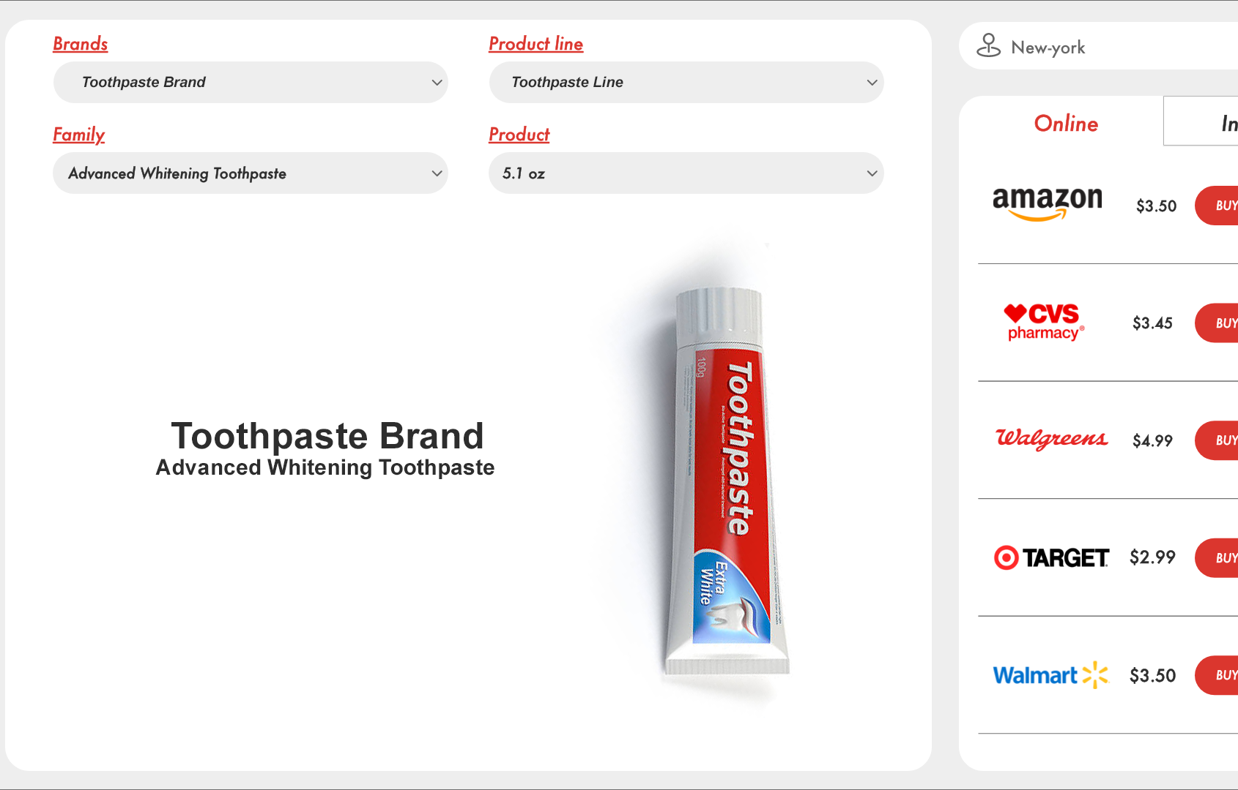
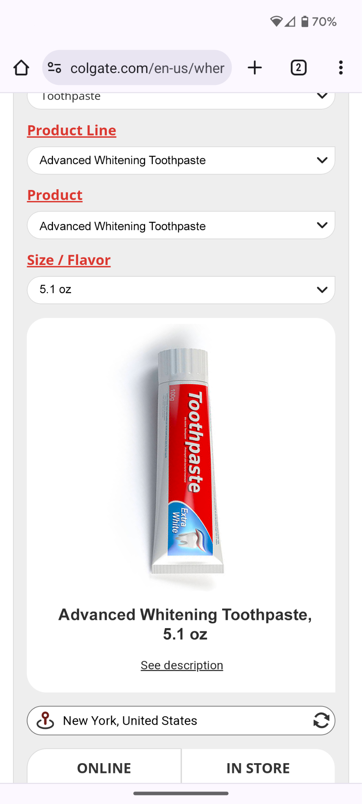
Enhanced filters to let consumers easily find and shop specific product types or variants
An Oral Hygiene brand increased purchase intent and conversions by leveraging MikMak 3.0 on its brand website to quickly and easily allow shoppers the ability to filter and search their entire product portfolio.
1.9x
Higher Purchase Intent Rate on MikMak 3.0 Commerce for brand website compared to the MikMak brand website benchmark
4. Personalize Selection
Use product filters and carousels to make specific categories, variants and related products easily discoverable and available to interested shoppers.
9x
Higher Conversion Rate on MikMak 3.0 Commerce for brand website than the industry benchmark according to Shopify
1k+
SKUs discoverable from a single MikMak Commerce for brand website experience thanks to enhanced filters

Slide 18

Testing & Learning
As mentioned earlier, there is no one single answer to determining the optimal creative layout for Where-to-Buy solutions. However, what is crucial is ensuring a smooth customer journey and avoiding any broken user experiences that may lead consumers to dead-ends. Success hinges on constantly monitoring your results and utilizing insights to optimize strategies, from marketing tactics to collaborative planning with retailers.
Many industry-leading brands using MikMak conduct A/B tests, leveraging our analytics to identify approaches that yield the best results in enhancing performance. We've selected a few examples for your inspiration.
Make your products discoverable
Use Case 1: A/B testing Evergreen content vs Seasonal hits
A global Beauty brand conducted A/B testing to compare the performance of evergreen content with holiday-specific creative and messaging in the US market. Surprisingly, MikMak analytics revealed that the brand's evergreen content achieved significantly higher Purchase Intent Rates and outperformed their seasonal campaign.
MikMak Insight: Successful A/B testing can bring a 50% increase in the average revenue per unique visitor for eCommerce

Slide 19


Improve marketing effectiveness
Use Case 2: Multi-Retailer eCommerce enablement drove 2X more Purchase Intent
A global Personal Care Brand in Australia expanded their retailer redirection options on their website from 1 to 4 within their MikMak Commerce Experience. This led to a doubling of Purchase Intent Clicks without any increase in traffic. Consequently, the brand's Visitor Conversion Rates also increased by up to seven percentage points.
Accelerate sales
Use Case 3: 2X more transactions with MikMak’s in-page Commerce Experience
A global leader in CPG tested two different options of Where-to-Buy on their websites across several brands. MikMak's analytics revealed that the MikMak Commerce Experience with an in-page layout reduced clicks and recorded up to a 55% increase in Where-to-Buy performance, resulting in a doubling of transactions compared to their previous solution. As a result, they swiftly adopted MikMak's solution, which they could embed directly on any of their Product Detail Pages.
MikMak Insight: 41% of cart abandonment can be tied to a retailer preference. Offering multiple retailer options allows you to cater to more shopper preferences, to increase your chances of conversion.
MikMak Insight: Frictionless path to purchase and reducing the number of clicks needed to access purchase options critically reduces shopper frustration and accelerates sales conversion.

Slide 20

Save time & money
Use Case 4: Incremental sales avoiding out-of-stock experiences
Vitamin and supplement brand Olly facilitates the sale of out-of-stock products on their website through third-party retailers. When shoppers come across an out of-stock product, instead of an ‘add to cart’ button, they will see a ‘where to buy’ button that loads MikMak Commerce, showing online and in-store purchase options based on the shopper’s geolocation. This also allows Olly to capture first-party data on the shoppers interacting with out-of-stock products. Olly gets valuable insights into the performance of enabling sales on out-of-stock items and the shopping preferences of their consumers.
READ CASE STUDY
MikMak Insight: Don't leave your shoppers empty-handed, or worse, risk losing them to your competitors! If your DTC store is out of stock but your retailers have your product on their shelves, Where-to-Buy ensures a seamless path to purchase. This ensures your customers receive a great user experience on your brand website, whether they buy the product from your eCommerce platform or your retailer partners.

Slide 21
Evaluating Where-to-Buy performance
Purchase Intent Clicks:
The number of times a shopper has clicked through to at least one retailer during a single session
How do you evaluate your Where-to-Buy solution's performance? Start by defining your key goals. Determine if you aim to enable global or local eCommerce options, streamline customer journeys, boost sales with specific retailers, or support your DTC store to prevent out-of-stock experiences, and other objectives.
Setting clear goals guides implementation, creative layout, feature selection, and KPI metrics. At MikMak, we track various KPIs, offering insights into consumer activity, preferences, and conversions across retailers, products, traffic sources, and more. Our easy-to-use reporting dashboard provides detailed analysis and comparison, ensuring effective monitoring of customer journey data. Here’s a glimpse at a few metrics we monitor, to give you an idea:
Transactions:
The number of attributable, unique orders that occurred within the retailer-defined attribution window
Total Basket Attribution Sales:
The total tracked sales value from transactions that occurred within the retailer-defined attribution window
Online Sales Estimation:
A projection of total expected sales based on a model that uses various sales data points gathered from MikMak Commerce experiences
Purchase Intent Value:
When clicking through to a retailer, the potential dollar value of the product selected by a shopper if every click resulted in a transaction

Slide 22

Measure your conversion funnel from traffic sources to destination
On brand websites, Purchase Intent Rates*, indicating how likely consumers are to purchase at your retailer sites, are usually much higher than on media. This is logical because consumers visiting brand websites are already more qualified, and particularly interested in your brand. Media campaigns have a higher reach in the upper marketing funnel, but direct conversion rates are often lower. You can check some of MikMak’s Benchmarks from your sector to get more insights.
The performance and conversion through a Where-to-Buy solution depend on multiple factors and how your marketing activities evolve. The most critical factor is the source and quality of the traffic being driven to it. Monitoring your website visitor behavior from source to conversion is therefore important. This will allow you to identify where, when, and how your key audiences interact with your brand, and build look-alike audiences to widen your reach of potential customers.
How you implement your Where-to-Buy solution on your brand website also impacts results. For instance, ensuring that your 'Buy Now' CTAs are visible and easily accessible on product pages and listings with high traffic will increase the likelihood of shoppers engaging with your Where-to-Buy service.

Slide 23
Average Purchase Intent Rate 2024
Make sure to compare apples to apples
Performance can vary by sector, product category, and region. It's important to note that when selecting a Where-to-Buy solution, KPI metrics may differ among service providers. According to the MikMak Shopping Index, the average Purchase Intent Rate*, Year-over-Year (YoY), for all sectors is currently 15% on brand websites and 4% on media. However, some brands achieve significantly higher rates, irrespective of sector, based on their marketing strategies and optimization capabilities.
Brand websites
15%
Media
4%
As a general observation, products with a higher purchase value (i.e., more expensive) and lower purchase frequency, such as Fragrances, Consumer Electronics, Home Appliances, and Toys, tend to exhibit higher Purchase Intent Rates compared to consumables that are frequently repurchased, such as Food & Beverages and CPG products. When purchasing more expensive, long-lasting products, consumers often conduct more research and comparison on brands' websites than for their day-to-day essentials. For instance, this year, the MikMak Shopping Index recorded an average Purchase Intent Rate of 41 percent in the Beauty sector.
However, this is by no means a reason for CPG brands to overlook their website visitors regarding purchase paths. The competition is fierce, and if you've successfully engaged your audience through marketing efforts, it's essential to ensure they can easily find and purchase your products without losing track, whether on your brand website or other digital touchpoints. Leveraging insights from collected first-party data from your brand website visitors is crucial for optimizing your marketing strategies and expanding your reach to similar customer profiles.
*Purchase Intent Rate:
The percentage of shoppers who clicked through to at least one retailer

Slide 24


Why choose MikMak Commerce for Brand Websites?
“MikMak has been an instrumental partner throughout our digital transformation, especially across the IT, Marketing, Product, and eCommerce teams here at Mark Anthony Group. We’re an agile organization that moves fast, so one of the main reasons we chose to partner with MikMak over other providers is that they're constantly innovating.”
- Nuno Pedro, Global Head of the Digital Center of Excellence, Mark Anthony Group
MikMak Commerce for Brand Websites provides the easiest implementation of omnichannel Where-to-Buy experiences, complete with customizable templates, filtering options, and a wide array of checkout options from the industry's biggest online and in-store retailer network.
MikMak is focused not only on reducing friction for consumers but also for our brand partners.
"MikMak plays a fundamental role in achieving our goals. First, their solutions allow us to offer a quality service to all our brand audiences whatever their shopping preferences are, online and offline. Second, we are able to leverage our digital marketing to drive sales both via our DTC and Retail channels, which is crucial. Third, we get to track the sales conversion and a clear view on our KPIs to evaluate and optimize our digital strategy. ”
- Julien Ensuque, Global E-commerce & Digital Director, Biocodex

Slide 25
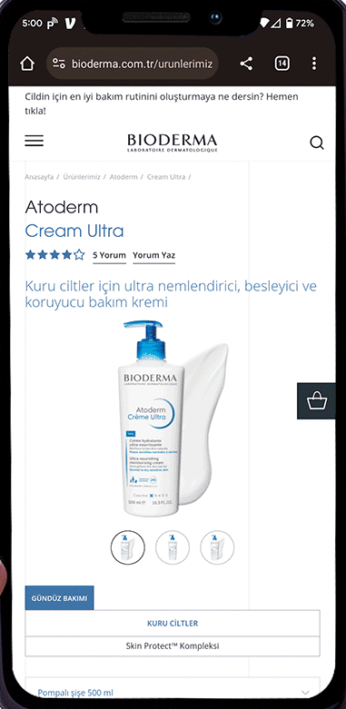
Here are a few additional highlights that set MikMak apart in creating seamless Commerce experiences, both for shoppers and brands:
Simplified integrations to create omnichannel Where-to-Buy experiences
Implement your Where-to-Buy solutions faster by leveraging our pre-built templates that are easily customizable to fit your brand's look and feel
Use our advanced filtering features to quickly and easily allow shoppers the ability to search through your brand’s entire product catalog
Accelerate data exchanges thanks to direct integrations with third-party PIM platforms, and the ability to export data via APIs
Benefit from our Self-Service tools to autonomously create and deploy shoppable media and Where-to-Buy experiences featuring inventory-aware, multi-retailer checkout capabilities
Bioderma Turkey onboarded and implemented MikMak Commerce for their website in one week
Enterprise Level Set-Up
With enterprise- level implementation, onboarding support, and efficient product data collection w/ 3rd party PIMs - MikMak reduces the stress of switching Where To Buy solution providers.
READ CASE STUDY

Slide 26
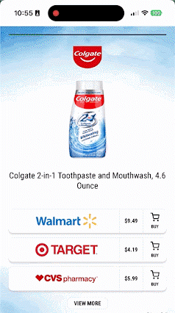
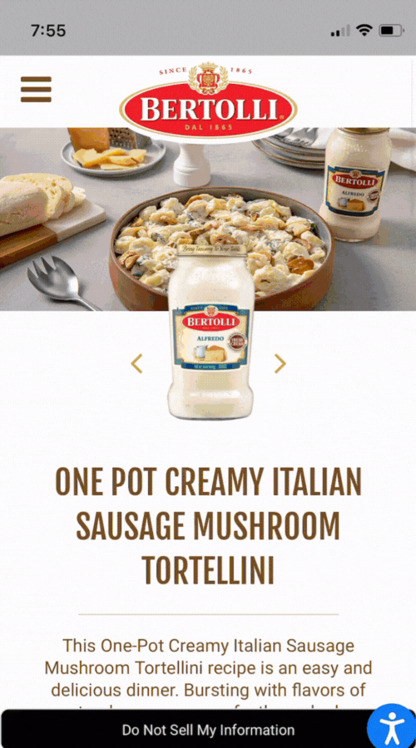
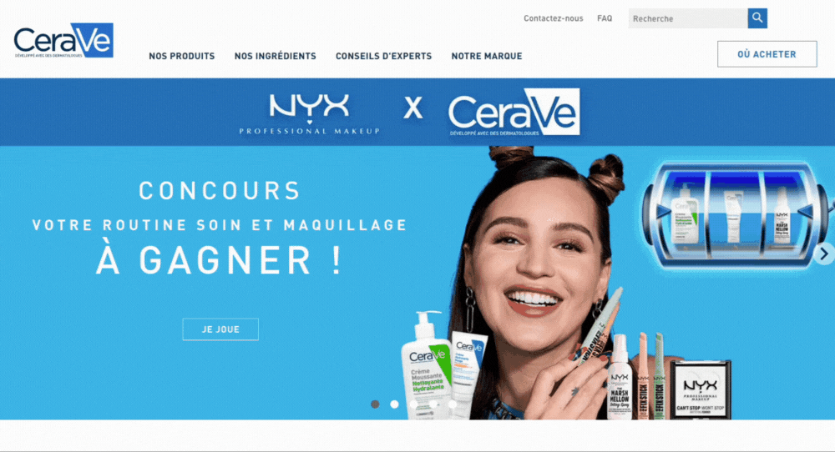
Global Store Locator & Digitally Influenced Offline Sales Report
Refine searches at the state, city, or postal code level, and see store addresses with directions from your current location
Drive omnichannel commerce offering
both offline and online checkout options
Measure the impact of your digital marketing on your offline sales with reports developed in partnership with Circana
Direct Add to Cart
Allow shoppers to add a product to their retailer cart with just one click
Capture exclusive first-party consumer insights to better understand shopper behavior and preferences
Shoppable Recipes
Empower consumers to make quick purchases directly from your recipe content at their preferred retailers
Offer a seamless path to purchase with full recipes in the cart in a few clicks

Slide 27
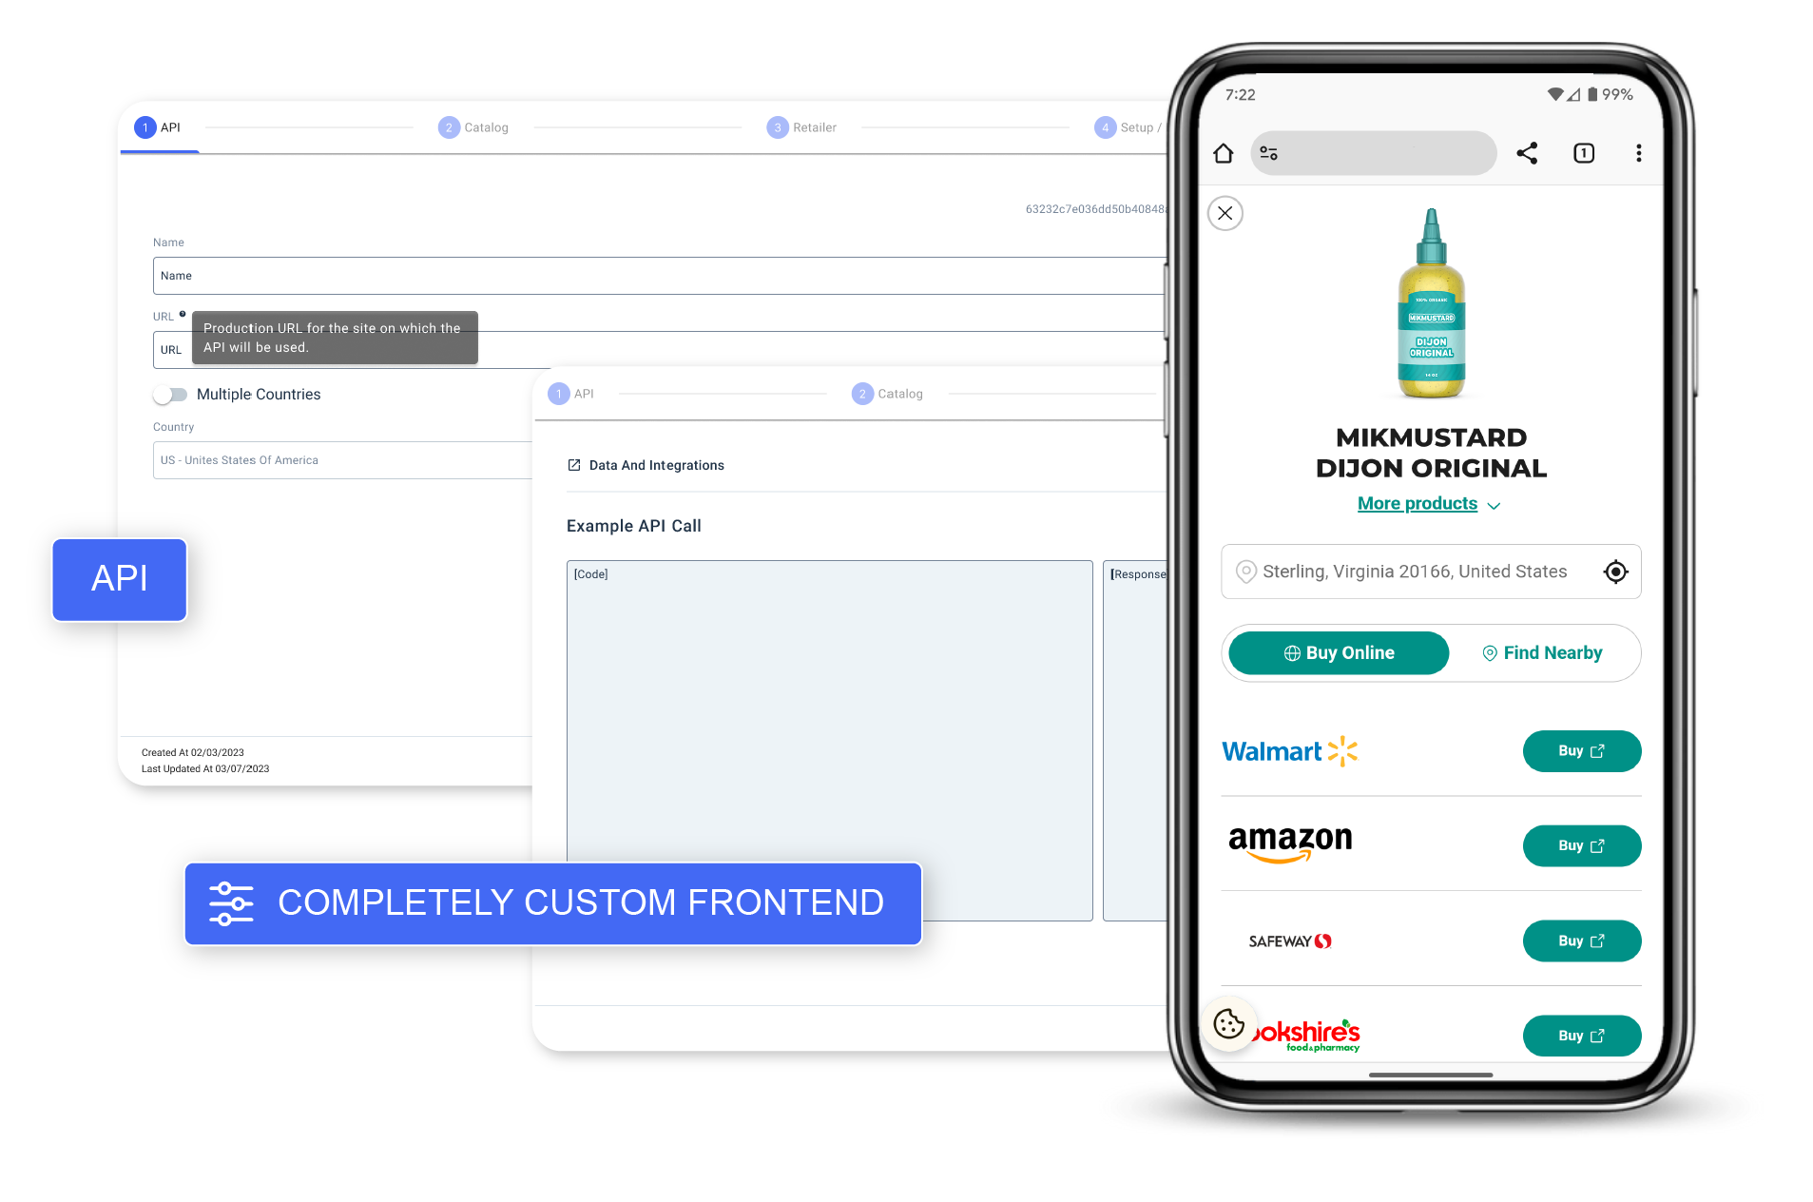
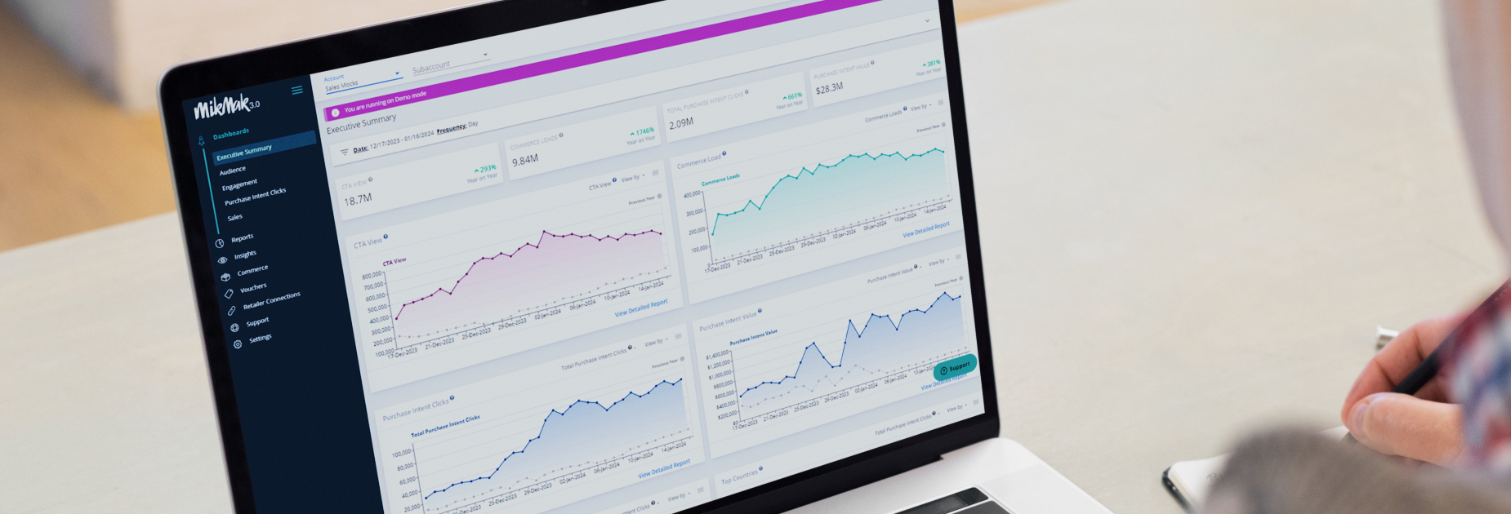
MikMak Headless Commerce API & Superior Inventory Management
Have full control of the look and feel of your shoppable media and Where-to-Buy experiences, while leveraging MikMak’s best-in-class inventory data, commerce technology, retail network, and sales attribution
Prevent consumers from reaching dead-end experiences such as ‘out-of-stock' pages
One easy-to-use global platform to consolidate all your eCommerce data
Gain a complete understanding of consumers’ online behaviors and preferences across all media and brand websites
Collect first-party consumer behavior data and insights to win in a cookieless, consumer-driven world
With our Custom Report Builder, create and share personalized reports that incorporate your desired metrics, dimensions, and filters
The MikMak platform draws in insights from 7,000+ media and retail partners across the world to help you identify shopping patterns, improve marketing effectiveness, and grow your brand’s marketing ROI.

Slide 28



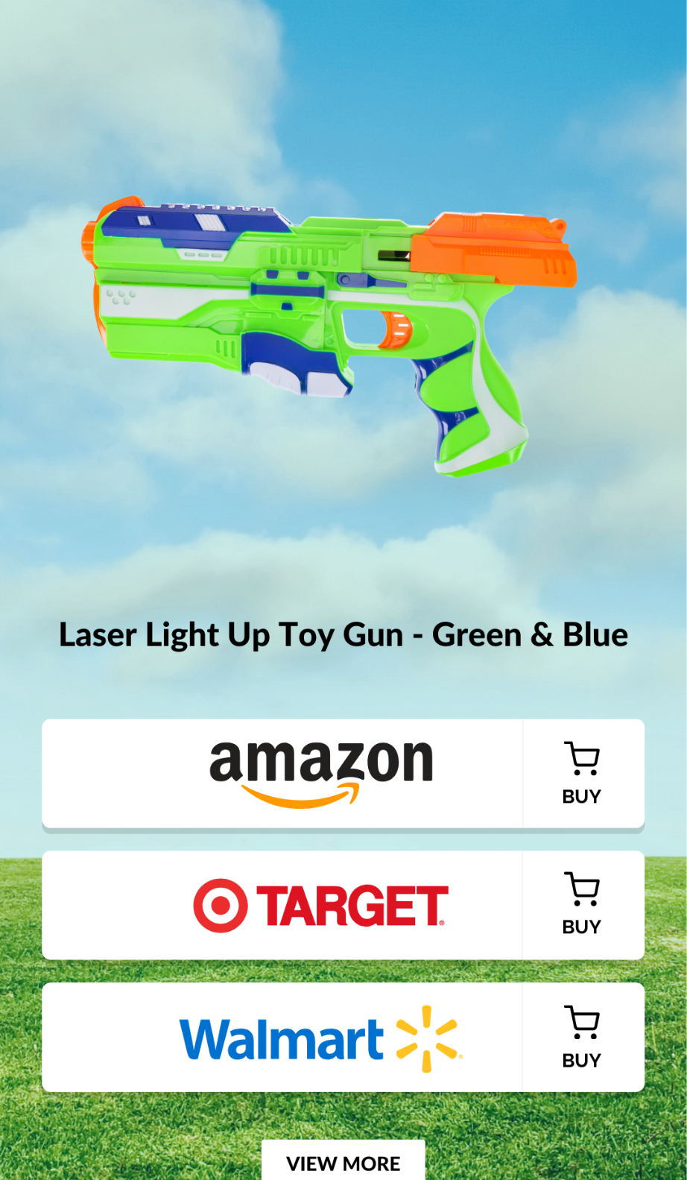
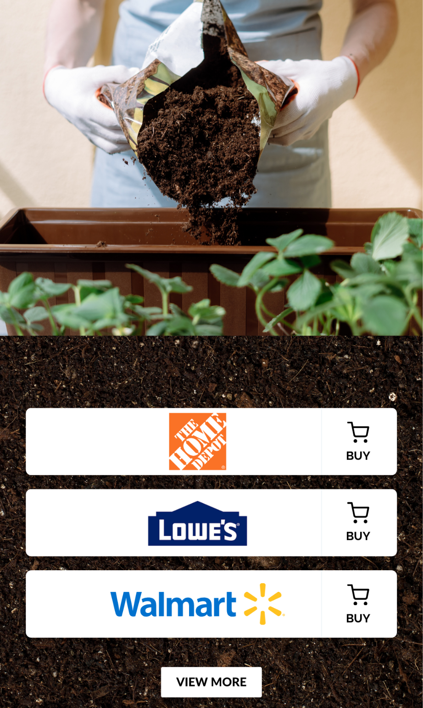
Toy Brand switched to MikMak on brand website to get a more holistic view of their eCommerce analytics
A Lawn & Gardening Brand switched to MikMak on brand website, and saw increased performance immediately
Why they switched
Why they switched
Managed Services
Product Data Integration
Holistic View of Data and Insights
Optimized Retailer Conversion
More Granular Insights
More Capabilities
“As our relationship with MikMak continued to progress it was clear they were the best sole provider of shoppable media, where to buy, and eCommerce analytics due to their managed services and holistic, actionable insights.”
“We’re excited to see what this will do for us when we hit our peak months, but what we’ve seen so far is MikMak has been outperforming our previous provider.”

Slide 29
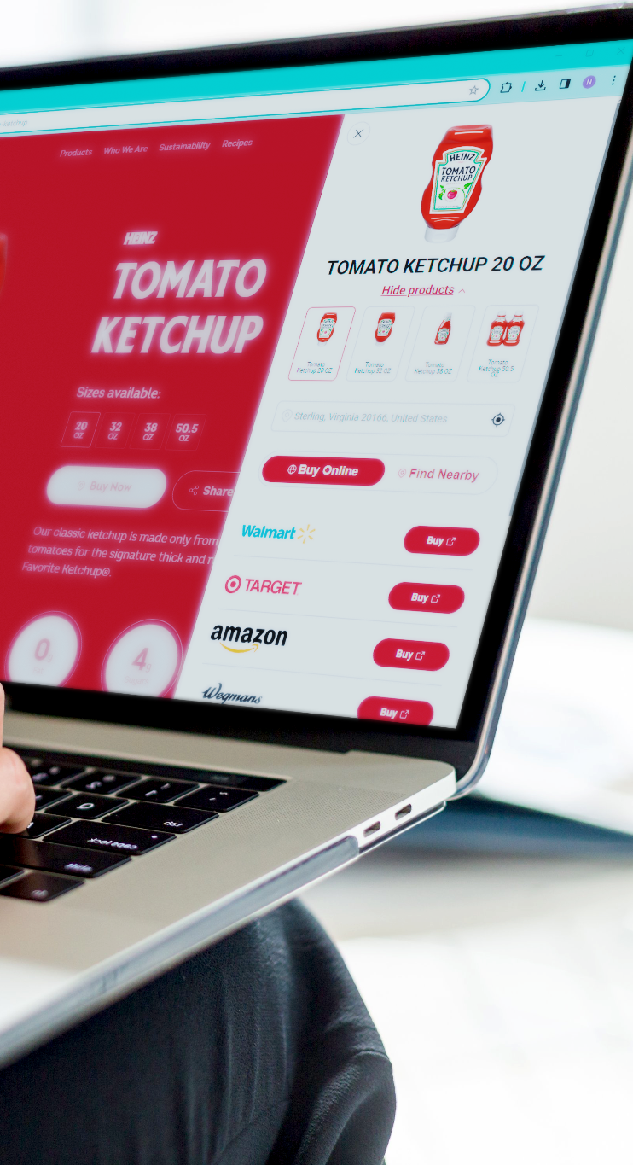
Conclusion
Whether it's to generate incremental sales, provide seamless shopping experiences, or strengthen retailer partnerships, Where-to-Buy solutions can be your greatest ally. The benefits of using advanced Where-to-Buy tools and analytics are profound and far-reaching in improving multichannel brands’ marketing effectiveness, and driving business growth.
To select the right Where-to-Buy solution provider, start by aligning objectives, feature requirements, and evaluation criteria to maximize success. By setting clear goals and continuously monitoring performance metrics, you can refine your brand’s strategies, optimize results, and stay ahead in a competitive market.
At MikMak, we're committed to driving innovation and delivering unparalleled value to our partners. With MikMak Commerce for Brand Websites, brands can effortlessly integrate omnichannel Where-to-Buy experiences, streamline checkout processes, and gain invaluable insights into consumer behavior, and all this while enhancing brand visibility and driving sales.
Don't just take our word for it - learn from MikMak’s customers. Check out our case studies, industry benchmarks, and insights guides to learn from industry-leading brands. Then, get started, and adopt the best Where-to-Buy solutions for your brand!

Slide 30
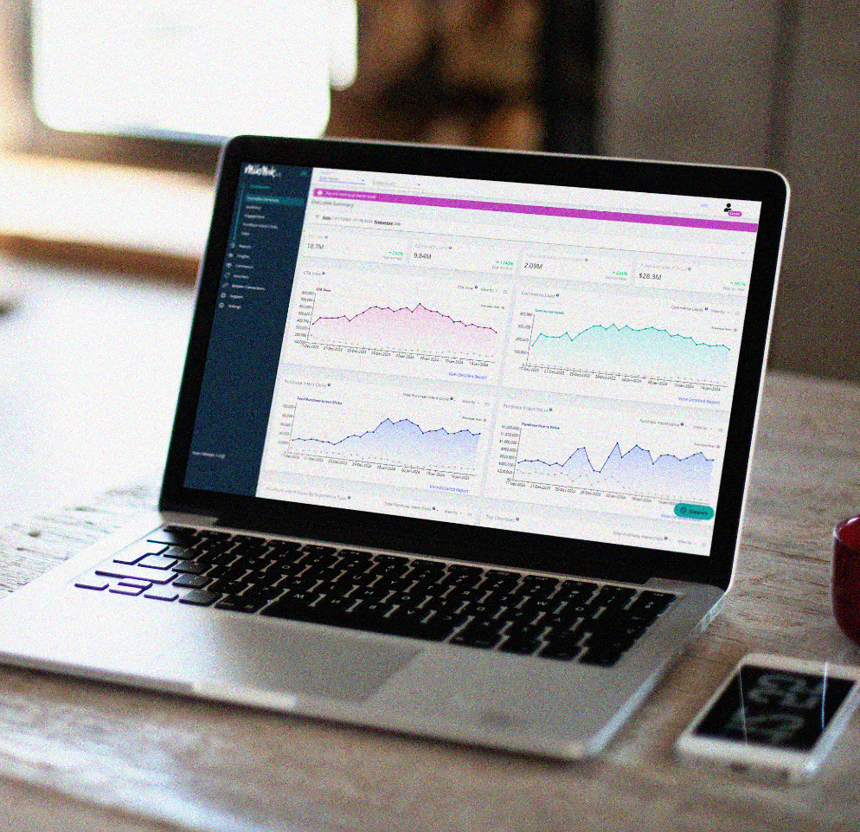

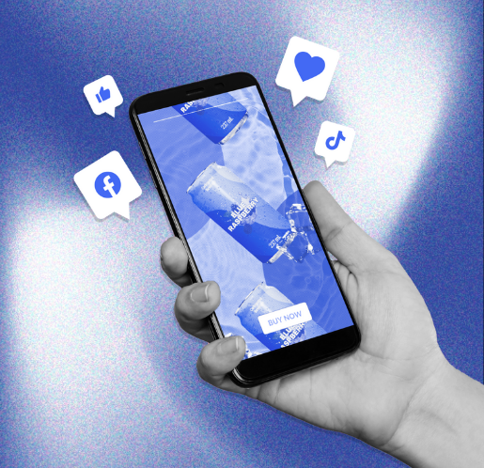
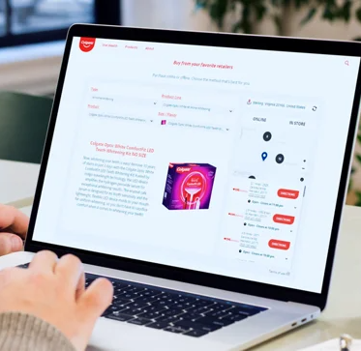

Recommended Reading
RFP Guide
eBook
eBook
Blog
Webinar
Shoppable Media & Where-to-Buy
Inflation & Commerce Marketing
State of Social Commerce: 2024
10 reasons to use WTB on your brand websites
Consumer-Centric Commerce
Read Now
Read Now
Read Now
Read Now
Watch Now

Slide 31
Want to learn more?
We’re here to help.
Schedule a Demo with MikMak

