Slide 1
2023 eCommerce Guide
European eCommerce Benchmarks & Insights for Multichannel Food & Beverage Brands
UK & France
How MikMak Helps Food & Beverage Brands Grow, Commerce-First

Slide 2
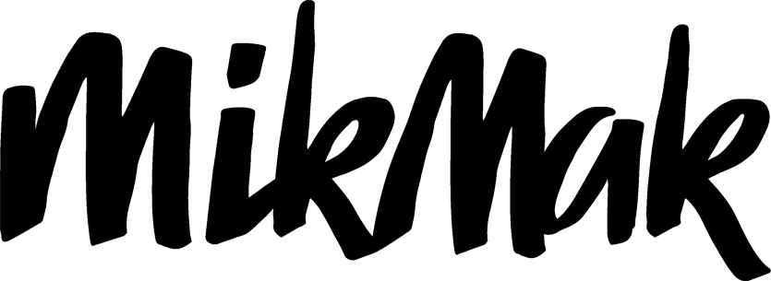
Food & Beverage Benchmarks and Insights - Europe
Food & Beverage eCommerce: UK & France
Food & Beverage is the UK’s largest manufacturing sector by turnover, valued at £104 billion (approx. €120 billion), and France is the biggest EU Food & Beverage producer, with a turnover of €212 billion.
In this guide, we take a closer look at what drives online shopper engagement and sales for multichannel Food & Beverage brands, to help them grow, commerce-first.
Food & Beverage eCommerce was highly accelerated by COVID-19 in the UK and France. It plays a key role in both countries today, influenced by shifting omnichannel consumer habits.
In 2023, just over 50 percent of the UK population and 25 percent of French households purchase food and non-alcoholic drinks online.

Slide 3
Food & Beverage Benchmarks and Insights - Europe
Overview
Search and Social Media are the biggest eCommerce traffic sources for Food & Beverage brands in the UK and French markets
TikTok is the social media platform that drives the most Food & Beverage shopping traffic in the UK
In France, October and Mondays yield the highest Purchase Intent Rates from online Food & Beverage Shoppers
Category Benchmark UK & France:
8.2%
Purchase
Intent Rate
*Purchase Intent Rate:
The percentage of shoppers who clicked through to at least one retailer.
Food & Beverage is a category made up of a vast array of product types. In this guide, we take a look at packaged food and non-alcoholic beverages sold at supermarkets, mass merchant retailers and specialized Food & Beverage online shops in the UK and in France. Across all channels in these two markets, Food & Beverage brands have a category benchmark Purchase Intent Rate* of 8.2 percent, according to MikMak Shopping Index.

Slide 4
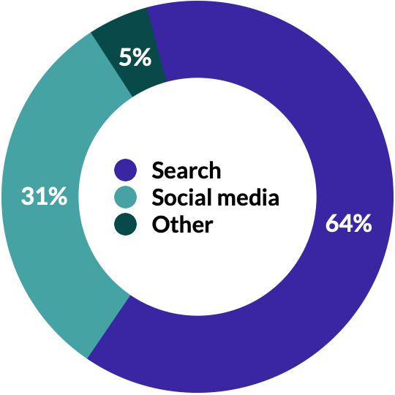
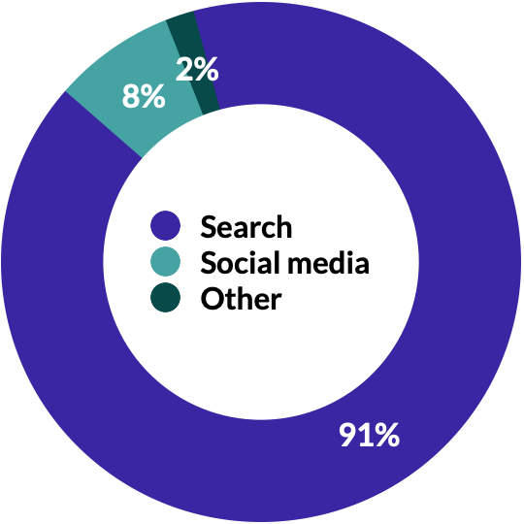
Food & Beverage Benchmarks and Insights - Europe
*Purchase Intent Clicks
The number of times a shopper has clicked through to at least one retailer during a single session.
Accelerate Sales & Market Share
Make your products discoverable
Traffic Sources by Share of Purchase Intent Clicks
For any brand, it is important that across all media and brand websites, shoppers can find and buy your Food & Beverage products easily, in-store and online.
Across all channels, Food & Beverage brands in the UK and in France have a category benchmark Purchase Intent Rate of 8.2 percent.
In terms of eCommerce shopping traffic for Food & Beverage brands, search (organic and paid) leads the way with 63.7 percent of of Purchase Intent Clicks* in the UK and 90.6 percent in France.
Social media drives the second most in-market traffic with 31.3 percent in the UK and 7.6 percent in France. Other media formats like video, display and CTV ads are in third position with 5.0 percent in the UK and 1.8 percent in France.
UK
FR

Slide 5
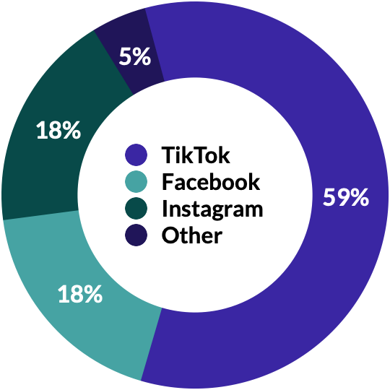
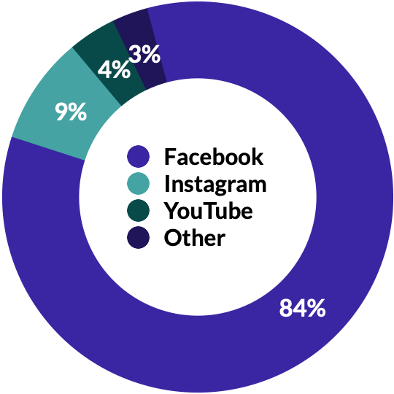
Food & Beverage Benchmarks and Insights - Europe
For multichannel brands, it is essential to track the performances of each campaign systematically throughout the shopping journey, and to monitor conversion at retailers. This allows brands to identify their most performant strategies for each social channel, to drive profitability and to reduce costs.
When ranking top 3 social channels by Purchase Intent Clicks, it’s interesting to see the differences between the two countries.
In the UK, TikTok generates, by far, the highest share of shopping traffic for Food & Beverage brands, with 58.7 percent of tracked social media Purchase Intent Clicks. Facebook and Instagram have equal shares, 18.4 and 18.3 percent respectively.
In France, it’s another story. Facebook is leading with 84.5 percent share, followed by Instagram at 8.7 percent and YouTube at 4.1 percent.
Other social media that matter to Food & Beverage brands this year in the UK and in France include Pinterest, Snapchat, and Reddit.
It is important to note that the Purchase Intent Click tendencies can also be due to the fact that brands are spending more of their budget on the top 3 channels mentioned above.
Top 3 Social Media by Share of Purchase Intent Clicks
UK
FR
Note: The share of Purchase Intent Clicks in this table corresponds to the percentage of the total number of Purchase Intent Clicks generated on Social Media during the year.

Slide 6
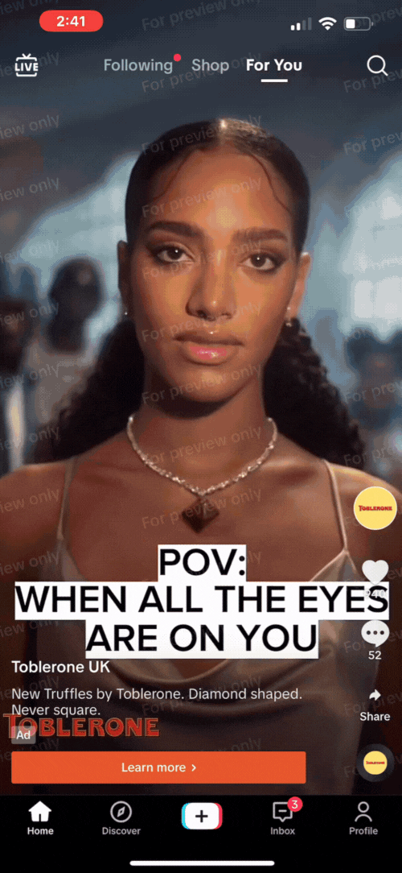
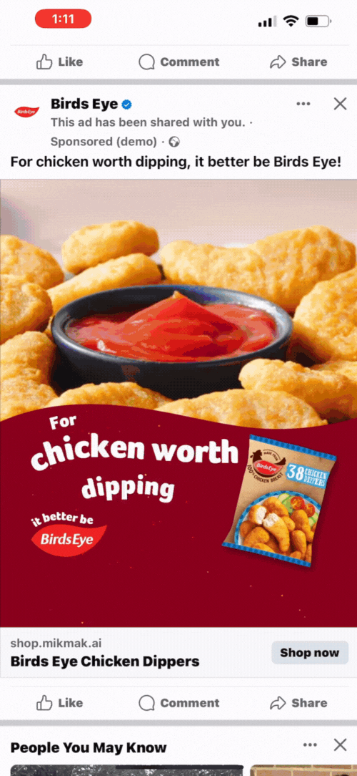
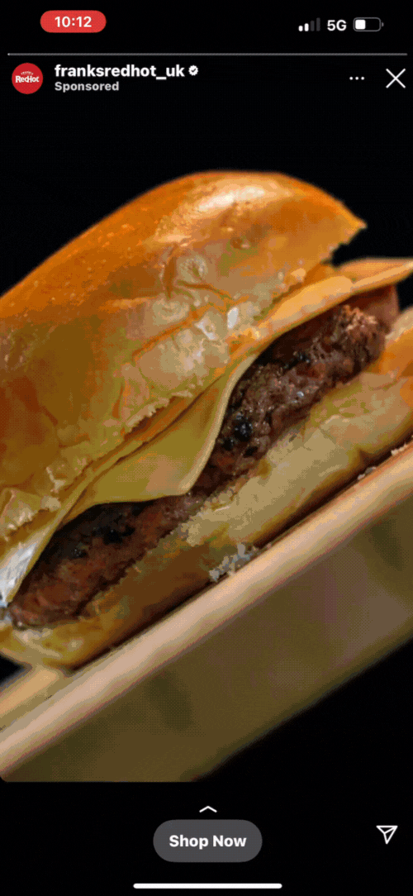
Food & Beverage Benchmarks and Insights - Europe
What top-performing Food & Beverage eCommerce ads have in common:
Bold, eye-catching creative that visually stands out
Product first, showcasing both the product and its value right away
Clear call to action. Include bold links with simple text such as “Buy Now” or “Check Out”
Flexible checkout that allows shoppers to switch between in store and online, different geolocations, and fulfillment options
Don’t be afraid to try out different formats. Successful Food & Beverage brands in 2023 have effectively used QR codes, OTT advertising, and livestream commerce to reach consumers
Hot tip: Be quick and nimble with your creative. The world needs to be able to experience your brand and buy it.
This is how MikMak Commerce works on Social Media in the UK:
How MikMak makes products discoverable
MikMak Commerce provides premium consumer shopping experiences that create a seamless path to checkout at any retailer, from anywhere across your entire media mix, including social media, retail media, programmatic, paid search, CTV, video, email, and brand.com.
TikTok
Facebook
Instagram

Slide 7
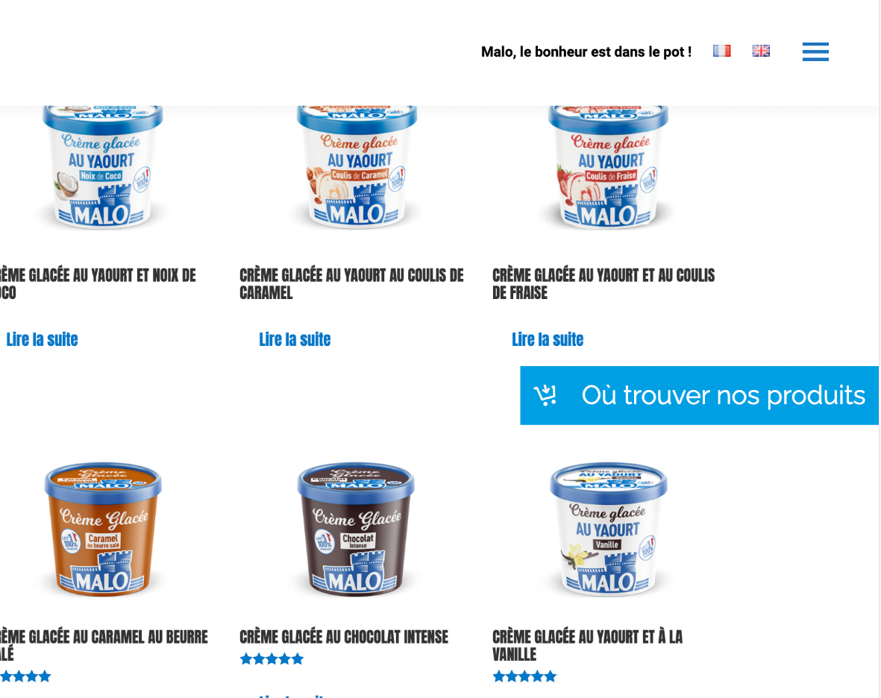
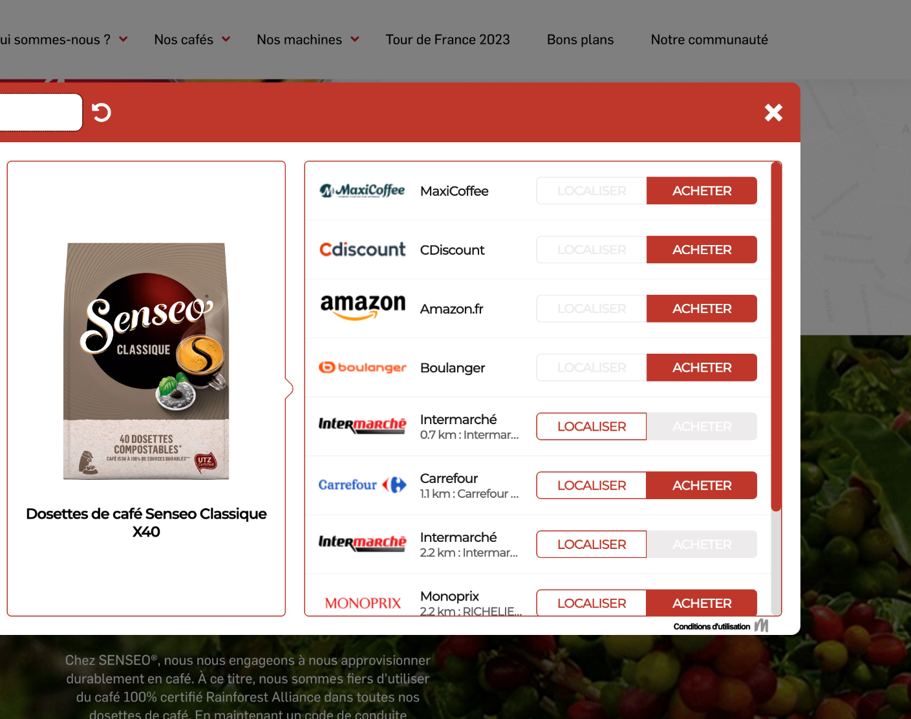
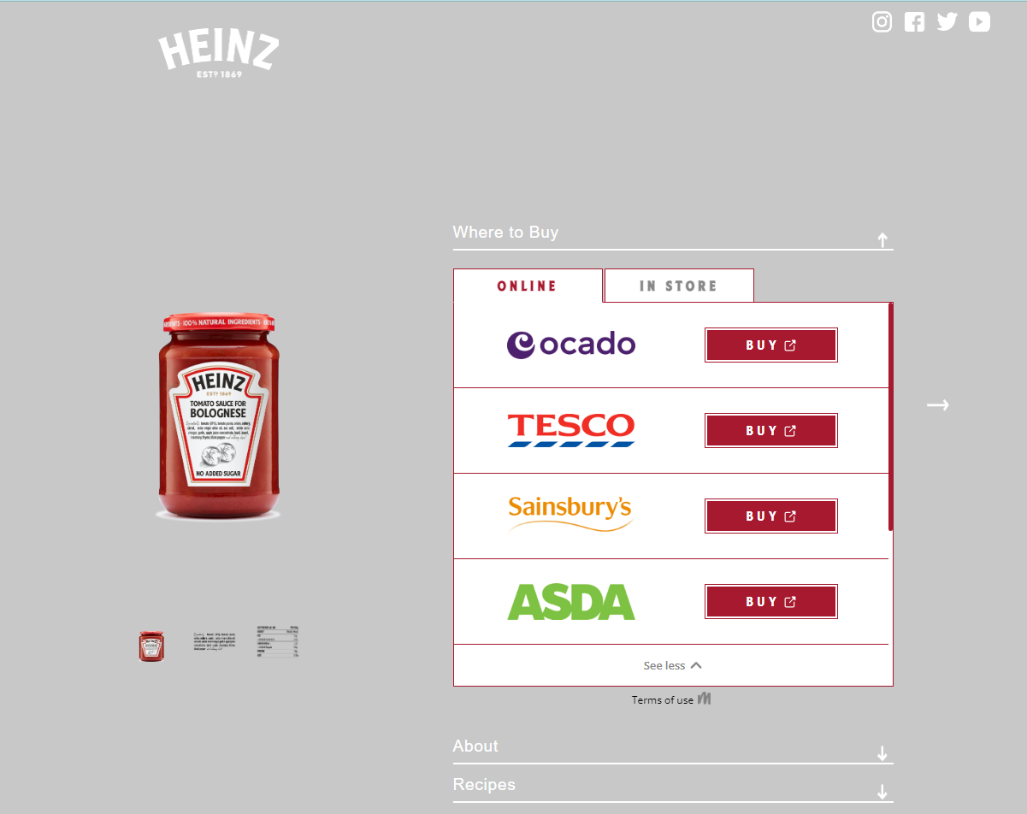
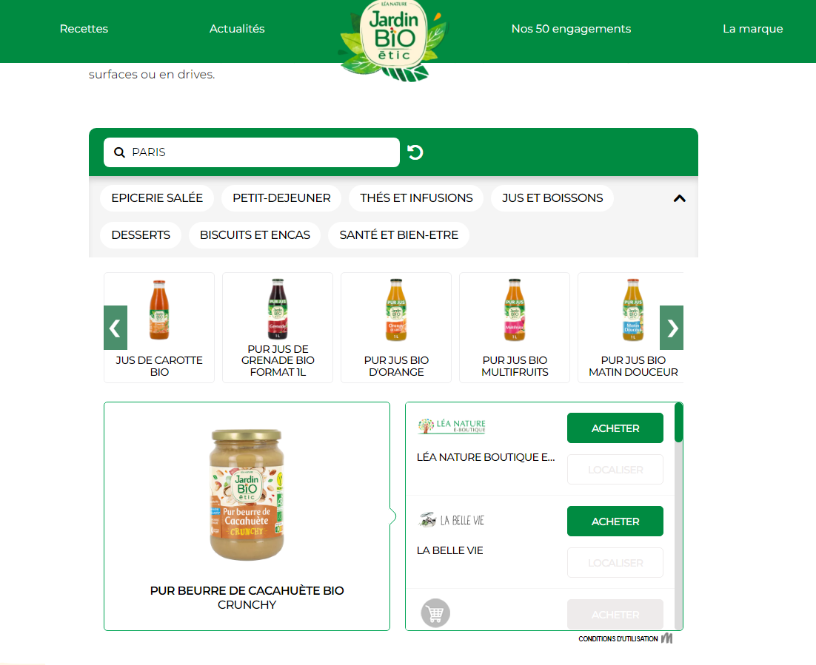
According to a recent study, brand websites are among the Top 5 places for pre-purchase research with 56 percent of shoppers. Here are a few best practices from MikMak to accelerate sales by offering frictionless, convenient shopping experiences for your consumers. MikMak provides a seamless and efficient integration process, featuring templatized UX options, for adding our Where-to-Buy solutions to your brand website.
Creative Best Practices to Improve Marketing Effectiveness on Brand Websites
Simplify Checkout
Use a clear CTA like “Buy now”, and make it visible on all your product pages and other pages with high traffic
Increase Convenience
Let your shoppers complete their purchase at any of their preferred retailers
Reduce Clicks
Display both online and in-store checkout options within one user interface / design
Personalize Selection
Use product filters and carousels to make variants and related products discoverable and available to interested shoppers

Slide 8
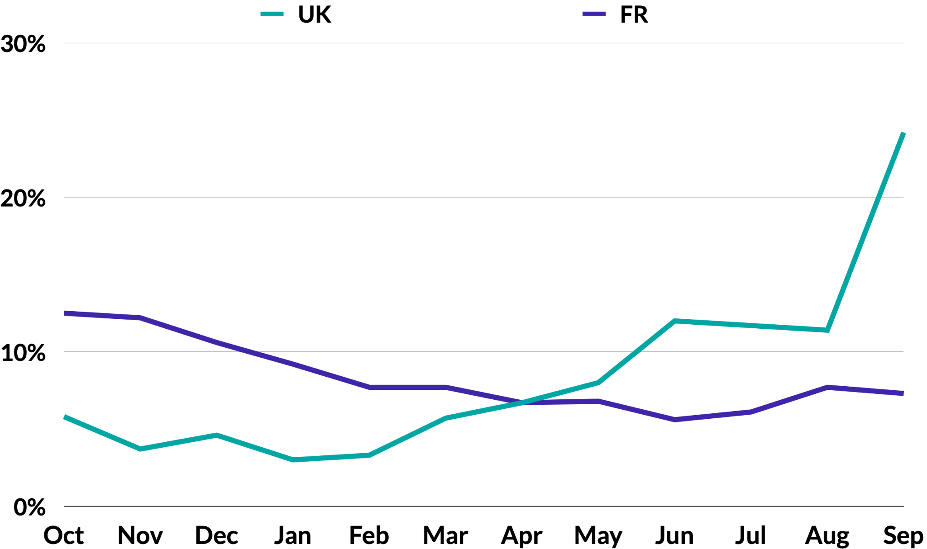
Food & Beverage Benchmarks and Insights - Europe
Share of Purchase Intent Clicks by Month - Food & Beverage
Accelerate Sales & Market Share
Beat the competition
To effectively grow market share, you must know, compare, and optimize your performance against brands in your category by channel, retailer, and more. You must also understand how performance changes over time.
In the UK, Food & Beverage shopping traffic is highest in September, on Mondays, but the best Purchase Intent Rates occur on Thursdays.
In France, October and Wednesdays drive the most in-market traffic to Food & Beverage retailers, but Mondays score the best in Purchase Intent Rates.
Purchase Intent Peaks

Slide 9
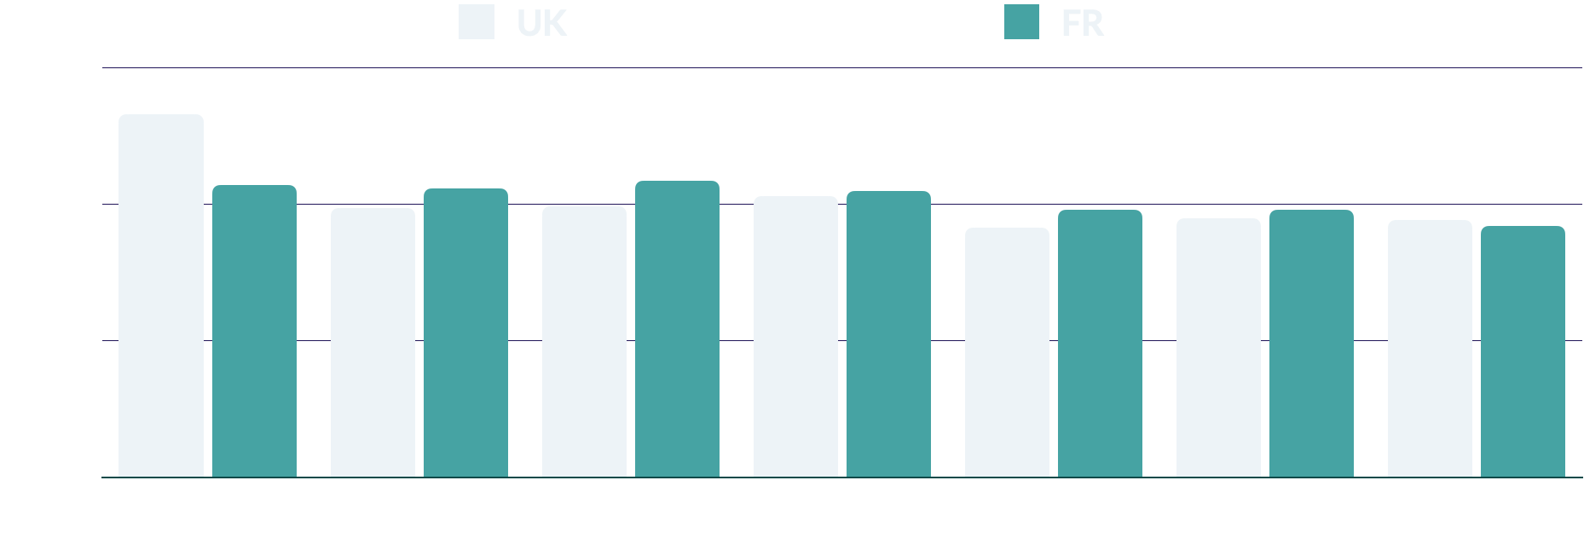
Food & Beverage Benchmarks and Insights - Europe
Share of Purchase Intent Clicks by Days of the Week - Food & Beverage
Right now, Monday (18.8 percent of Purchase Intent Clicks) and Thursday (14.4 percent) drive the most shopper traffic from brands’ shoppable media and brand websites to Food & Beverage retailers in the UK. In France, the beginning of the week is the most active, with Wednesday (15.2 percent) and Monday (15.0 percent) as best days.
Looking at overall conversion, by Purchase Intent rates, Thursdays and Wednesdays score the highest in the UK and Monday and Saturday in France.

Slide 10
Most Popular Online Shopping Days of the Week Food & Beverage (By Purchase Intent Rate)
UK |  | France
1 | Thursday | 1 | Monday
2 | Wednesday | 2 | Saturday
3 | Tuesday | 3 | Sunday
4 | Sunday | 4 | Wednesday
5 | Friday | 5 | Friday
6 | Saturday | 6 | Thursday
7 | Monday | 7 | Tuesday

Slide 11
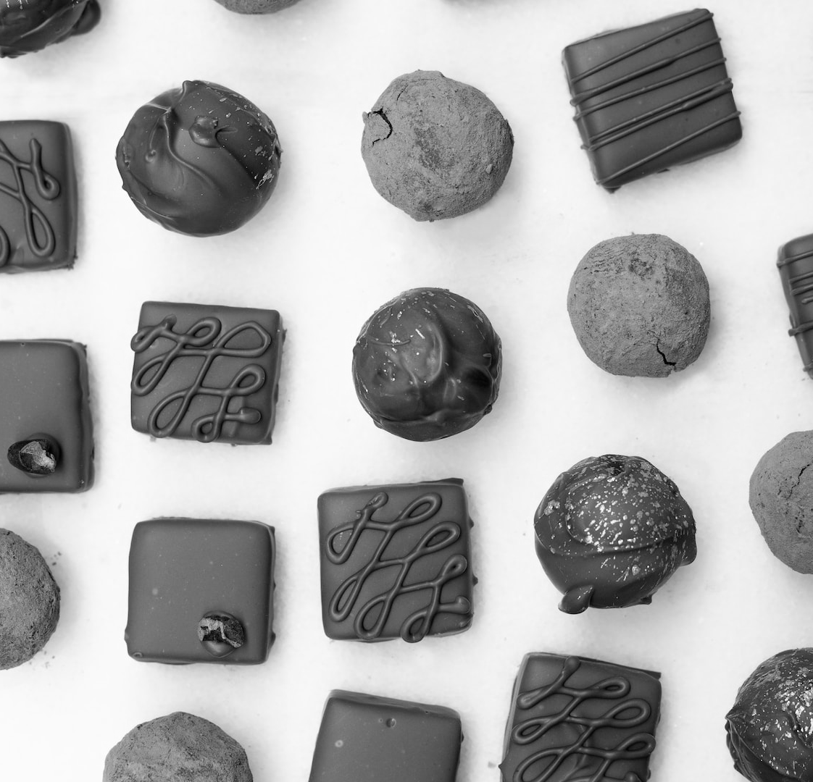
Food & Beverage Benchmarks and Insights - Europe
How MikMak creates competitive advantage
LISTEN HERE
With MikMak Benchmark Insights, you can see how your brand stacks up against other brands in your category. More specifically, you can understand your performance and media investment relative to the competition. This allows your brand to identify new conversion opportunities and compare your performance over time to quickly understand changes and progress toward your goals.
“I think a lot of people are still looking at eComm as something that is out there, but it's very much in the shoppers’ behavior today”
- Marie-Jeanne Matei
Vice President of eCommerce, Ferrero

Slide 12
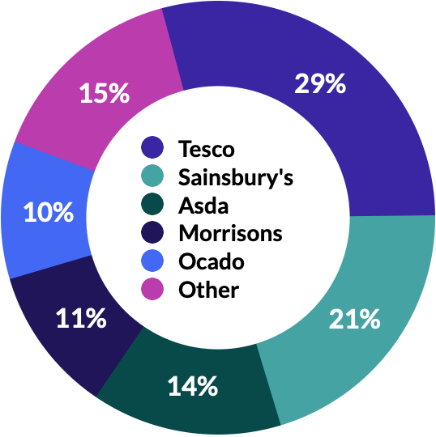
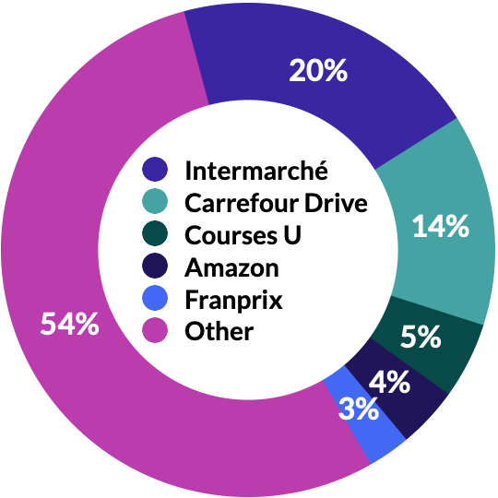
Accelerate Sales & Market Share
It is important to note that brands can decide to give more visibility in their branding to specific retailer partners with whom they have the best collaboration and results, and who also share more data insights on sales conversions.
On the MikMak Platform, retailers can easily improve their references in collaboration with supplier brands, to strengthen their performance.
Strengthen Retailer Partnerships
Top 5 Retailers by Share of Purchase Intent Clicks
Using proprietary, retailer-specific consumer insights in joint planning discussions with retailers can help unlock shelf space and media value.
Tesco is the top retailer for Food & Beverage shoppers in the UK, and Intermarché in France.
Right now, in the UK, among the Top 5 Food & Beverage retailers, Tesco is driving the most in-market traffic, with 29.0 percent share of Purchase Intent Clicks. Sainsbury’s and Asda are second and third with 20.5 percent and 14.2 percent, respectively. Morrisons and Ocado round out the Top 5 retailers at 10.9 and 10.3 percent.
In France, we see Intermarché in the first position with 20.2 percent share of Purchase Intent Clicks. Carrefour Drive is in second position with 13.9 percent. The next three positions are shared fairly equally by Courses U at 5.0 percent, Amazon at 4.0 percent and Franprix at 2.8 percent.
UK
FR

Slide 13
Food & Beverage Benchmarks and Insights - Europe
How MikMak helps brands strengthen retailer partnerships
LISTEN HERE
Do you know if your media investment resulted in a purchase? If so, what was in that cart? This is where MikMak Sales Insights’ closed-loop attribution, or the ability to tie granular consumer touchpoints like platform and campaign all the way through to purchase, comes in. Drive business impact and accelerate your eCommerce growth by gaining visibility into your consumers’ shopping journey, all the way through purchases at select retailers.
“I think the world has shown through Google, Facebook, or any other marketplace or platform, by sharing more data they end up growing. Companies are realizing it, it's just a state of journey.”
- Tony Navin
Director eCommerce, International, Kraft Heinz

Slide 14
Food & Beverage Benchmarks and Insights - Europe
Top 10 Food & Beverage products by Purchase Intent Rate
UK |  | France
1 | Instant coffee | 1 | Coffee pods
2 | Flavored instant coffee | 2 | Vegan sweetbread
3 | Salad dressing spray | 3 | Organic crackers
4 | Curry sauce | 4 | Mineral water - big size bottles
5 | Piccalilli | 5 | Sheep milk yoghurt
6 | Mustard | 6 | Milk sticks
7 | Flavored mayonnaise | 7 | Mini burger buns
8 | Vegetable soup | 8 | Fizzy water
9 | Fish fingers | 9 | Oat milk yoghurt
10 | Baked beans with sausages | 10 | Butter
Food & Beverage Shoppers have an Average Basket Size of 4.4 items across the UK and France
According to the MikMak Shopping Index, Food & Beverage shoppers have an Average Basket Size of 4.4 items when looking at the UK and French markets. The average Purchase Intent Value of the items placed in these baskets is currently €5.91 in the UK and €6.86 in France. Within the baskets, Coffee products are leading in terms of Purchase Intent Rate, followed by organic sweetbread and crackers in France and special flavored sauces in the UK. The popularity of these types of products driving shopper traffic explains the rather high average Purchase Intent Value.
Average Basket Size
4.4 items

Slide 15
Food & Beverage Benchmarks and Insights - Europe
How MikMak provides first-party data
LISTEN HERE
Use first-party data collected by MikMak Commerce to build and segment qualified shopper audiences within your ads managers/DSP to improve media targeting based on product interest, retailer preferences, and channel behavior. You can also retarget or build lookalike audiences to be leveraged across your entire media plan.
“Start from the customer and work backwards, the need is there and now it is on all of us to make it work.”
- Neel Arora
Global Head of eCommerce, Nestlé

Slide 16
Your eCommerce Marketing Checklist
Get the basics down. Are you mixing TikTok, Meta, and YouTube in the right way for the right products and audiences? Have you optimized your collaboration with the top performing retailers in your target markets thanks to first-party data?
Develop more nuanced insights for consumer relevance. Is your brand’s website utilizing multi-retailer checkout? Which channels are part of their shopping journey? Add the channels and retailers that resonate with your consumers to the mix. Can you expand to new formats like QR codes and CTV?
Be agile and quick with your data, and use insights to adjust your creative and advertising methods effectively
Explore growth opportunities. Check your performance against category (and subcategory!) benchmarks to see how you stack up against the competition. A/B test creative and messaging to see if purchase intent increases.
We're here to help. MikMak helps multichannel brands gain deeper consumer insights to grow and protect market share. Contact us at marketing@mikmak.com!

Slide 17
All data and insights from this Category Benchmark and Insights are sourced from the MikMak Shopping Index.
Let’s chat!
Want to get even more insights?
Looking for a different category?
Contact marketing@mikmak.com!
The MikMak Shopping Index was developed to provide a standardized set of metrics, methodology, and benchmarks to help drive brands’ business results and strategy. It is a collection of key eCommerce KPIs collected across hundreds of brands and over 250 channels and more than 4,000 retailer integrations to understand consumer online shopping behavior.
All data in this report is from 1 October 2022 - 1 October 2023.

