Slide 1


State of Social Commerce Report: 2023
From the MikMak Shopping Index

Slide 2
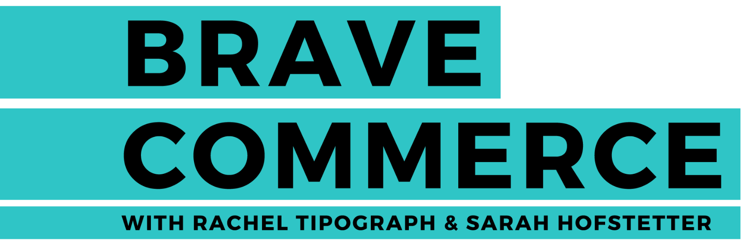
MikMak • State of Social Commerce Report: 2023
Social commerce is blazing
State of Social Commerce Report: 2023
U.S. social commerce sales will surpass $53 billion this year, and they’re expected to grow at a double-digit clip in the next three years. There are a few factors that are feeding this rapid growth:
New social commerce activity is surging: New shoppers continue to seize social commerce options. In fact, it has been reported that almost 108 million people will buy via social platforms in the U.S. in 2023.
Average spend is increasing: As activity grows, spending is also increasing. According to eMarketer, retail social commerce spending increased by 26.9 percent, on average, in 2022.
Millennials and Gen Zers are in the driver’s seat: As Millenials and Gen Zers who are comfortable with technology build their bank accounts, they could push social commerce even higher in the future.
Social commerce is a hot topic, and it’s positioned to ignite eCommerce sales even more in the future. According to a Statista report, global sales through social media platforms climbed to an estimated $992 billion in 2022. That figure is expected to hit $2.9 trillion by 2026. And according to data from the MikMak Platform, shopping traffic on social channels grew 19 percent year over year.
As money streams into social platforms, select marketing strategies are helping eCommerce brands carve out a bigger hunk of market share. In this guide, we analyze MikMak data to uncover social commerce trends and spot what best practices are capturing the most attention—and sales—through social platforms.
QUICK REVIEW
What is social commerce?
Social commerce is an eCommerce term that describes shopping experiences that take place on a social media platform. It also includes moments when shoppers click on social media links that direct them to a purchasing option on a retailer’s page.
"Our consumer, because they happen to be a Gen Z consumer, lives a good portion of their lives on social media so that’s where a lot of the magic happens with our commerce driving abilities.”
- Soyoung Kang, CMO, eos
Season 1, episode 49

Slide 3

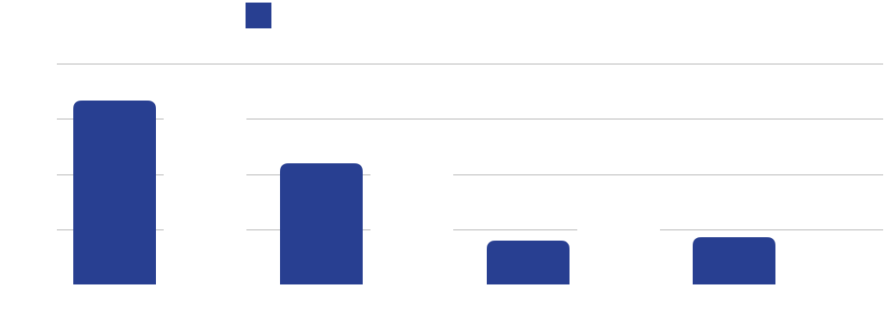




MikMak • State of Social Commerce Report: 2023
Livestream shopping could catch fire
Meta leads social Commerce, but TikTok is rising quickly
According to eMarketer, livestream shopping is expected to bring in $623 billion in China this year. In the U.S., Forrester estimates it will hit just $25 billion. But that U.S. figure could explode soon; Facebook, Amazon, TikTok, and Pinterest have all recently announced investments in livestream shopping.
Wondering how livestream commerce looks in action? At MikMak, we’ve seen our customers across categories, such as CPG, grocery, and beauty, successfully use livestreaming as part of their eCommerce experience. For instance, snack brands have seen success by placing ads within gaming livestreams on Twitch, and beauty brands have streamed makeup tutorials on TikTok. These creative ads target shoppers in real time on the social platforms consumers engage with most.
Wondering which social platforms are being used most for social commerce? Meta’s platforms, Facebook and Instagram, continued to be the most popular sites for social commerce buyers in 2022. However, TikTok is quickly catching up. Last year, TikTok’s number of U.S. social buyers passed Pinterest for the first time, hitting 23.7 million, according to eMarketer.
U.S. Commerce Buyers By Platform (in millions)
The content we create for live streaming is essentially very different from what you get in store. Content first then the shopping behavior follows if it is something very relevant and unique. - Jie Cheng, Mondelez
Source: eMarketer

Slide 4
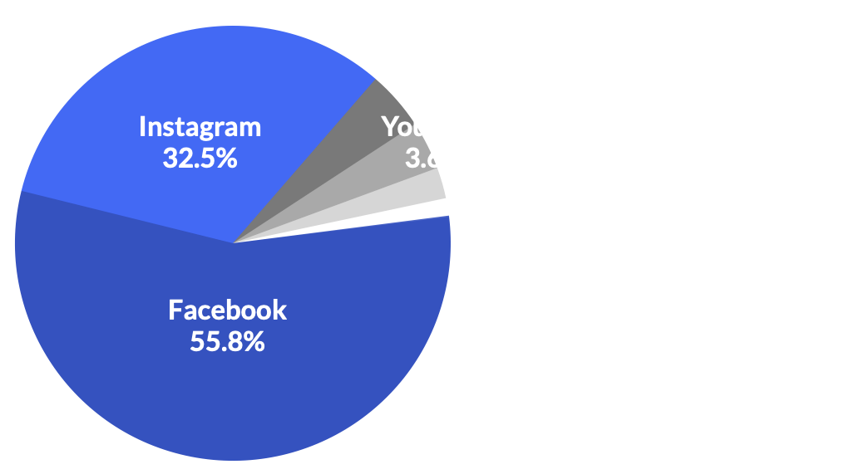
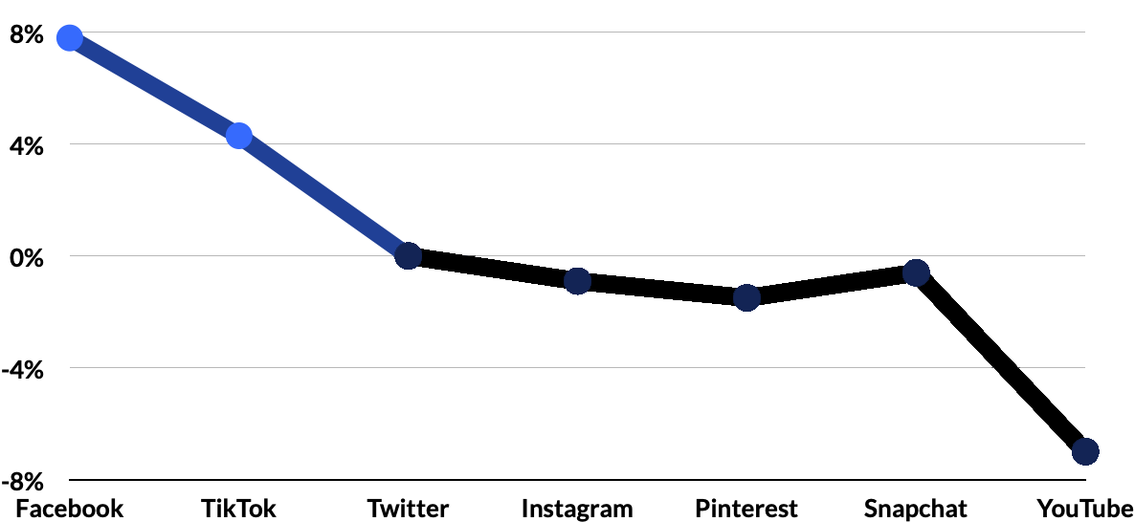
MikMak • State of Social Commerce Report: 2023
TikTok continues to emerge as a major player in social commerce
What social platforms are seeing the highest purchase intent?
Facebook and Instagram continue to generate the biggest share of social commerce purchase intent clicks (PIC) in 2022 with 55 percent and 32 percent, respectively. Purchase intent clicks represent shopping traffic, defined as the number of times shoppers have clicked through to at least one retailer from a social platform.
When it comes to traffic share, TikTok is quickly gaining ground. In 2021, TikTok sat in seventh place for social commerce traffic share. In 2022, it leapt up to the third position, securing nearly all of its share of traffic in a single year. Facebook also increased its social commerce traffic share in 2022, growing 7.81 percent year over year.
Share of Purchase Intent by Social Platform
Change in Share of Purchase Intent by Social Platform, 2022

Slide 5





MikMak • State of Social Commerce Report: 2023
TikTok drives shoppers to Target, Walmart, and Amazon
Purchase Intent Clicks* Leaders
by Platform
The grocery category attracts more clicks
Retailer | Purchase Intent Rate* Leaders (in order)
Walmart | 1. Facebook 2. Instagram 3. YouTube 4. TikTok 5. Snapchat
Amazon | 1. Facebook 2. Instagram 3. YouTube 4. TikTok 5. Snapchat
Target | 1. Facebook 2. Instagram 3. TikTok 4. YouTube 5. Snapchat
When it comes to Purchase Intent Clicks (PICs) or shopping traffic across all social platforms, the same categories led the way in 2022 as in 2021. Grocery, beauty, and personal care ranked in the top three spots. However, grocery PICs shot up significantly in 2022, jumping by 61 percent over 2021. Beauty fell by 23 percent, and personal care increased by 34 percent. This could indicate shoppers are scaling back and opting for more essentials as financial stress increases.
Although Facebook and Instagram take the top spot, TikTok appears as the third-most popular social platform for driving shoppers to Target and fourth for Walmart and Amazon. Pinterest only appears on the top 5 list for Drizly and Instacart, likely because of the platform’s ties to recipes and cocktail-making ideas.
Categories with most Social Commerce Traffic*
1. GROCERY
2. BEAUTY
3. HAIR AND PERSONAL CARE
4. ALCOHOL
5. TOYS
*Purchase Intent Clicks
The number of times a shopper has clicked through to at least one retailer during a single session.
*Traffic = Purchase Intent Clicks, or the number of times shoppers have clicked through to at least one retailer from a social platform.

Slide 6
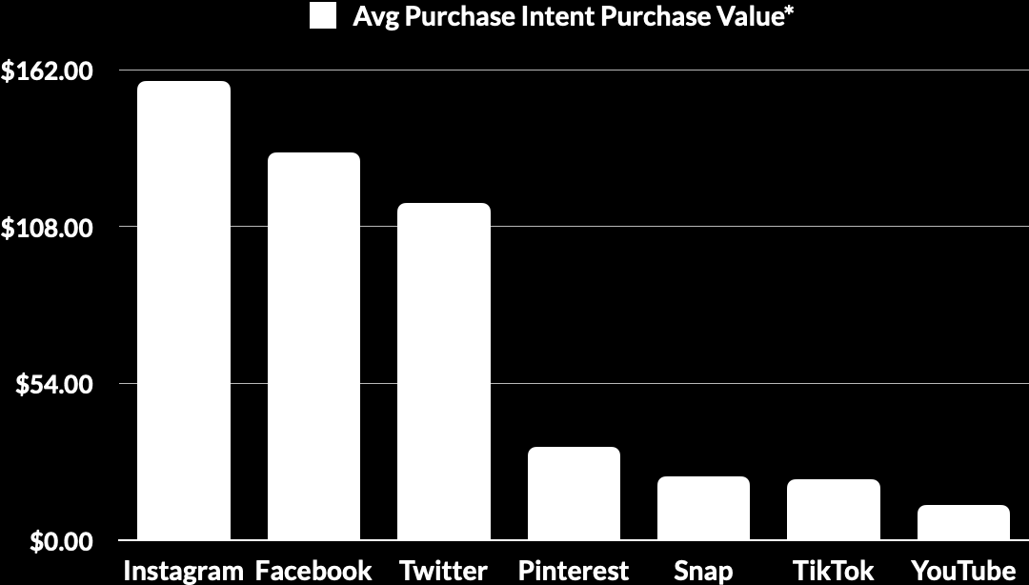
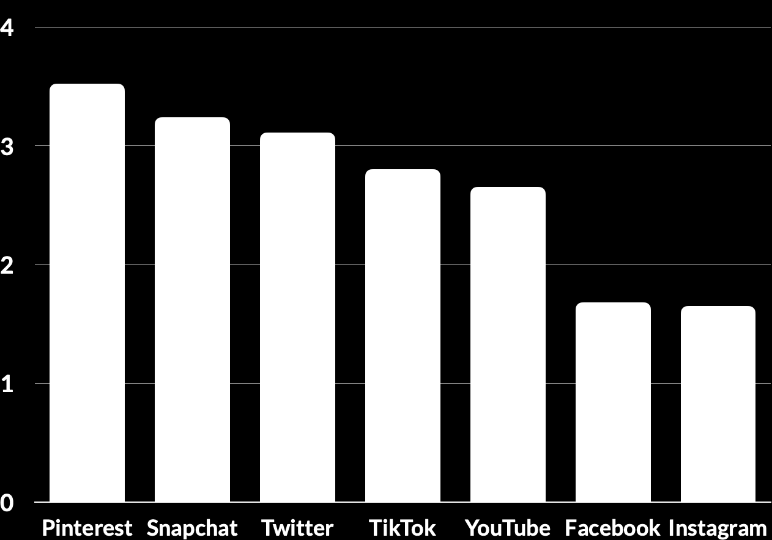
MikMak • State of Social Commerce Report: 2023
Social platforms draw in unique buyers
At the same time, Instagram and Facebook dominate in terms of price. The average annual Purchase Intent Value* (PIV) for an Instagram shopper is $158, and the average annual PIV for a Facebook shopper is $133. These numbers tower above Snap, which has an average PIV of just $21.
The leading categories also varied by social platform in 2022. For instance, the grocery category featured the most clicks on all platforms—except TikTok, where beauty led the way. When it comes to purchase intent rates (PIR)—a leading indicator of conversion rates that measures how likely a population of in-market shoppers is to make a purchase—infant care was the leading category on Facebook and Instagram, while toys was the top category on Snapchat and YouTube. Again, TikTok stood out as an outlier, with health & wellness grabbing the highest PIR on its platform.
Avg Annual Purchase Intent Value by Social Platform
How are buyers spending on different social platforms?
Avg Number of Products per Basket, by Social Platform
The amount shoppers spend and the size of their baskets vary dramatically from one platform to the next. Overall, shoppers are buying a higher quantity of items from Pinterest and Snapchat. Those platforms saw 3.52 and 3.24 items, respectively, in the average shopper’s basket.
*Purchase intent value = the potential dollar value of the product selected by a shopper when clicking through to a retailer, calculated by multiplying the listed SKU price and the total number of purchase intent clicks.

Slide 7
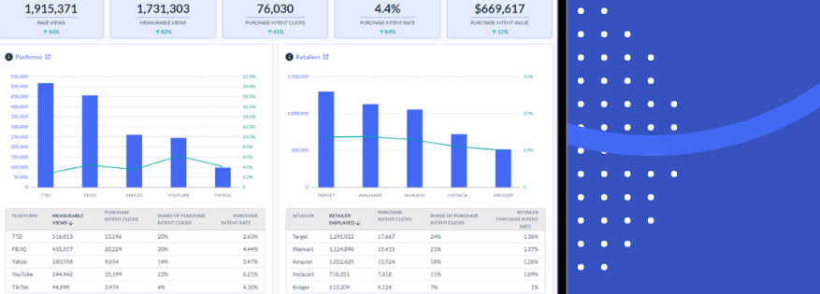

MikMak • State of Social Commerce Report: 2023
What does social commerce data mean for eCommerce brands?
Overall, the numbers show that social media can be a cost-effective and high-performing commerce channel for both brands and retailers. The trick going forward is to pinpoint the social channels that resonate most with your shopping audiences. From there, keep testing, analyzing data, and weaving creative messages into those channels. Above all else, stay flexible and anchored to data. Especially during today’s rocky economic climate, the faster you can act on real-time social commerce data, the easier it will be to capture more sales.
Get started with social commerce today
When your consumer is interested in a product, the shortest path to purchase is through their preferred retailer. Every step outside of the intended path to purchase opens up opportunities for your competitors to intervene.
With MikMak, you can give consumers what they want while also:
Bringing agility and efficiency into your organization
Being able to own and act on invaluable audience insights
Freeing up your teams to work smarter
Strengthening retailer relationships
Driving BIG business decisions and results

Slide 8




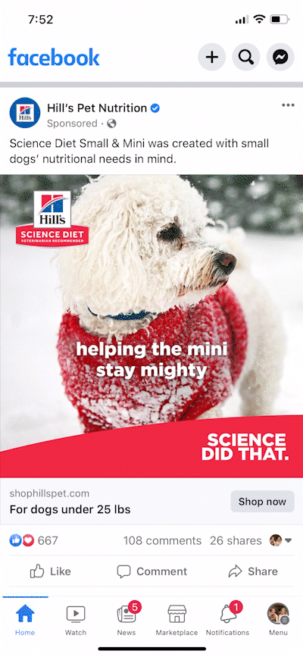
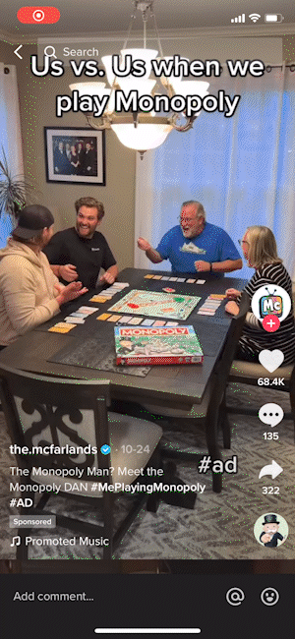
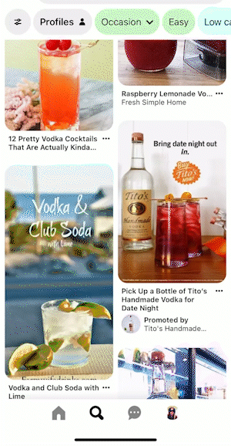
MikMak • State of Social Commerce Report: 2023
Here are just a few examples of how it looks in action:
FB - Hills
TikTok - Hasbro
Pinterest - Tito’s

Slide 9
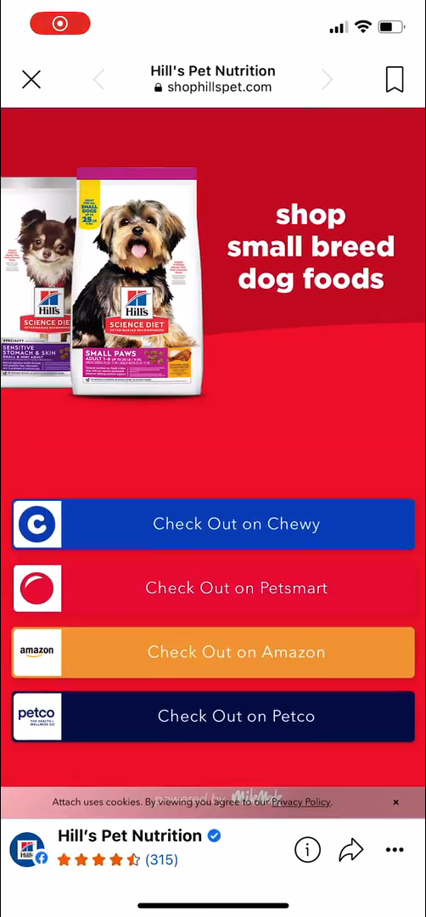
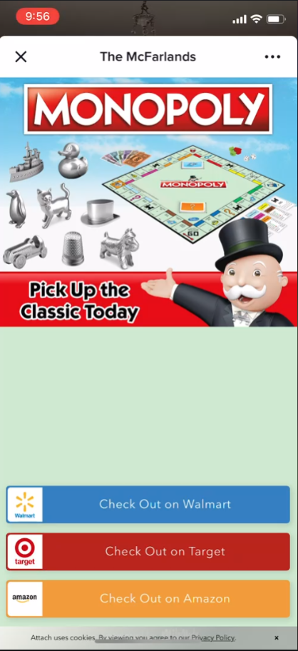
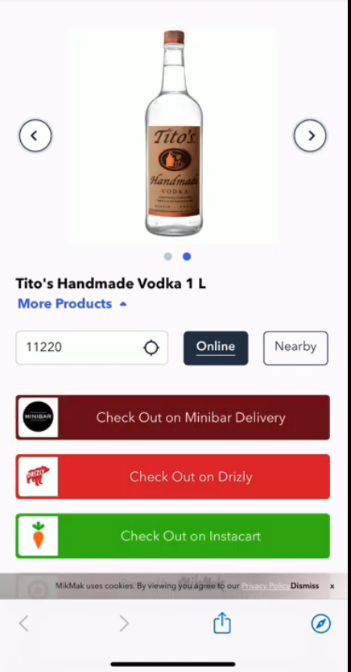
MikMak • State of Social Commerce Report: 2023
Here are just a few examples of how it looks in action:
FB - Hills
TikTok - Hasbro
Pinterest - Tito’s
Notes:
STILL IMAGE VERSION FOR PDFs

Slide 10
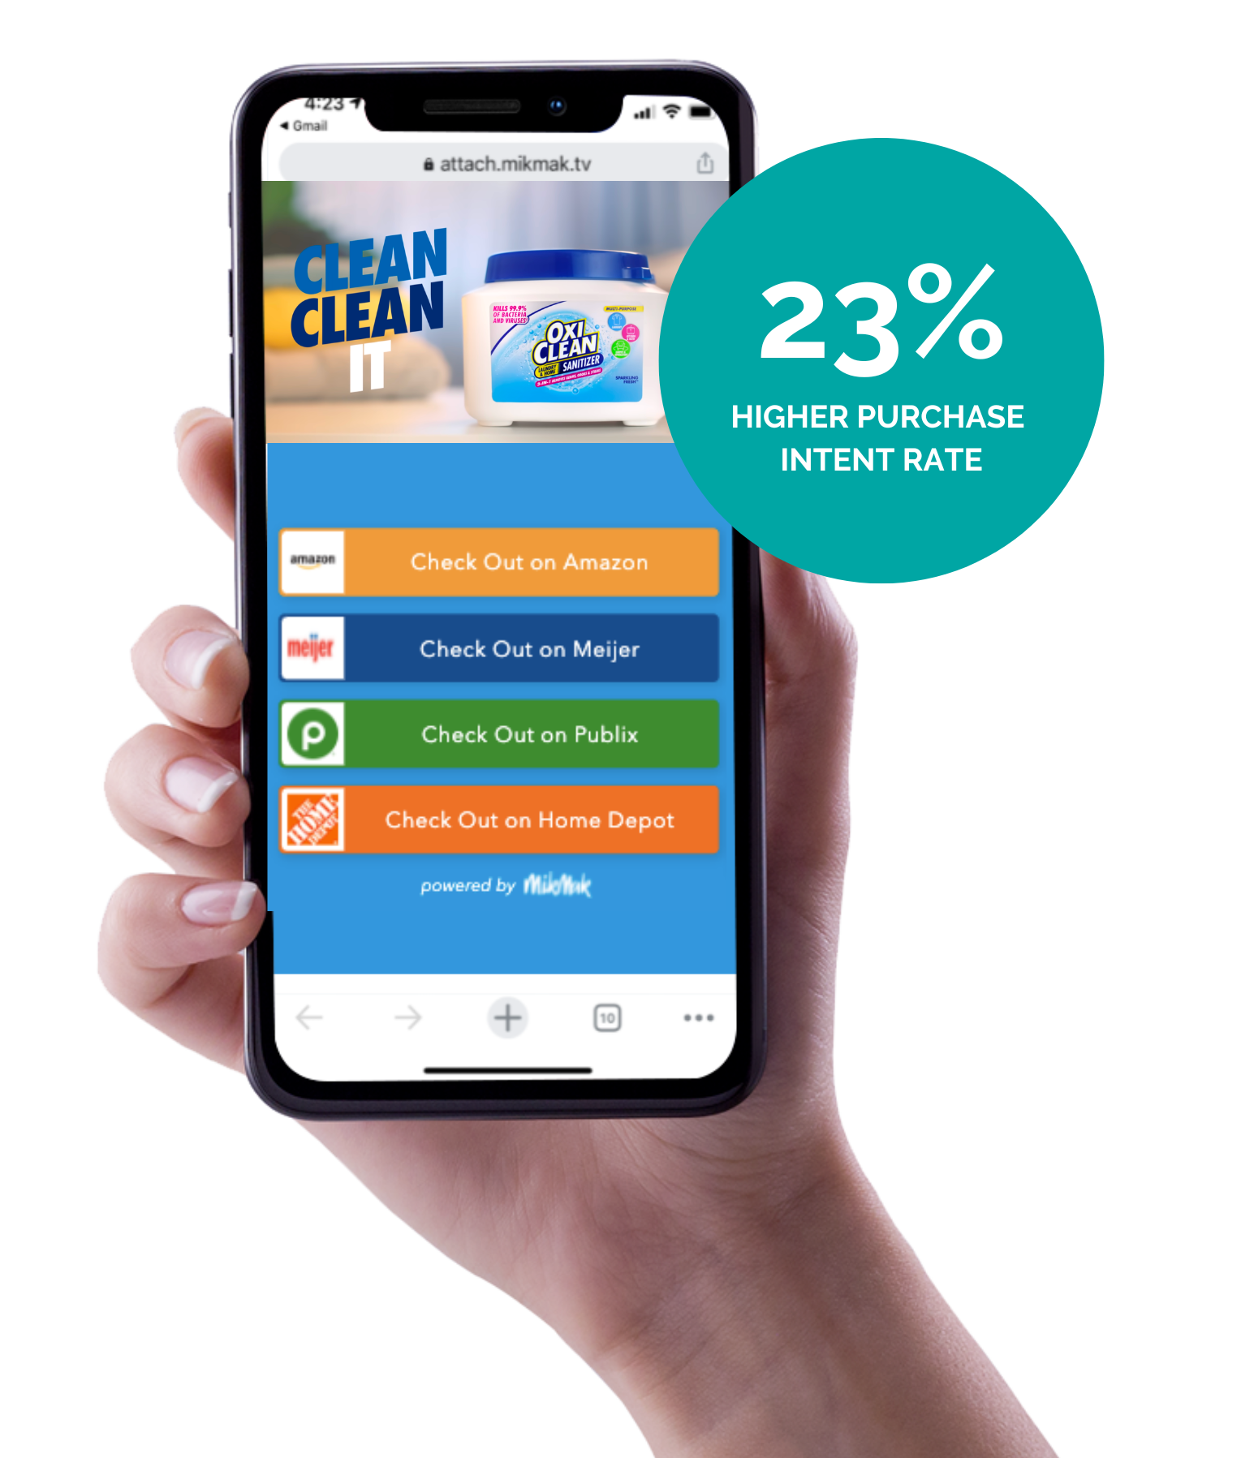
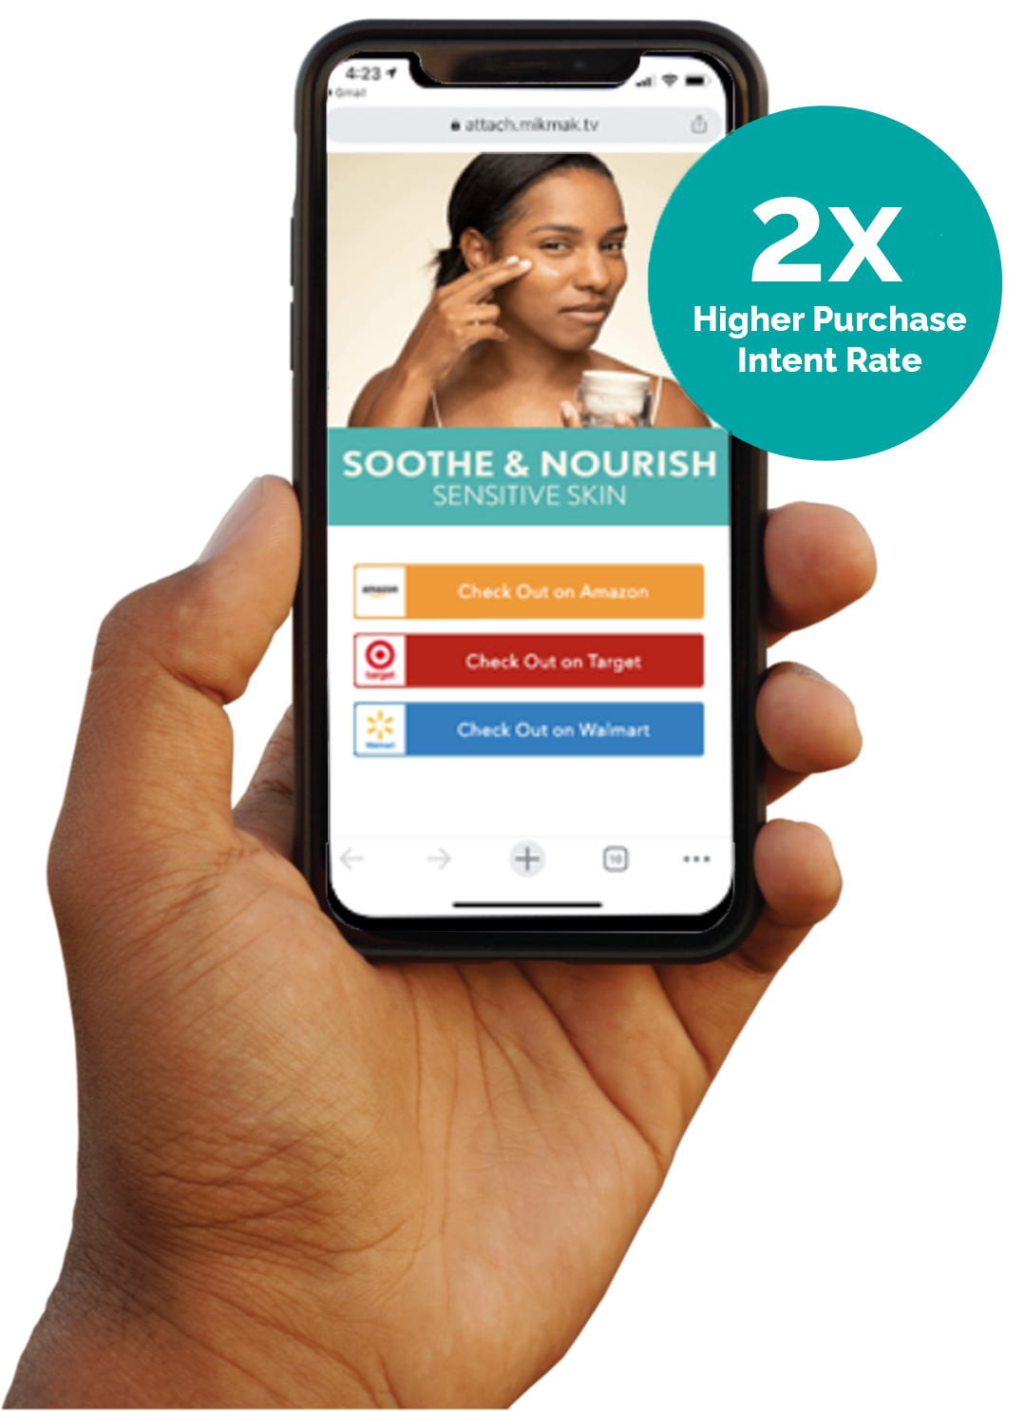
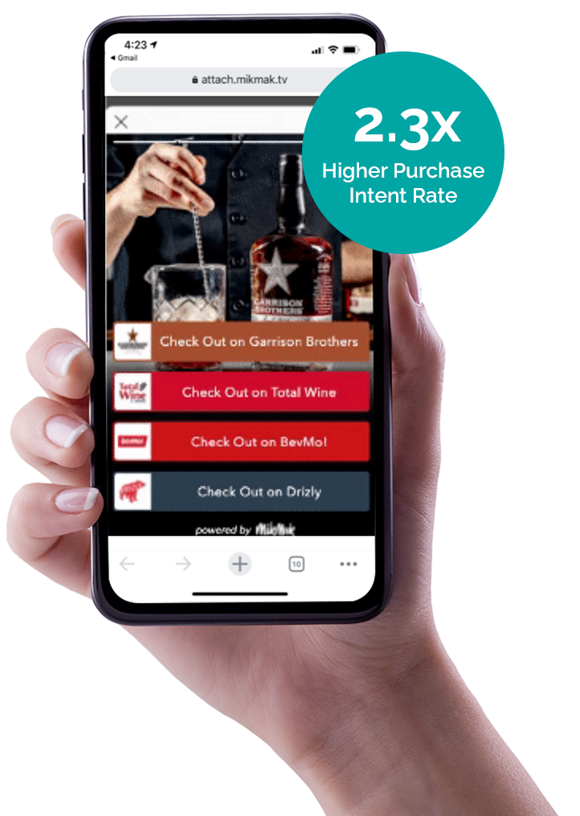
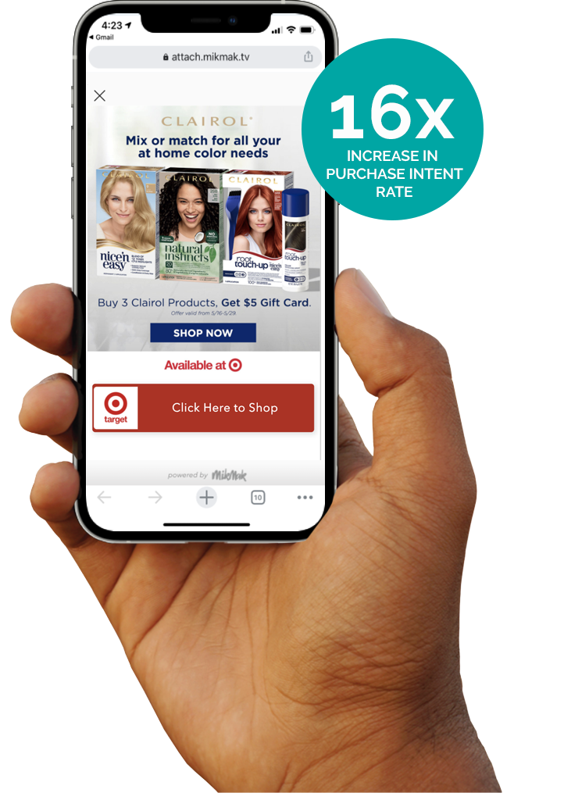
MikMak • State of Social Commerce Report: 2023
MikMak Social Commerce Customer Stories
OxiClean
Aveeno
Garrison Brothers Distillery
Clairol
Read Case Study
Read Case Study
Read Case Study
Read Case Study

Slide 11
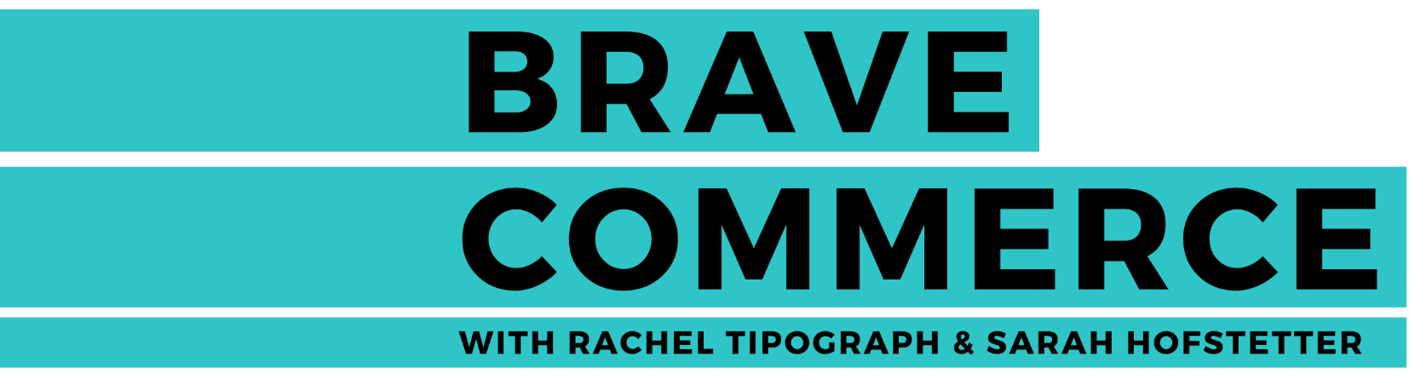




Want to keep learning about Social Commerce?
All data and insights from this Social Commerce Report are sourced from the MikMak Shopping Index.
The MikMak Shopping Index was developed to provide a standardized set of metrics, methodology, and benchmarks to help drive brands’ business results and strategy. It is a collection of key eCommerce KPIs collected across hundreds of brands and over 250 channels and more than 2,000 retailer integrations to understand consumer online shopping behavior. The Index also includes data from MikMak Shopper Intelligence, which ties first-party eCommerce data to 1,000+ demographic and psychographic data points and can be segmented by product, retailer, and more. Shopper Intelligence is available through an industry-exclusive partnership with LiveRamp.
All data in this report is from Jan. 1, 2021-Dec. 1, 2022.
Check out these BRAVE COMMERCE episodes:
LISTEN NOW
LISTEN NOW
LISTEN NOW
LISTEN NOW
The power of social for brand building with eos Products CMO Soyoung Kang. | Mondelez’s Jie Cheng on different eCommerce adoption & maturity dynamics across global markets. | Pam Kaufman of Paramount on adapting IP to consumer goods, utilizing new social channels, and leading a major brand. | The art of storytelling and margarita making with Patrón's Adrian Parker.
Let’s chat!
Want to get even more insights?
Contact marketing@mikmak.com!

